Slide 1
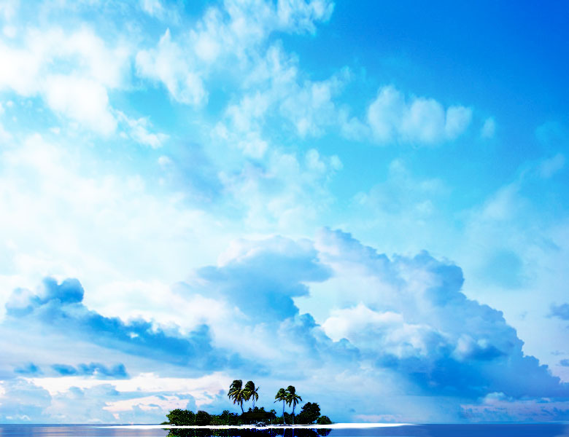
ENVIRONMENTAL
AUDIT
ASOSAI Seminar at the National Audit Office of the People’s Republic of China
Prepared by Fathimath Inaya
Republic of Maldives
August 24, 2008

Slide 2
Contents
The Maldives
Auditor General’s office
Major natural resources
Environmental issues
Impact on the economy
Environmental protection
Environmental controls
Environmental protection laws and regulations
Public awareness and education

Slide 3
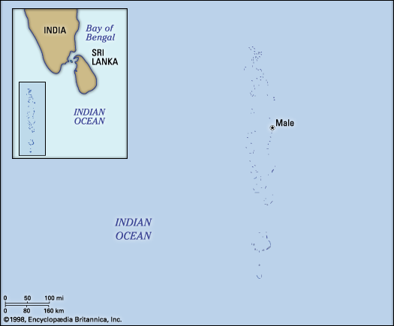
Profile
Official name | Dhivehi Raajjeyge Jumhooriyyaa (Republic of Maldives)
Form of government | republic¹ with one legislative house (Majlis² [42³])
Head of state and government | President
Capital | Male
Official language | Dhivehi
Official religion | Islam
Monetary unit | rufiyaa (Rf)
Population estimate | (2007) 305,000
Total area (sq mi) | 115
Total area (sq km) | 298

Slide 4
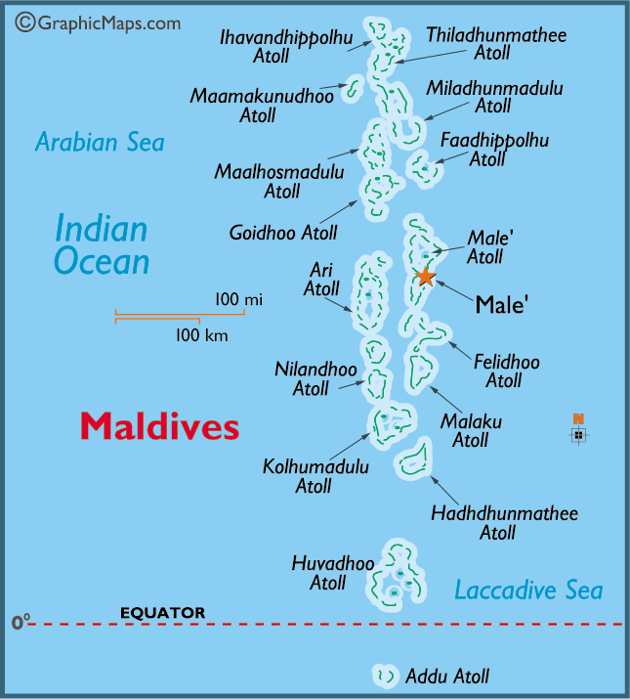

Slide 5
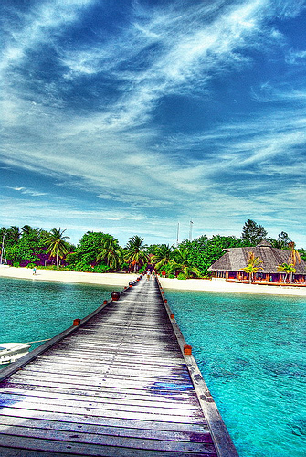
Introduction
The Republic of Maldives is comprised of 1,192 small, low-lying coral islands in the Indian Ocean.
The total land area of the Maldives is estimated at around 300 km2.
The islands are surrounded by coral reefs, which protect these islands from the impacts of strong waves and other such effects.
The main contributors to the economy are the tourism, fisheries, constructions and commercial sectors.
The tourism and fisheries sectors are very much dependent on the coastal environment of Maldives.

Slide 6
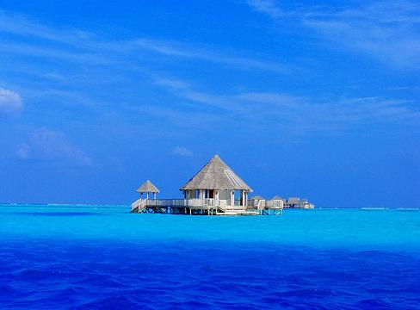
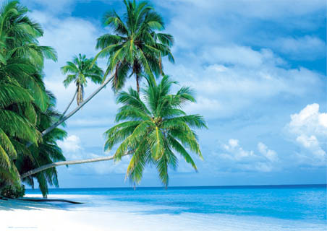
Climate
Maldives enjoys a warm and humid tropical climate, with the weather mainly being dominated by two monsoon periods: the southwest monsoon (the wet period, from May to November); and the northeast monsoon (the dry period, from January to March).
The temperature varies little with an annual average maximum of 30 degree Celsius and minimum 26 degree Celsius.

Slide 7
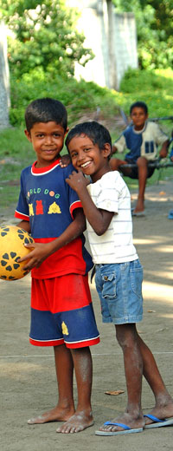
People
The Maldivians are a mixed people, speaking an Indo-European language called Divehi (the official language); Arabic, Hindi, and English are also spoken.
A population of little over 300,000 people is spread over the islands with over a quarter of them living in Male’, the capital.
The birth rate for the Maldives is somewhat higher than the world average, but the death rate is lower. About one-third of the total population is under 15 years of age.
Life expectancy is about 68 years for men and 67 for women.

Slide 8
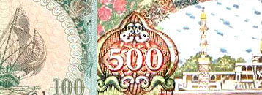
Economy
The country’s lack of land-based natural resources and mineral resources necessitates high import content in virtually all economic production, creating a heavy dependence on foreign exchange earnings.
Despite its natural disadvantages, the country has achieved sound growth over the past two decades, mainly through the development of its tourism and fishery industries.
Tourism has grown significantly (from 195,000 arrivals in 1990 to 617,000 in 2004) and currently accounts for 33% of GDP, a quarter of total employment and more than 60% of the Maldives' foreign exchange receipts.
Fisheries exports are mostly canned and fresh tuna, which is the second largest source of foreign exchange for the country. Industry, which consists mainly of garment production, boat building, and handicrafts, accounts for about 15% of GDP.

Slide 9
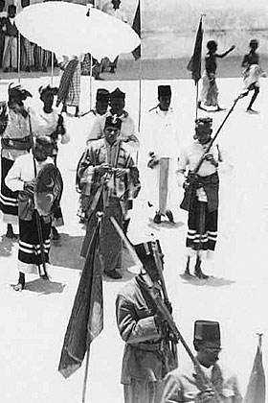
History
The Maldives has been an independent state throughout its known history, except for a brief period of 15 years of Portuguese occupation in the 16th century. The Maldives became a British Protectorate in 1887 and remained so until 26 July 1965.
The independent Maldives reverted from a Sultanate to a Republic on 11th November 1968. The first written constitution was proclaimed in 1932.

Slide 10
Auditor General’s Office
The AGO is an independent state organisation responsible for carrying out audits of Government org anisations, Government companies and other bodies entrusted with Government revenues and assets.
AGO achieved independence with the enactment of the Audit Act (4/2007) following the revision of the constitution. It gives full authority to the Auditor General, to undertake the audit of all government entities and the government companies.
The first independent Auditor General was appointed on 16 January 2008.
Auditor General makes Government accountable in its financial management and ensures public moneys are spent wisely.
Most reports of the Auditor General submitted to the Parliament are in local language, Dhivehi.
However, some reports and summaries are provided in English. Major cases reported by the public will be published on this website together with follow-up actions. These would be in the language they are reported to the AGO.
Types of audit conducted by the Audit Office :
Financial audit
Regulatory Audit

Slide 11
Audit on natural resource development and protection and sustainable energy

Slide 12
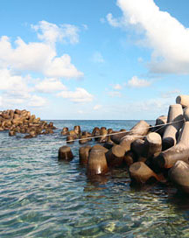
Environmental Auditing
Definition - An examination of a facility’s environmental records and practices while checking for both accuracy and conformance to the organization’s environmental policies and regulatory responsibilities.

Slide 13
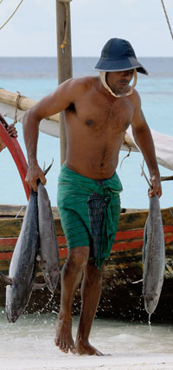
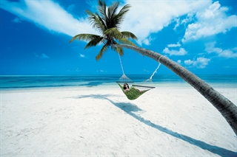
Natural Resource
Major Natural Resources
Maldives has two primary natural resources:
Tourism Industry
Fishing Industry

Slide 14
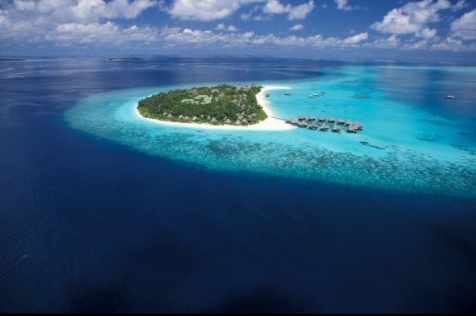
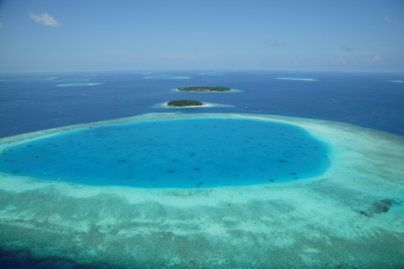
Natural Resource cont....
Tourism Industry
tourism is the country’s biggest foreign exchange earner.
accounting for 33% of GDP and more than 60% of the Maldives' foreign exchange receipts.
Each tourist resort is situated on an uninhabited island.
The islands are self-contained, with its own electricity, water and waste disposal facilities.
The islands are developed according to the standards and guidelines set by the Ministry of Tourism.
The beauty of the islands brings in about $325 million a year.

Slide 15
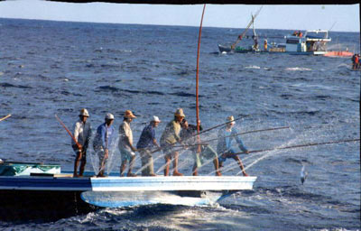
Natural Resource cont....
Fishing Industry
second leading sector in the Maldives
employs about 20% of the labour force and contributes 10% of GDP
The economic reform program by the government in 1989 lifted import quotas and opened some exports to the private sector.
all fishing is done by line as the use of nets is illegal
provides a sizeable proportion of the gross domestic product and job opportunities for the vast majority of the island population.

Slide 16
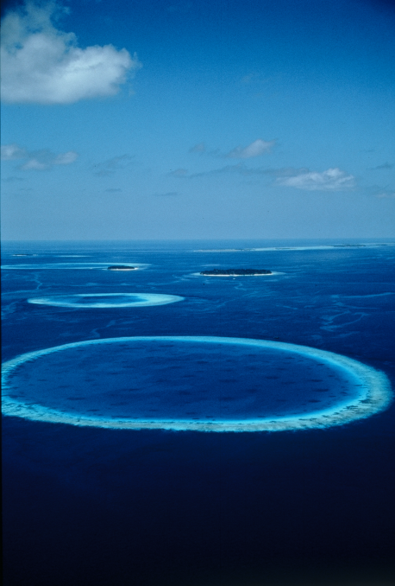
Environment Issues
Construction of coastal structures
Destruction of reefs from coral and sand mining
Land loss and beach erosion
Infrastructure damage
Damage to coral reefs
Water resources
Pollution

Slide 17
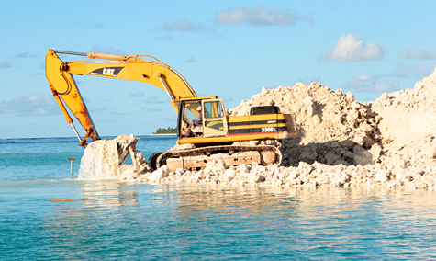
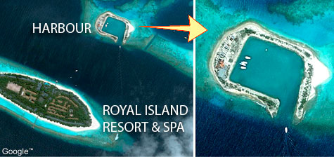
Environment Issues cont....
Construction of coastal structures
movement of sand around the island is obstructed by the construction of coastal structures such as rockfilled jetties
alteration of the current movements largely by creation of ripp currents
greater sedimentation on the coral colonies occurs during the process of dredging of the inner lagoon for harbor development. Corals are literally suffocated by sedimentation.
destruction of the habitat of many marine creatures from reef blasting.

Slide 18
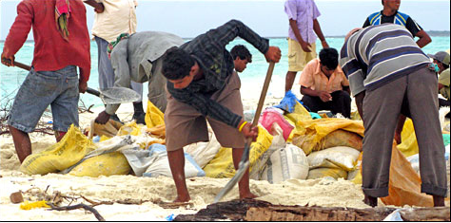
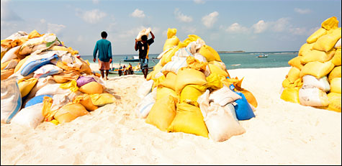
Environment Issues cont....
Destruction of reefs from coral and sand mining
In the development of the first generation resorts, coral and sand were mined extensively. Consequently, many reefs were destroyed and sandbanks disappeared.
affects the islands and undermines their biological role as a fishery area and repositories of biodiversity.
while diving is one the most important tourism attractions, loss of the beauty of the reefs, due to coral mining, severely affects tourism.

Slide 19
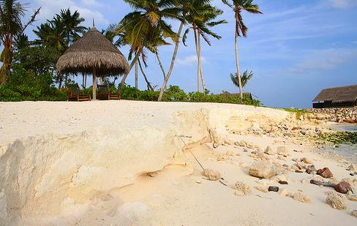
Environment Issues cont....
Land loss and beach erosion
80% of the land area in the Maldives is less than 1 m above mean sea level.
50% of all inhabited islands and 45% of tourist resorts face varying degrees of beach erosion.
Climate change and projected sea level rise would aggravate the present problem of beach erosion.
It is expected that even a 1 m rise
in sea level would cause the loss of
the entire land area of Maldives.

Slide 20
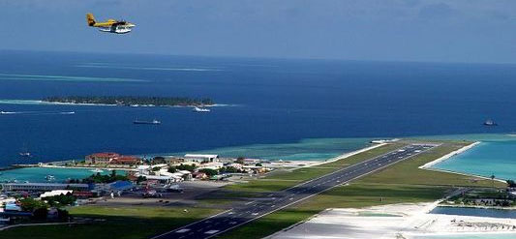
Environment Issues cont....
Infrastructure damage
All the human settlement, industry and vital infrastructure in the Maldives lie very close to the shoreline. Therefore, the projected rise in sea level poses a grave threat to the existence of these structures.
Malé International Airport on Hulhulé island needs to be given priority, as this is the only gateway to the Maldives. The height of the runway is only 1.2 m above mean sea level and is extremely vulnerable to climate change related sea level rise.

Slide 21
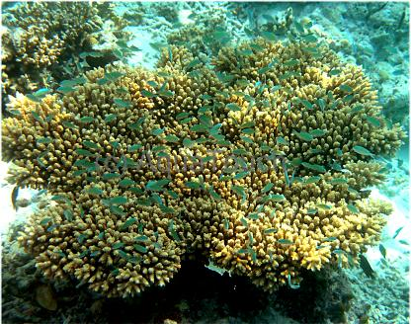
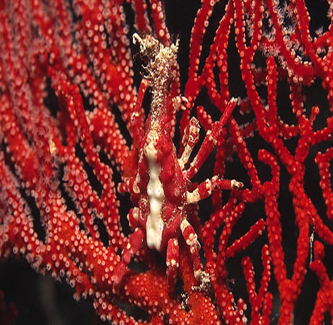
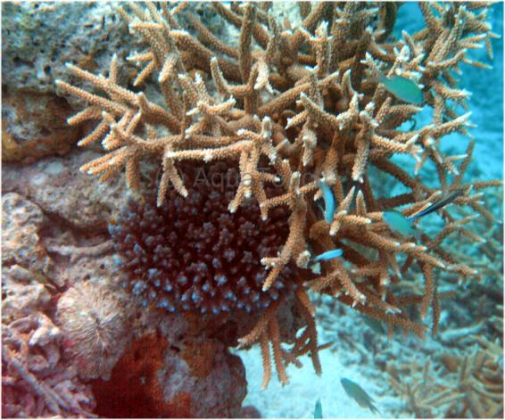
Environment Issues cont....
Damage to coral reefs
These coral reefs not only provide protection for the islands, but are related to success of the main economic activities: tourism and fisheries.
The corals are very sensitive to changes in sea surface temperature. Unusually high sea surface temperatures in 1998 caused mass bleaching on coral reefs in the central regions of the Maldives.
If the observed global temperature trend continues, there would be a threat to the survival of the coral reefs in the Maldives.

Slide 22
Environment Issues cont....
Water resources
mainly depends on groundwater and rainwater as a source of freshwater which are vulnerable to changes in the climate and sea level rise.
The rise in sea levels would force saltwater intrusion into the freshwater lens.
more than a quarter of the population depends on desalinated water for drinking and other uses.

Slide 23
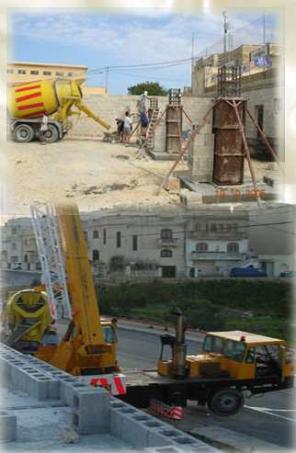
Pollution
Pollution
mainly due to particulate emission from vehicles, power generation, and construction related activities. Particulate includes a range of materials such as soot and coral dust.
High rise buildings and congestion in Malé has disrupted cross circulation of air and emissions from the Increasing number of motor vehicles on the roads are deteriorating the urban air quality of Malé.
Elevated particulate levels are implicated in a range of respiratory problems such as asthma, allergic respiratory responses, bronchitis and emphysema.

Slide 24
Impacts on the economy
tourism
reefs and tourist dive sites
beaches
tourism infrastructure and support facilities
fisheries

Slide 25
Environmental Protections
Solid waste and sewage management
Development of an integrated solid waste management system taking into consideration the unique environmental condition of the small islands would be a huge step for the sustainable development for all the small island countries.
Increasing vegetation cover
A three year plantation of one million trees was initiated in 1996 to increase the vegetation cover of the Maldives. Due to the huge success of the program in the first year, the program was extended to two million trees.
Improving the health of the coral reefs
Implementing measures such as banning of coral mining and pre-treatment of sewage discharged on to the reefs, minimize the human impact on the reef and thus improve the health of the reefs.

Slide 26
Environmental Protections cont....
Coastal Protection
A seawall has been constructed along the coast of Malé with the assistance of the Japanese Government, to protect the high investments and the resident population.
Ban on coral mining
Change of user behavior by providing imported construction materials as an alternative to traditional coral rock, as coral is used as a construction material in the islands.
Protection of the International Airport
No possible alternatives to the protection of the international airport are foreseen, as the existing domestic airports currently do not have the capacity to accommodate international flights.
Upgrading of existing domestic airports to accommodate international flights in the case of emergencies.

Slide 27
Environmental Protections
Environmental Protections
cont....
Reduction of human impacts on coral reefs
Reduction of land based sources of pollution through strict policies, particularly on sewage treatment and safe disposal of sewage and solid waste.
Coastal protection of resort islands
beach nourishment by pumping sand from the lagoon rather than building coastal structures such as sea walls.
Protection of groundwater
Water reuse and recycling on tourist islands.

Slide 28
Environmental Protections
Resort Development
The Tourism Ministry imposes strict regulations and guidelines for resort construction and operation. It is particularly concerned with the carrying capacity of the islands. Measures to limit the number of people in a resort island below the environmental threshold include;
limiting the maximum built-up area to 20% of the total land area;
the maximum height of the building has been limited two stories provided that there is vegetation in the island to conceal these buildings.
in construction of tourist accommodation, all rooms should face the beach and 5 linear meters of beach line has to be allocated to each tourist in front of their rooms. Only 68% of the beach length can be allocated to guest rooms as 20% has to be allocated to public use and 12% left as open space; and
construction on reef flats and lagoons are discouraged. However, as over-water bungalows are very popular among tourists they are permitted construction provided equal open space is left on the land for each building developed on the lagoon.

Slide 29
Environmental Protections
Environmental Controls
  control and mandatory replacement for each tree that is cut down
  allocating space for vegetation between each building
  all coastal works and larger projects have to be commenced after a through environmental impact assessment
  construction of rock-filled jetties and groynes are controlled
  construction of seawalls, detached and submerged breakwaters are restricted
  coral and sand mining from resorts and inhabited islands and from their house reefs are strictly prohibited.
  spear, poison and dynamite fishing are strictly prohibited
  all resorts are required to have incinerators, bottle crushes and compactors.
  sewage disposal through soak pits into the aquifer is discouraged
  other environmental regulations include architectural controls.

Slide 30
Environment protection laws and regulations
The Environmental Protection and Conservation Act4/93 contains provision for conservation of biological diversity, management of protection areas and natural reserves, environment impact assessment procedures and guidelines, disposal of waste, oil and poisonous substances, and trans-boundary movement of hazardous, toxic or nuclear wastes.
the projects which might effect the environment, have to do an Environmental Impact Assessment before the start of the project.
Ministry of Environment and Energy have full authority to stop any project which shows the effect to the environment, without any compensation.
Pole and line is the fishing method which ensured that non other than fished was the victim. Use of poison, dynamite and spear and even large scale netting have always been forbidden by customary law.

Slide 31
Public awareness and education
Raising public awareness about environmental issues is a high priority for the Government of Maldives.
  Incorporation of Environmental Studies in the primary and middle school curricular
  The President’s Environmental Award Program
  World Environment Day celebrations
  The World Clean-up Day Program
  A large-scale tree planting program (the “Two Million Tree” Program)
  Hosting international conferences relating environmental issues.

Slide 32

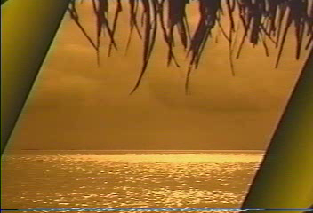

Slide 33
Thank you

