Slide 1
PPT模板下载：www.1ppt.com/moban/ 行业PPT模板：www.1ppt.com/hangye/
节日PPT模板：www.1ppt.com/jieri/ PPT素材下载：www.1ppt.com/sucai/
PPT背景图片：www.1ppt.com/beijing/ PPT图表下载：www.1ppt.com/tubiao/
优秀PPT下载：www.1ppt.com/xiazai/ PPT教程： www.1ppt.com/powerpoint/
Word教程： www.1ppt.com/word/ Excel教程：www.1ppt.com/excel/
资料下载：www.1ppt.com/ziliao/ PPT课件下载：www.1ppt.com/kejian/
范文下载：www.1ppt.com/fanwen/ 试卷下载：www.1ppt.com/shiti/
教案下载：www.1ppt.com/jiaoan/
Chinese Government
Actively Copes with
Atmospheric Pollution
National Audit Office of P.R.China
Notes:
幻灯片放映→使用演示者视图

Slide 2
•The fundamental interests of citizens
• The sustainable and healthy development of the national economy
•Long-term accumulation
SHORT-TERM MANAGEMENT

Slide 3
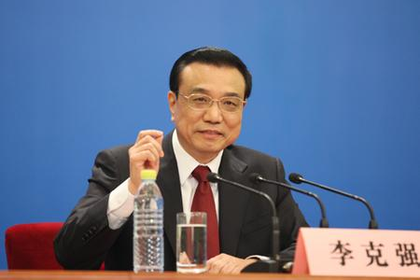
We will declare war against pollution and fight it with the same determination we battled poverty!

Slide 4
Main Measures
Put forward clear goals, determine key areas.
Explore and implement the working mechanism of joint prevention, control for regional atmospheric pollution.
Increase investment to guarantee the implementation of atmospheric pollution prevention and control measures.
Improve the monitoring and early warning emergency system
Environmental Auditing promotes prevention and control of atmospheric pollution

Slide 5
Clear goals, Key areas
• The overall national air quality will improve
• Heavy pollution weather
GREATLY REDUCED
•The key areas has been determined
【PART 1】

Slide 6
Working mechanism of joint prevention, control
The regional and compound
Atmospheric environment
PROMINENT
•New Huge challenges
The frequency of heavy and wide-range
Air Pollution
INCREASING
【PART 2】

Slide 7
Working mechanisms of joint prevention, control
•A new set of working mechanism
joint law enforcement
supervision mechanism
assessment consultation of major projects
unified working mechanism
early warning and emergency response mechanism
information sharing mechanism
【PART 2】

Slide 8
Increase investment to guarantee the implementation of atmospheric pollution prevention and control measures.
80 millions USD FOR Support Coal-Fired Boiler Smoke Management in 12 KEY cities
800 million USD for Support in JING-JIN-JI Area
Increasing public finance investment in 2014
Predicted total investment surpass 280 billion USD
Set up new Special Funds
【PART 3】

Slide 9
Improve the monitoring and early warning emergency system
The governments at all levels
Formulate emergency plan
Publish real-time information
The specific inspection
Monitoring and early warning system
Release forecast early warning timely
Adopt emergency measures in time
The analysis on pollution trend
【PART 4】

Slide 10
Environmental Auditing promotes prevention and control of atmospheric pollution
• The management and use of the funds for atmospheric pollution prevention and control
Done by CNAO
• The completion of obligatory target of atmospheric pollutants emission reduction
• The implementation of relevant policies are audited.
【PART 5】

Slide 11
CNAO will timely carry out Environmental Auditing on the prevention and control of atmospheric pollution
Continue to focus On:
• Key funds
• Key projects
【PART 5】

Slide 12
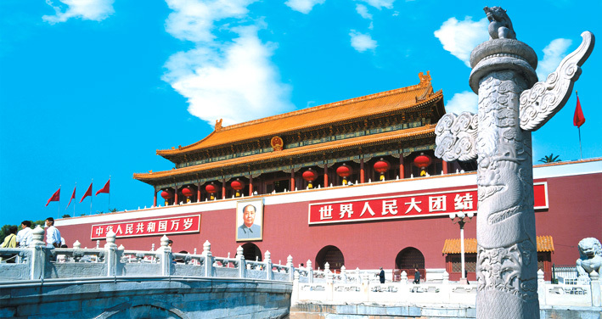
THANKS
For Your Attention

