Slide 1
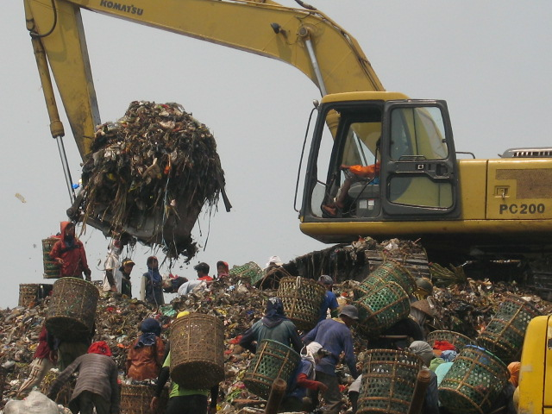
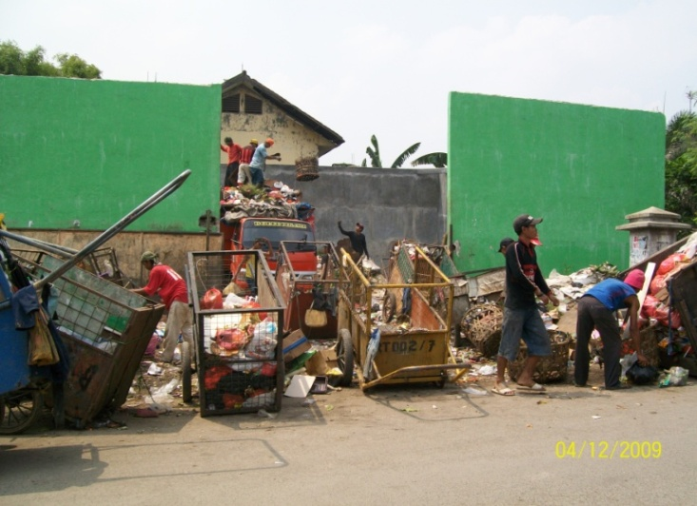
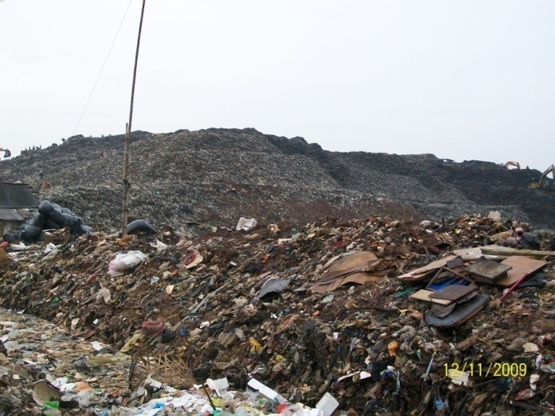
Performance Audit of Municipal Solid Waste Management The Audit Board of the Republic of Indonesia
Presenter: Muhammad Ihsan – Auditor – Team Leader

Slide 2
Background
Why?
Municipal Solid Waste Management
State Finance
Local Environment Durability
Citizen’s Quality of Life
Greenhouse Gasses
Etc

Slide 3
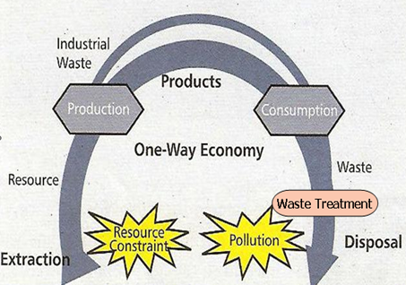
Background
Old Paradigm (End of Pipe Treatment)
Waste
Collecting
Transporting
Final Disposal

Slide 4
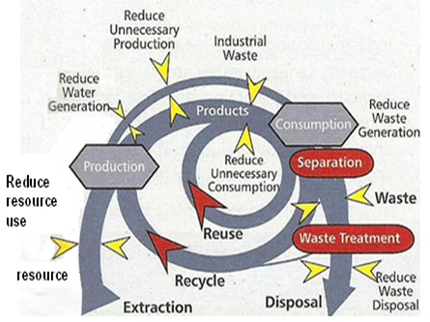
Background
New Paradigm
Reduse
Reuse
Recycle
Waste
Residue
Transporting
Processing
Sanitary Landfill/Waste to Energy

Slide 5
Background
Special Purposes
National development goals related to waste management
Harmonization of regulations and solid waste development plan
Effectiveness of the planning and execution of the solid waste development
Effectiveness of the planning and supervision of the Clean Development Mechanism (CDM)
At least 75% Municipal waste transported to landfill
Effectiveness of landfill management with environmental friendly approach

Slide 6
Background
Criteria
Law Number 18, 2008 Law
Waste Management
Presidential Regulation Number 7, 2005
National development goals 2004-2009 (including waste management)
Internal Regulation from the State Ministries Related
Ministry of the Environment
Ministry of Public Work

Slide 7
Methodology
Planning Phase
Implementation Phase
Reporting Phase

Slide 8
Methodology
Planning Phase
Reviewing related documents
Reviewing the results of the preliminary audit
Identify problems
Determine Object Inspection
Exposes about specific matters
Performed by related ministries/ institution
Determine Key Areas
Review the criteria, News, etc

Slide 9
Methodology
Implementation Phase
Reviewing policies
Audit techniques (interviews, inspection, confirmation, etc)
Develop the results to assess whether the performance of the entity that has been audited in accordance with the criteria or not
Identify the possibilities to improve the performance of the entity
On The Spot Sampling in 5 (five) City
Visit to landfills in Jakarta Province, Bandung, Gianyar, and Bekasi
Collect the results and compare them with the purpose of the audit
Rules and regulations those problems identified at the planning phase
Interview with the local government
interview with the local people
Collect data
Utilize the results to support recommendations and audit conclusions

Slide 10
Methodology
Reporting Phase
Compiling the Audit Reports based on Findings and Audit Working Papers from the Implementation Phase.
Recommendations are written in this Audit Reports together with its response from the entities

Slide 11
Finding and Recommendations
Policy Finding
Overlapping activities of The Ministry of the Environment and The Ministry of Public Work due to the specific job and role of each ministry regarding waste management is not yet clear
Both Minister need to coordinate and synchronize execution of jobs and roles in support of the implementation of the development goals related to waste management
Finding
Recommendation

Slide 12
Finding and Recommendations
Policy Finding
The Provincial Government of DKI Jakarta, and the City Government of Bandung, Gianyar, and Bekasi, did not have Minimum Service Standards in Waste Management
Local Government should create the Minimum Service Standards in Waste Management and propose it to the Local Legislature
Finding
Recommendation

Slide 13
Finding and Recommendations
Implementation Finding
The 3R (Reduce, Reuse, Recycle) program launched by the government is not optimal implemented by related entities
Government financial extravagance
Suboptimal results of the 3R program implementation nationally
Ministry of Environment does not have a general plan (grand design) of the 3R program implementation
Finding

Slide 14
Finding and Recommendations
Implementation Finding
BPK recommends that the Minister of the Environment and the Minister of Public Work to:
Preparing Standard Operating Procedure (SOP) in the planning of 3R program activity by creating steps and methods of risk identification and preparedness/resource adequacy beneficiaries
Synchronize the planning and implementation of the 3R activities involving the Ministry of the Home Affairs which is a bridge between local government and other ministries
Establishing a mechanism of incentives and disincentives for the implementation of these activities
Recommendation

Slide 15
Finding and Recommendations
Implementation Finding
Dumpster and Landfill Management in the sampling cities were not implement an Eco-Friendly Management yet
Local Government should create a guidance in collection, transportation, and waste removal based on ISO
Continuously monitor the landfill operators to perform its obligations to manage and monitor the environment in accordance with the Environment docs (AMDAL, RKP, RKL), and to report periodically the implementation of its activities to the competent authorities;
Finding
Recommendation

Slide 16
IMPACTS AND RESULTS
Regulation
Before
Law Number 18, 2008 regarding Waste Management
Presidential Regulation Number 7, 2005 regarding National Development Goals
After
Government Regulation Number 81, 2012 regarding Waste Management
Future Plan
Minister of The Environment Regulation regarding Waste Management Strategy
Minister of Home Affairs Regulation regarding Waste Management Cooperation
Positive Effects
Minister of The Environment Regulation Number 7, 2011 and later revise to Number 1, 2013 regarding Adipura Implementation Guidelines
Minister of The Environment Regulation Number 13, 2012 regarding Waste Bank
Minister of Public Work Regulation Number 3, 2013 regarding Implementation of Infrastructure and Facilities In Household Waste Management

Slide 17
IMPACTS AND RESULTS
Local Government’s Follow Up
Minimum Service Standards in Waste Management
Jakarta Province, Bandung City, Bekasi and Gianyar have released the Minimum Service Standards in Local Development Goals related to waste management (updated every 5 years)
Dumpster and Landfill Management
Overloaded/nearly overloaded Dumpster or Landfills stopped its activity to prevent a serious damage to environment nearby. Waste thensent to another available landfill. The overloaded one is “having a rest” for years to let it become green open spaces. I.e Pasir Impun and Leuwi Gajah (Bandung)
Landfill utilize to become a power plant (using its methane gas). i.e Bantar Gebang (Bekasi) and Gede Bage (Bandung – on progress)
Some temporary dumpster has been replaced by household waste recycling centre to optimize the 3R activity

Slide 18
IMPACTS AND RESULTS
Programs Related to Waste Management
Ministry of Public Works
Landfill Management
378 landfills (2008) → 438 landfills (Feb 2014)
Rehabilitation
3R Waste Treatment Facilities
Total 525 (2010-2014)
Including household waste recycling centre, Integrated waste treatment facilities, composting facilities, incinerator, etc

Slide 19
IMPACTS AND RESULTS
Programs Related to Waste Management
Ministry of the environment
Adipura Award
Yearly award for local government (town, city, and metropolitan area) based on the cleanest and the availability of green open spaces
Assessment highly based on waste management and its result
Ministry of the Environment is the leader, with helps from Provincial Government, Academics, NGO, and Mass Media

Slide 20
IMPACTS AND RESULTS
Programs Related to Waste Management
Ministry of the environment
Waste Bank
The concept of waste collection (sorted) that can be exchanged for money
In May 2012 there are total 886 active waste banks, >2,000 tons waste managed monthly, 84,623 depositors, and generates Rp3.182.281.000,00 monthly ($280,000.00 per month) – Indonesia’s waste bank profile 2012
Ministry of the Environment provide tools such as composter, crusher, cart, sorter tool, office equipment, etc.
Run by local community throughout Indonesia
Waste collected then recycled to gain potential economics value, such as fertilizer, accessories, recycled paper, etc
In Dec 2013 there are total 1,443 waste banks, and generates around Rp15.700.000.000,00 monthly ($1,350,000.00) - prediction

Slide 21
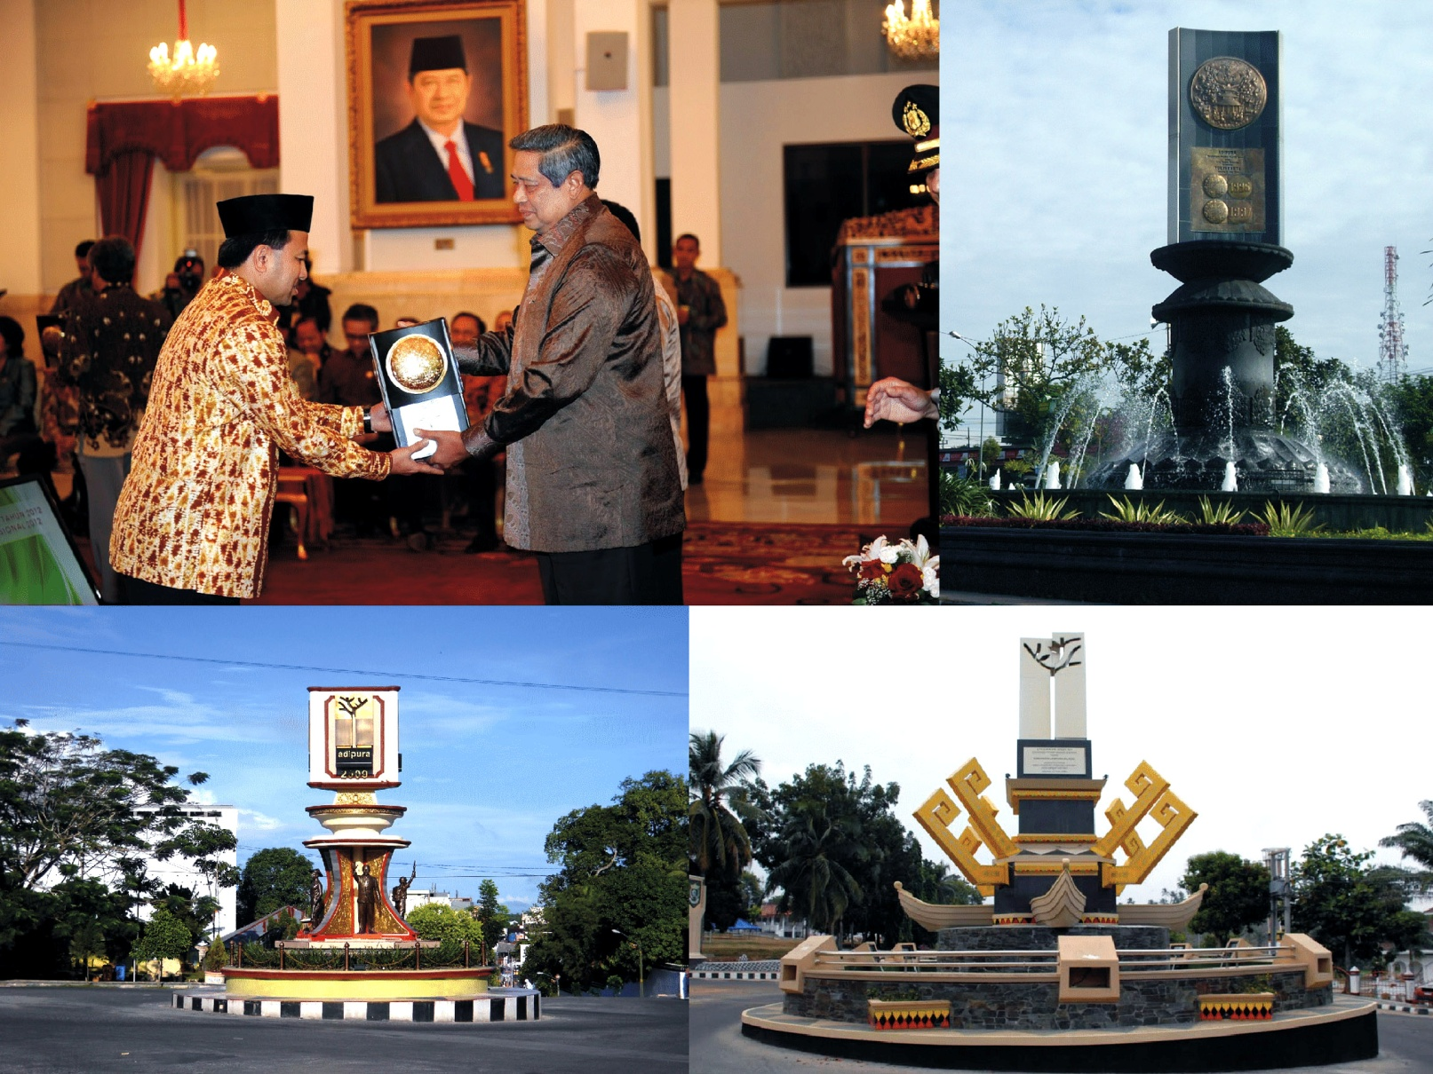
IMPACTS AND RESULTS
Programs Related to Waste Management
ADIPURA

Slide 22
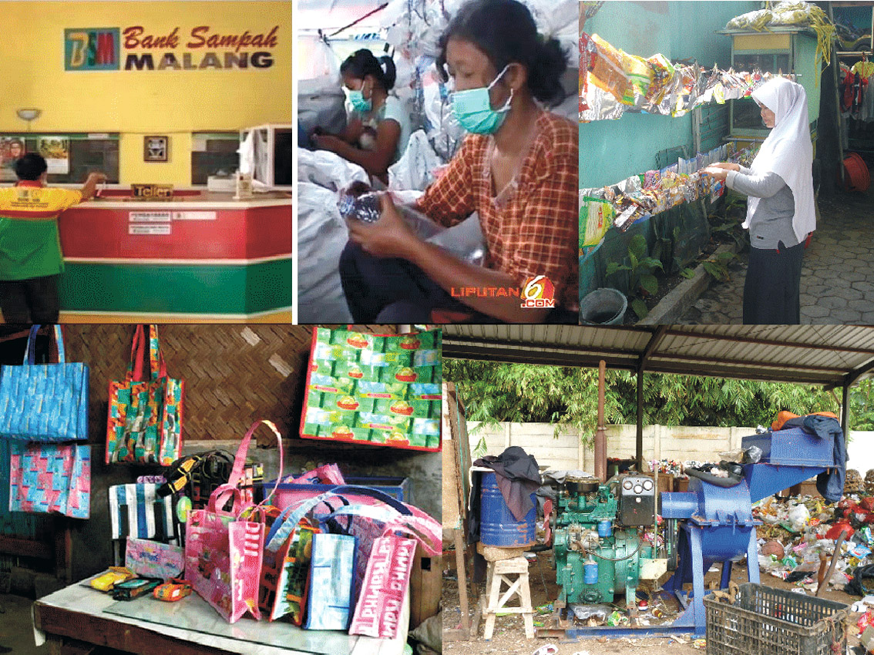
IMPACTS AND RESULTS
Programs Related to Waste Management
WASTE
BANK

Slide 23
IMPACTS AND RESULTS
The Audit Board of the Republic of Indonesia
Performance Audit Related to Solid Waste
Audit in Citarum Drainage Basin Management – 2012
Audit in Toxic Waste Management - 2013
Audit in Brantas Drainage Basin Management - 2013
cover some of Indonesia’s biggest city such as Jakarta and Bandung (West Java Province Capital)
cover some of Indonesia’s biggest city such as Surabaya (East Java Province Capital) and Malang

Slide 24
Challenges and Barriers
How to determine waste management performance cost benefit correlate to state finance?
BPK at that time only has very few auditors from environmental science background
These minor problems are able to overcome by the teams with the continuous discussion with related entities/institutions, study the literatures, and also willingness of everyone involved in this audit activity

Slide 25
Lesson Learned
It is clearly understood that municipal solid waste is become one of a big problem in almost every big city, especially in developed country. It involves a lot of entities, including government, local government, private sectors, and people of the city itself. Population growth also contributes a significant result of the waste management whether it will be success or not
Since the auditing principal of this matter is to preventing the worse case that could happen in the long-term situation, it is important for auditor to capture the problem not in a short term only. The regulations must be one of the primary audit subjects to ensure that it will overcome, or at least minimize the problems in the future

Slide 26
Thank You

