Slide 1
8th ASOSAI Seminar on Environmental Auditing
Theme: Audit Promoting Government Accountability for Environment
Corrine Horton
Executive Director
Australian National Audit Office

Slide 2
Environment: a shared responsibility
Responsible for national matters, such as:
the protection of matters of national environmental significance; and
implementing Australia’s obligations under international environmental treaties and conventions.
Responsible for matters within their jurisdiction, such as:
regulation of pollution;
approval of certain types of development activity; and
natural resource management.
Responsible for local matters, such as:
town planning approvals;
sewerage;
maintaining local parks and streets; and
rubbish collection

Slide 3
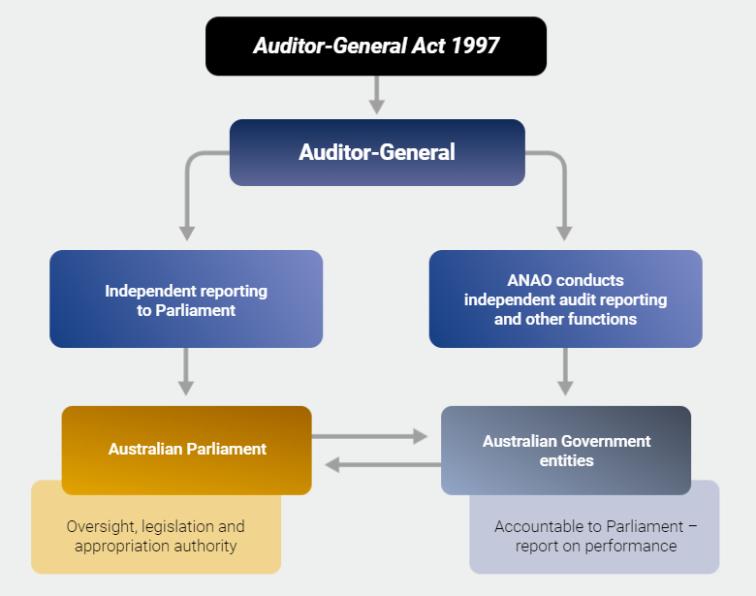
Auditor-General’s mandate
The Auditor-General for Australia is responsible under the Auditor-General Act 1997 for auditing Commonwealth public sector entities and reporting to the Parliament of Australia.
The Australian National Audit Office (ANAO) assists the Auditor-General to deliver these functions.

Slide 4
Responsible Australian Government entity
The Agriculture, Water and the Environment portfolio is responsible for advising the Australian Government and implementing programs on the environment, water resources, and Australia’s agricultural, fisheries and forestry industries.
The Department of Agriculture, Water and the Environment (DAWE) is the lead entity in the portfolio.

Slide 5
ANAO’s environment audits
The ANAO’s environment related audits are generally conducted under the Auditor-General’s performance audit mandate.
From 2019–20 to 2020–21, the ANAO tabled 84 performance audits, with nine audits relating to the environment and agriculture.

Slide 6
Annual Audit Work Program and audit coverage
The Auditor-General publishes an annual audit work program in July each year.
The purpose of the annual audit work program is to inform the Parliament, government sector entities and the public of the audits the ANAO proposes to deliver throughout the financial year.

Slide 7
Risks in environment
The ANAO focuses its environment audit coverage on specific risks, including:
measuring and demonstrating the achievement of intended goals;
the achievement of value for money through grants and procurement;
implementation of new policies;
planning and implementation of environmental and agricultural regulation; and
procurement and financial management.

Slide 8
Themes from recent audits
Weaknesses in management of probity and conflicts of interest
Variability in the maturity of risk-based frameworks for the delivery of regulatory functions
Scope to improve performance measurement frameworks to determine the impact and effectiveness of environmental programs and regulatory functions

Slide 9
Weaknesses in management of probity and conflicts of interest
In recent audits, the ANAO identified weaknesses in relation to the management of probity and conflicts of interest.
Auditor-General Report No. 35 of 2019–20 Grant Program Management by the Australian Renewable Energy Agency
Auditor-General Report No. 47 of 2019–20 Referrals, Assessments and Approvals of Controlled Actions under the Environment Protection and Biodiversity Conservation Act 1999
Auditor-General Report No. of 2020–21 Procurement of Strategic Water Entitlements

Slide 10
Key messages for the public sector
Data and information from IT and records management systems needs to be accessible and have appropriate quality controls if it is to effectively support the identification of key risks and trends.
Entities should ensure records relating to conflict of interest declarations are current, complete and accessible.
The coverage and scope of the probity management framework should be commensurate with the nature and level of the risks involved.
Entities should ensure appropriate probity policies are developed, regularly reviewed and demonstrably adhered to through appropriate reporting on compliance. This involves an active rather than passive approach to acting on probity risks.

Slide 11
Risk-based environmental regulation
The ANAO identified variability in the maturity of risk-based approaches to the delivery of regulatory functions.
Auditor-General Report No. 42 of 2020–21 Responding to Non-Compliance with Biosecurity Requirements
Auditor-General Report No. 47 of 2019–20 Referrals, Assessments and Approvals of Controlled Actions under the Environment Protection and Biodiversity Conservation Act 1999
Auditor-General Report No. 45 of 2020–21 Management of Commonwealth Fisheries

Slide 12
Key messages for the public sector
Regulators should use collected information and intelligence to assess the level of risk across the entire breadth of their regulation, and then target their activities at those areas with the highest level of risk.
Governance and risk frameworks should consider available resources and feasibility of implementation to ensure intended outcomes are achieved.
Undertaking regulatory activities in full accordance with procedural and legislative requirements, including maintaining appropriate records, is necessary to ensure effective and defensible action can be taken in response to non-compliance.

Slide 13
Measuring the impact and effectiveness of environmental functions
Fit-for-purpose performance measurement frameworks enable an assessment of the extent to which programs are achieving established objectives.
Auditor-General Report No. 35 of 2019–20 Grant Program Management by the Australian Renewable Energy Agency
Auditor-General Report No. 45 of 2020–21 Management of Commonwealth Fisheries
Auditor-General Report No. 47 of 2019–20 Referrals, Assessments and Approvals of Controlled Actions under the Environment Protection and Biodiversity Conservation Act 1999

Slide 14
Key messages for the public sector
Entities should implement performance and evaluation frameworks that provide information on their progress towards desired outcomes, to develop a meaningful understanding of their effectiveness and allow them to respond to emerging issues.
The establishment of appropriate efficiency measures will better position regulators to identify and address the reasons for declining performance.
To facilitate a meaningful assessment of progress and achievement, entities should ensure they are monitoring, evaluating and reporting on their effectiveness at achieving their objectives.

Slide 15
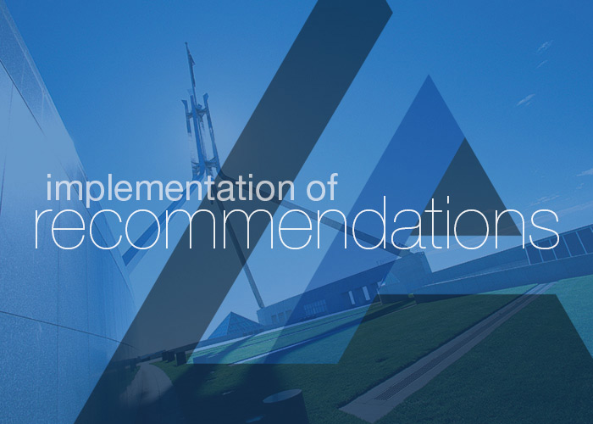
Audit impact
Program-level impact
Program-level improvements can occur during an audit engagement as interim findings are made.
Entities will often begin to address issues as they emerge during the audit process.
Improvements can also occur after the audit has been completed and formal findings are communicated.
The ANAO reports to the Australian Parliament on areas where improvements can be made to aspects of public administration and makes specific recommendations to assist public sector entities improve performance.

Slide 16
Audit impact
System-level impact
More systematic impact can involve legislative changes or regulatory reform.
The EPBC Act audit informed the Independent Review of the Environment Protection and Biodiversity Conservation Act 1999.
The review examined how the EPBC Act has been operating, and any changes needed for Australia to support ecologically sustainable development into the future.
Final Report concluded that:

Slide 17
Audit experience
Use of data analytics and systems assurance specialists
Appropriate utilisation of data analytics and systems assurance allows for a more efficient audit process and robust results. However, engagement of specialists is not always the more efficient pathway.
Data and record-keeping
The ANAO encountered a number of challenges related to entities’ poor record-keeping practices.
Sample testing
The ANAO conducted a number of sample testing in the audits, which presented different learnings.

Slide 18
Sharing with the international SAI community
The ANAO shares its knowledge and learns from the experiences of others through three working groups on environmental auditing:
Australasian Council of Auditors-General (ACAG)–Pacific Association of Supreme Audit Institutions (PASAI) Regional Working Group on Environmental Auditing;
Asian Organization of Supreme Audit Institutions (ASOSAI) Working Group on Environmental Auditing; and
International Organization of Supreme Audit Institutions (INTOSAI) Working Group on Environmental Auditing.

Slide 19
Thank you

