Slide 1
Audit Promoting Government
Accountability for Environment
October 2021
Prepared by:
Maitham Saeed & Mohamed Jasim

Slide 2
Main steps taken by the NAO Bahrain for promoting government accountability for environment
1
Environmental Audit in the NAO’s strategic and annual plans.
2
Environmentally related audit assignments.
3
Capacity Building in relation to Environmental Audits.
4
Utilization of IT and virtual technologies during COVID-19 Pandemic.

Slide 3

Environmental Audit in the NAO’s strategic and annual plans
Environmental audit projects have been included in the NAO’s strategic and annual audit plans.
Strategic
Plan
Annual
Plan

Slide 4
Environmentally related audit assignments
The NAO Bahrain regularly conducts performance audit assignments on various government environmental programs and issues.
Assess the efficiency and effectiveness of the government’s environmental entities and programs.
Scrutinize compliance with national environmental laws and regulations as well as adherence to international environmental treaties.
The NAO Bahrain provides stakeholders (concerned environmental entity, government, and parliament) with independent audit findings and recommendations.
The NAO Bahrain conducts an annual follow up of its audit reports to ensure the implementation of its recommendations.

Slide 5

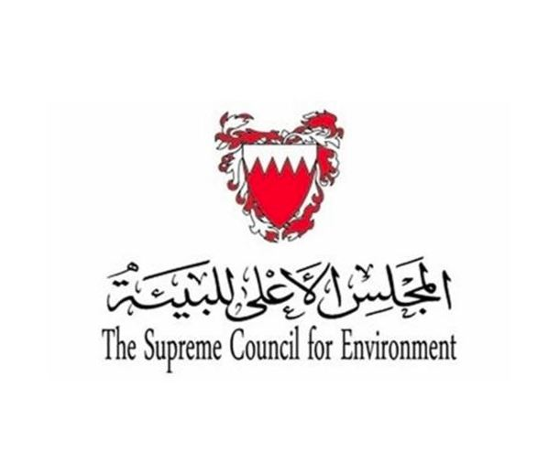


Examples of Environmental audit assignments
Assessing the readiness of governmental entities in the Kingdom of Bahrain (KOB) to implement Sustainable Development Goals (SDGs) including environmental goals.
Audit of the performance of the Supreme Council for Environment of the KOB.
Audit of waste management in the KOB.
Audit of sea sand mining in the KOB.

Slide 6








Environmental audit methodology
Reviewing environmental laws and regulations.
Analyzing environmental data.
Reviewing environmental international standards and best practices.
Assessing the coordination among relevant governmental entities.
Reviewing environmental strategic and operational plans of relevant governmental entities.
Reviewing environmental studies.
Reviewing environmental roles and responsibilities of relevant governmental entities.
Conducting site visits to assess the environmental situation.

Slide 7


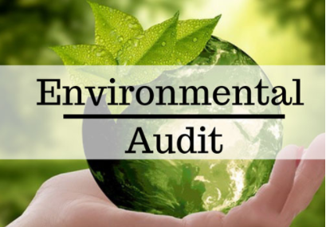
Capacity Building in relation to Environmental Audits
Investing in the capacity building of SAIs’ members and sharing lessons learnt
on an on-going basis enhances capacities of each SAI.
Regional and international training courses that deal with various aspects of environmental audit and audit of Sustainable Development Goals
(SDGs)
Share and exchange knowledge amongst SAIs and enhance auditors’ skills and capacities
Effective environmental
audits

Slide 8



Utilization of IT and virtual technologies during COVID-19 Pandemic
In the last two years, the COVID-19 Pandemic was the main challenge faced by SAIs when conducting audit assignments, including environmental audits. However, the NAO succeeded in overcoming this challenge by utilizing IT and virtual technologies, which provided alternative ways to conduct some audit procedures and helped in effectively carrying out several environmentally related audits.

Slide 9
Thank you

