Slide 1
Manish Kumar and Pushkar Kumar (SAI India)
8th ASOSAI WGEA Seminar on Environmental Auditing
Audit on Climate Change

Slide 2
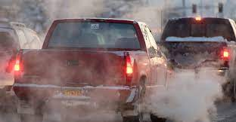
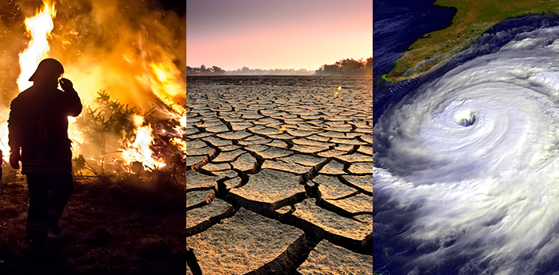
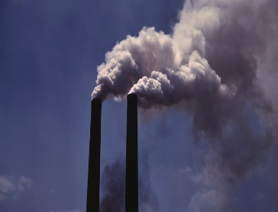
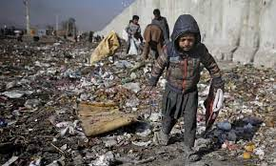
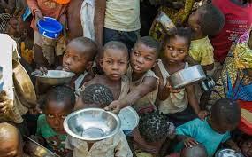
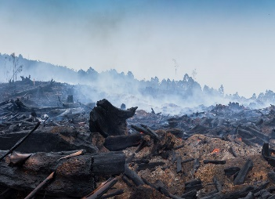
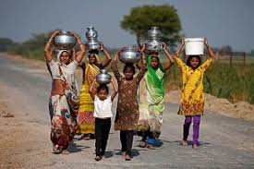
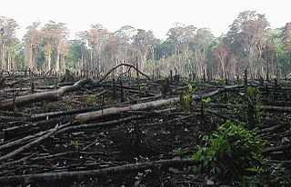
Climate Change: A Global Concern
Transportation
Pollution
Industrialization
Inefficient Energy Use
Deforestation
Unsustainable Resource Extraction
Agricultural Practices
Livestock
Rising Temperatures
Rising Sea Levels
Unpredictable Weather patterns
Extreme Weather Events
Land Degradation
Loss of Wildlife and Biodiversity
Poverty, Hunger, Food and Water Crisis, Loss of Livelihood, Risk of Diseases

Slide 3
Climate Change and SDGs
By 2030, provide access to safe, affordable, accessible and sustainable transport systems , enhance inclusive and sustainable urbanization and capacity for participatory, integrated and sustainable human settlement planning and management in all countries & increase the number of cities and human settlements adopting and implementing integrated policies and plans towards inclusion, resource efficiency, mitigation and adaptation to climate change
By 2030, build the resilience of the poor and those in vulnerable situations and reduce their exposure and vulnerability to climate-related extreme events and other economic, social and environmental shocks and disasters
By 2020, promote the implementation of sustainable management of all types of forests, halt deforestation, restore degraded forests and substantially increase afforestation and reforestation globally
By 2030, ensure sustainable food production systems and implement resilient agricultural practices that increase productivity and production, that help maintain ecosystems, that strengthen capacity for adaptation to climate change, extreme weather, drought, flooding
Implement the 10-year framework of programmes on sustainable consumption and production and by 2030, achieve the sustainable management and efficient use of natural resources
By 2030, upgrade infrastructure and retrofit industries to make them sustainable, with increased resource-use efficiency and greater adoption of clean and environmentally sound technologies and industrial processes, with all countries taking action in accordance with their respective capabilities
By 2030, ensure universal access to affordable, reliable and modern energy services, increase substantially the share of renewable energy in the global energy mix & double the global rate of improvement in energy efficiency. enhance international cooperation to facilitate access to clean energy research and technology, including renewable energy, energy efficiency and advanced and cleaner fossil-fuel technology, and promote investment in energy infrastructure and clean energy technology
Improve progressively, through 2030, global resource efficiency in consumption and production and endeavor to decouple economic growth from of programmes on sustainable co environmental degradation, in accordance with the 10-year framework consumption and production, with developed countries taking the lead

Slide 4
India- Climate Change Institutional Framework
Prime Minister’s Office
Prime Minister’s Council on Climate Change
NAPCC
Executive Committee on Climate Change (Committee of Secretaries)
Planning Commission
Ministry of Finance
Ministry of External Affairs
Ministry of Environment and Forests
Expert Panel on Low Carbon Strategies for Inclusive Growth
CCFU
National CDM Authority
CCU
Research Institutions
Bilateral Agencies International Organisations
NMCI
Climate Change Action Programme
Ministry of New and Renewable Energy
Ministry of Power
Ministry of Urban Development
Ministry of Agriculture
BEE
NMSA
JNNSM
NMSH
NMEE
 | Coordination Relationships
 | Executive Body
 | Plans and Processes
 | Nongovernmental actors, Bilateral agencies and International Organizations
Ministry of Science and Technology
Ministry of Water Resources
DST
NWM
NMSKCC
NMSHE
Departments of Environment/Department of Science and Technology in Individual States and Union Territories
Donor Agencies International Organisations
State Action Plans on Climate Cheque
Notes:
Source - https://nidm.gov.in/PDF/pubs/GIZ_NIDM_Climate%20RiskManagementFramework.pdf

Slide 5
National Action Plan on Climate Change
Launched in 2008
Eight National Missions
Coordinating Ministry- MoEF&CC
Emission Reduction/ Mitigation | Adaptation
National Solar Mission | Sustainable Habitat
Energy Efficiency | Water
Green India | Sustaining Himalayan Ecosystems
 | Sustainable Agriculture
 | Strategic Knowledge for Climate Change
State Action Plan on Climate Change
To achieve coherence between the strategies and actions at national and sub-national level,
States and Union Territories prepare State Action Plan on Climate Change (SAPCC)

Slide 6
Audit on Climate Change
Sources of GHG Emissions
Audits by SAI India
Performance Audit on Pollution by industries in West Bengal (Report No 5 of 2018) Compliance audit on Vehicular Emission by State Transport Undertakings in West Bengal (Report No. 2 of 2018), Compliance audit on Role of Uttarakhand Environment Protection and Pollution Control Board and Uttarakhand State Transport Department in controlling air pollution in Dehradun (Report No 2 of 2019)
Mitigation
Audits by SAI India
Performance Audit of Renewable Energy Sector in India (Report No. 34 of 2015) Performance Audit on Financing of Renewable Energy Projects by Indian Renewable Energy Development Agency Limited (Report No. 12 of 2015). Compliance Audit of Development and popularisation of Renewable Energy in Odisha (Report No. 3 of 2020) Performance Audit on Implementation of Renewable Energy Programme in West Bengal (Report No. 4 of 2018) Compliance Audit of Karnataka Renewable Energy Development Limited (Report No 3 of 2016) Performance Audit of Renewable Energy Sector in Maharashtra (Report No.3 of 2016) Performance Audit on Implementation of Renewable Energy Programme in Himachal Pradesh (Report No. 3 of 2016) Performance Audit of Pradhan Mantri Ujjwala Yojana, Ministry of Petroleum and Natural Gas (Report No.14 of 2019) Compliance Audit of Adherence to Pollution Control Norms in Thermal Power Plants of The Tamil Nadu Generation and Distribution Corporation Limited (TANGEDCO)(Report No 7 of 2016) Performance audit on Planning and Implementation of Phase III Expansion Project of Mangalore Refinery and Petrochemicals Limited (Report No. 33 of 2017) Performance Audit on Working of Maharashtra Forest Department (Report No. 1 of 2016) Compliance Audit on ‘State Compensatory Afforestation Fund Management and Planning Authority’ (Government of Assam Report No. 3 of 2017)
Adaptation Measures
Audits by SAI India
Performance Audit of Rejuvenation of River Ganga(Namami Gange) (Report No.39 of 2017) Performance Audit of Rejuvenation of River Ganga. (Government of Uttarakhand Report No.1 of the year 2018) Performance Audit of National Rural Drinking Water Programme Union Government (Civil) Report No. 15 of 2018 Performance Audit on Water Supply Management in Bhopal and Indore Municipal Corporations. (Government of Madhya Pradesh Report No. 3 of the year 2019) Performance Audits (Urban Local Bodies) (Government of Tamil Nadu Report No.1 of 2018) Compliance Audit of Construction of toilets under Swachh Bharat Mission (Gramin) (Government of Uttarakhand Report No.1 of the year 2018) Accelerated Irrigation Benefits Programme, Ministry of Water Resources, River Development (Report No.22 of 2018) Performance Audit on Soil Survey and Soil Conservation activities in Agriculture Department Government of Kerala Report No. 4 of the year 2016 Compliance Audit on Implementation of Pressurized Irrigation Network System (PINS) and Micro Irrigation System (MIS) on operational tube-wells Government of Gujarat (Report 3 of 2018)
Regulation, Monitoring and Supervision
Audits by SAI India
Performance Audit on Environmental Clearance and Post Clearance Monitoring Ministry of Environment, Forest and Climate Change (Report No. 39 of 2016) Performance Audit of Environmental degradation in the greater Guwahati area with special emphasis on the role of the Pollution Control Board, Assam (PCBA) Report of the Comptroller and Auditor General of India Government of Assam (Report No. 3 of 2016)
Audit on Climate Change
Sources of GHG emissions
Mitigation measures
Adaptation measures
Regulation, Monitoring and Supervision

Slide 7
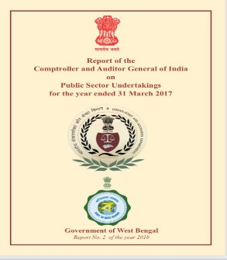
Vehicular Emission
Audit Objectives
To evaluate the Environment Plan and Policy outlined by the Government for mitigation of vehicular emissions by the State Transport Undertakings (STUs), and
Examine the Environment Management System for reduction of emissions implemented by the STUs and the impact of vehicular emissions.
Scope of Audit and Audit Methodology
This thematic audit on impact of vehicular emissions by five STUs covered the period from April 2012 to March 2017.
Audit methodology involved scrutiny of records, joint inspections, testing of smoke with smoke meters etc.
Audit Findings
Non-preparation of plans:
Non-creation of infrastructure for supply of Compressed Natural Gas (CNG)/ Coal Bed Methane (CBM)
Non-phasing out of Bharat Stage-I (BS-I), Bharat Stage-II (BS-II) and Bharat Stage-III (BS-III) buses
Shortfalls in testing the actual emissions according to the defined parameters
Lack of Environmental Reporting including Green Gross Domestic Product (GDP) Accounting.
Lack of adherence to statutory requirements and directions regarding measures to control air pollution
Inadequate maintenance of buses resulted in incomplete combustion/ higher consumption of fuel with increased emission.
Discharge of higher quantities of pollutant such as carbon monoxide (CO) by STU buses were attributable to (i) inclusion of old buses of BS-I, BS-II and BS-III categories in the total fleet, (ii) higher consumption of oil per Km run and (iii) improper maintenance of vehicles

Slide 8
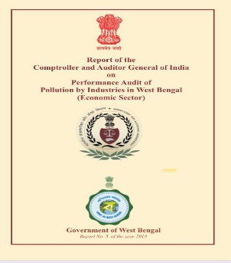
Pollution by Industries
Audit Objectives
To examine if steps were taken to prevent industrial pollution;
To check if Measures undertaken to control industrial pollution achieved the desired objective;
Analyze if monitoring of industrial pollution was effective
Scope of Audit and Audit Methodology
Audit covered the period from 2012-13 to 2016-17 encompassing initiatives for prevention, control and monitoring.
Audit methodology comprised of examination of records /documents, Environmental Clearance (EC) process, joint inspections of industrial units.
Audit Findings
Pollution Control Board did not prepare any inventory of industries giving cognizance to the Pollution Index.
Department did not have any vision/ plan/ policy.
SPCB did not prepare any time bound action plan to control pollution.
SPCB had not prepared Zoning Atlas for the State. Heavily polluting industries being set up in critically polluted areas.
Ecologically sensitive areas, were not considered in the siting policy, while setting up of industries.
Deviations from the laid down process of granting Environmental Clearance
Many industries operating without Consent to Establish (CTE).
SPCB had not set up any new real time air/ water quality monitoring stations in any of its critically polluted areas.
There was a wide gap, between generation and safe disposal of Hazardous waste. Instances of illegal disposal causing severe pollution were also noticed.

Slide 9
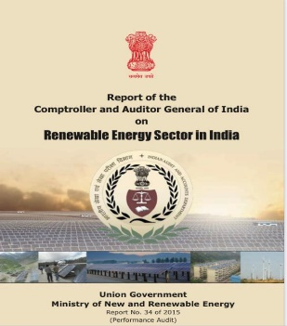
Renewable Energy Sector
Audit Objectives
To examine the progress made
in increasing the contribution of Renewable Energy resources in India’s energy mix/electricity mix
Increasing access to electricity/ lighting needs in remote and rural areas; and
Promoting research, design, development and demonstration.
Scope of Audit and Audit Methodology
The all India Performance Audit of Renewable Energy Sector in India included the audit of Ministry of New and Renewable Energy (MNRE) and institutions under it. The period covered in audit was from 2007-08 to 2013-14.
Audit Findings
Shortfall in achieving targets under Renewable Purchase Obligation & Renewable Energy Certificates vis a vis NAPCC norms
None of the schemes of MNRE encouraged the developer/ beneficiary to claim the benefits of CDM
No actual calculations of reduction in GHG emissions were made available by MNRE.
Solar Power
17 States had not fixed any targets during the period 2007-14
The installed capacity in high potential States varied from zero to 2.49 per cent of their potential.
As against an estimated potential of 7,48,980 MW, in 30 State/UTs, the installed capacity was only 0.36 per cent.
Anomalies in design of various schemes: Increase in tariff over the time period when costs were registering a downward trend, excess service charges amounting to (27.39 lakh) charged by IREDA in violation of the prescribed limit

Slide 10
Wind Power
Out of the potential of 1,02,788 MW, the installed capacity was only 21,132 MW (19.65 per cent)
Tariff fixation or allocation of sites to the developers.
Non-availability of sufficient transmission infrastructure
Small Hydro Power
Due to delays and problems in according technical approvals to Detailed Project Reports, allotment of projects, acquiring land for setting up projects and obtaining forest and environmental clearances, several projects could not be taken up and completed in time.
Biomass Power
There were instances of non-traceable biomass plants, inoperative plants, plants working at lower capacities, plants installed with different specifications than approved and plants using non-permitted fuels.
Solar Photovoltaic Systems
There were cases of irregularities in distribution of solar devices, delay in distribution, irregular purchases of solar devices, and deficiencies in award of works for Solar Power Plants, irregular payments and delays in completion of projects.
Cases of irregular installation, non-installation of solar devices and poor quality of work were noticed which indicated deficiencies in monitoring and evaluation. Maintenance of the off-grid systems was deficient.
Remote Village Electrification
There were instances of inordinate delays in completion of projects, award of contracts to ineligible contractors, irregular distribution of lighting systems and incomplete/non-installation of Remote Village Electrification systems.

Slide 11
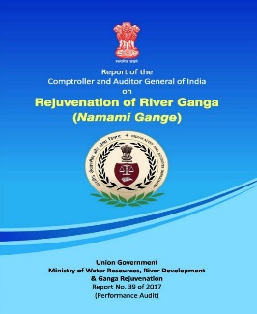
Rejuvenation of River Ganga (Namami Gange)
Audit selected 87 out of 145 projects constituting 60 per cent including 70 infrastructural and all 11 institutional projects, five afforestation projects and one bio-diversity project based on risk assessment on parameters such as preliminary/ detailed estimates, sanctioned cost, delay in execution, status of work, cost overrun, pollution load of the town on the River Ganga, threats to river and its tributaries etc. Sixteen audit offices were involved in this audit.
The Performance Audit revealed deficiencies in
Financial management and planning,
Shortfall in human resources at all levels,
Issues in implementation of projects for sewage treatment, rural sanitation, forestry interventions,
use of remote sensing/GPS, water quality monitoring and follow-up mechanisms which led to delays in achievement of objectives as per the prescribed milestones.
Water quality was found to be at significant variation vis a vis prescribed ranges.

Slide 12
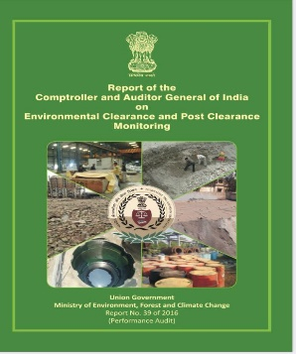
Environmental Clearance and Post Clearance Monitoring
Audit Objectives
Whether the process of grant of Environmental Clearance EC is in compliance with the laid down procedure, is adequate, fair and transparent.
Whether there is adequate Post Environmental Clearance Monitoring to ensure that the project proponents comply with all the conditions laid down in the EC letter and commitments made in the Environment Impact Assessment (EIA) report.
Scope of Audit and Audit Methodology
Projects granted Environment Clearance (EC) between
January 2011-July 2015 and
Calendar years 2008-2012.
Records were examined in Ministry including its 10 Regional Offices, Central Pollution Control Board and 33 State Pollution Control Boards/ Union Territory Pollution Control Committees (. Compliance reports submitted by the Project Proponents (PPs) to also examined AND Joint site visits were carried out.
Audit Findings:
Environment Impact Assessment process
Discrepancies in the database.
Delays at various stages of grant of Environmental Clearance (EC).
No Regulator at the National level to carry out an independent, objective and transparent appraisal and approval of the projects and to monitor the implementation of the conditions.
There was non-uniformity in the terms and conditions of the Environmental Clearance for similar kind of projects.

Slide 13
Compliance to General Conditions of Environment Clearance
Shortfall of expenditure on Environment Management Plan activities (26 per cent cases), Enterprise Social Responsibility activities (20 per cent cases) and development of green belt (47 per cent cases).
Time bound action plan for implementing the Environment Management Plan was not made.
Ground water was used without permission of the Competent Authority. The scope of work was changed after obtaining the Environmental Clearance.
The annual environmental audit report was not submitted by Project Proponents to State Pollution Control Boards/Union Territory Pollution Control Committees and in seven per cent of the cases construction/operations was commenced before grant of Environmental Clearance.
Compliance to Specific Conditions of Environment Clearance
Absence of action plan for conservation of flora and fauna. Rain Water Harvesting structure was not done. Improper storage and non-utilization of fly ash and consolidation and compilation of muck in non-designated dumping sites.
Monitoring of compliance of EC by Project Proponents
There were non-compliance in setting up of separate monitoring cell with adequate manpower.
Action plan for Critically Polluted Areas
Biennial environmental quality monitoring in Critically Polluted Areas were not carried out for computing Comprehensive Environmental Pollution Index.
Monitoring of compliance of ECs by Regional Offices of the Ministry
No database of cases received by it where the violations were reported by Regional Offices.
Monitoring of compliance of Environmental Clearances by State Pollution Control Boards
Clear cut responsibilities were not assigned to State Pollution Control Boards/Union Territory Pollution Control Committees regarding post Environmental Clearance monitoring. They did not have in place sufficient infrastructure and manpower for monitoring despite having sufficient funds.

Slide 14
Thank You

