Slide 1
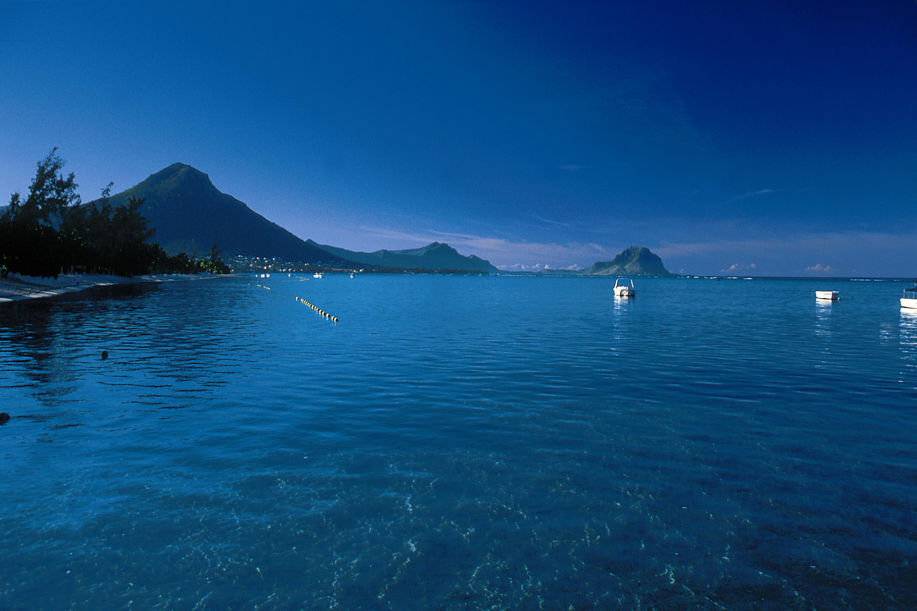


REPUBLIC OF MAURITIUS
Country Paper
Audit of Climate Change
Presented by
Mr Khemraj REETUN &
  Mr Juihendranath DODAH

Slide 2
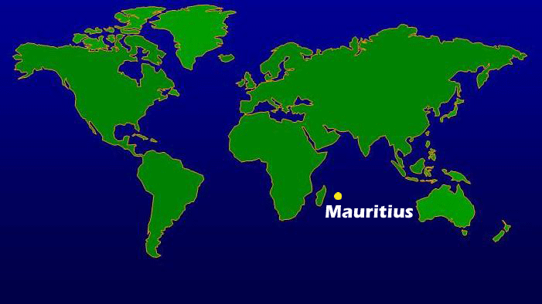
Geography
Mauritius is located approximately 2000 kilometres to the south eastern coast of Africa and lies east of Madagascar.

Slide 3
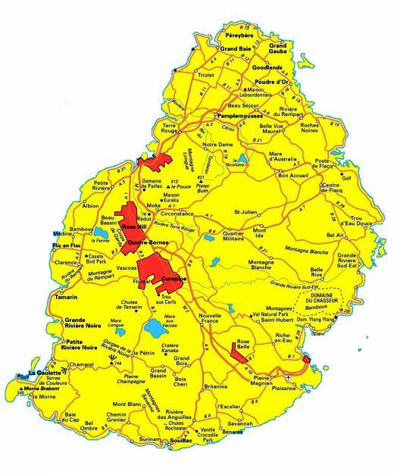
Mauritius covers an area of 1865km² with 330 kilometres of white sandy beaches and transparent lagoon , protected from open sea by the world’s third largest coral reef, which surrounds the island.
Mauritius is 45km in width and 65km in length.
Of Volcanic Origin

Slide 4
Environment Threats
Being an island state with its inherent risk, Mauritius is prone to many environmental threats such as
climate change,
coastal erosion and water management,
loss of biodiversity,
soil degradation,
invasive species,
marine pollution,
waste management & sustainable land use.

Slide 5
Effects of climate change
Frequent intense cyclones
Changing rainfall pattern with common flashfloods
Rise in Sea level
Coastal Degradation
Loss of Biodiversity
Increase food insecurity
others

Slide 6
The greatest risks Mauritius will be facing in the near future
Decline in agricultural production by as much as 15 to 25 % by 2050.
Decrease in rainfall of 10 to 20 %
Half of the beaches will be lost to the point of supporting no visitors
Extreme weather events, including heavy rains, storms and flash floods, are likely to become ever more frequent and intense

Slide 8
Government Response to Climate Change
Climate change is a high-priority issue on the government’s agenda
Set up a National Disaster Risk Reduction & Management Council
Emphasing on building a climate-change resilient nation to meet adaptation and mitigation objectives
Other funding Mechanism

Slide 9
Some Funding Agencies
National Environment Fund , Mauritius
Adaptation Fund
Global Environment Facility
Green Climate Fund
Climate Investment Fund
Climate Technology Centre and Network (CTCN)

Slide 10
Climate Change
Risk Management in Mauritius
Sectors and Measures Identified

Slide 11
Adaptation
Sectors
ADAPTATION MEASURES IDENTIFIED
Enhancing protection of critical public infrastructure and ecosystem;
Enhancing protection of coastal zone;
Enhancing water security;
Strengthening food security;
Improving resilience to climate change impacts in the health sector;
Improving protection and resilience in biodiversity sector;and
Improving resilience of Rodrigues to climate change.
Infrastructure
Disaster risk reduction strategy
Water
Agriculture
Tourism
Fisheries
Coastal Zone
Biodiversity
Health

Slide 12
MITIGATION
SECTORS
Mitigation Measures Idenfied
smart use of marine resources;
expansionin solar, wind and biomass energy production and other renewable energysources;
sustainable consumption and production in all sectors of the economy;
gradual shift towards the use of cleaner energy technologies;
efficient use of energy through the deployment of appropriate technologies in all sectors of the economy and awareness raising on energy conservation;
sustainable transportation, including promotion of energy efficient mass transportation systems ;
climate smart agriculture including bio-farming;
sustainable and integrated waste management, including waste to energy;
sustained tree planting programmewithin the context of the cleaner, greener and safer initiative; and
leapfrog to low global warming potential refrigerants.
Energy,
Transport,
Industry,
Agriculture,
Waste, and
Land Use and Forestry.

Slide 13

Auditing Government response to Climate Change
Undertaken by the National Audit Office, the SAI of Mauritius
    https://nao.govmu.org

Slide 14
Auditing Climate Change
Incorporated in the three types of Audit undertaken by SAI Mauritius.
  Financial Audit,
  Compliance Audit and
  Performance Audit

Slide 15
Performance audit conducted
The Performance Audit Unit of SAI Mauritius carried out several performance audits relating to Climate Change. These reports are available on the SAI website nao.govmu.org

Slide 16
Auditing Climate Change
The relevant published reports are as follows:
Mitigating of the Impacts of Deforestation - June 2012
Government Response to Mitigate Beach Erosion – November 2013
Moving Towards Renewable Energy- Solar Water Grant Scheme- 2017
Government Response to mitigate the impact of Flooding - February 2018

Slide 17
Government Response to mitigate the impact of Flooding
Key Findings:
Recommendations in a strategic plan on Disaster risk reduction were only partially implemented due to factors, such as complexity of projects, involvement of different players and shortage of funds
Drainage works were reactive nature rather than a pro-active
The drain return period of morcellement was 10 years only, which was considered not sufficient to cater for excess water during extreme rainfall
Managing effectively wetlands was a challenge for Government
A holistic and a risk based approach to prevention and protection has not been adopted.

Slide 18
Government Response to Mitigate Beach Erosion
Key Findings
Government faced several constraints that prevented it to address the problem of beach erosion in a comprehensive manner
The Integrated Coastal Zone Management Committee is not function properly
There was no action plan for the implementation of the recommendations formulated by a consultant.

Slide 19
Government Response to mitigate the impact of Flooding(contd)
Absence of Data Sharing Protocol among Stakeholders
Absence of Beach Profile Monitoring
Absence of Assessment of Measures Taken
Absence of Maintenance of Completed Works
Inadequate Coral Reef Conservation Measures

Slide 20
Mitigating of the Impacts of Deforestation
The current legal framework is not enough to cater for loss of private forest land
Slow implementation of the strategies identified in the forest policy
The impacts of deforestation and forest degradation are material and are the main causes for loss of biodiversity and habitat for wildlife and endangered species. Several species of endemic flora and fauna are in danger of extinction.

Slide 21
Mitigating of the Impacts of Deforestation(Contd)
Costly to carry out restoration and conservation activities on state forest land.
Limited conservation is being carried out on state land while that in private sector it is insignificant
The monitoring and enforcement mechanism need to be improved.
No assessment has been carried out on the effectiveness of the National Tree Plantation Campaign.
The National Campaign on Afforestation has been launched on ad hoc basis without any target and fund commitment

Slide 22
Moving Towards Renewable Energy- Solar Water Grant Scheme
Key Findings:
complementary policies and incentives for householders were not yet developed .
uneven allocation and reliance on grants did not contribute to stabilise the Solar Water Heater market and eventually to its maturity.

Slide 23
Moving Towards Renewable Energy- Solar Water Grant Scheme(Contd)
Though the objectives of SWHGS were linked to renewable energy policy and strategy, there was no indication as to which entity consistently owned the Scheme
issues in respect of quality of SWHs, implementation and post implementation reviews arising during past Phases were not appropriately addressed in Phases 3 and 4. This led to their recurrence which undermined the achievement of the objectives of the Scheme
Neither the Complaints Centre has been set up, nor random checks were carried out for quality control purposes.
The performance of SWH suppliers in respect of after-sale services during the warranty period was not assessed as the Scheme did not provide for such assessment

Slide 24
Regularity Audit (Financial & Compliance)
As part of its regularity audit SAI Mauritius has regularly highlighted several environment issues relating to Government projects, programmes and interventions in addressing the impacts of climate change in its Annual Audit Report. These reports are available on the SAI website https:\\nao.govmu.org

Slide 25
Limitations of Traditional Accounting System in Handling Environment Issues
Recognition of environmental accounting in line of IPSAS
Accounting for provisions and Contingencies
Audit of Strategic plan and directions for climate change
Audit of Performance Targets and dashboards for each parameter as used by NAO UK
Audit of carbon budget

Slide 26
Challenges
Strengthening the capacity development of Auditors in the field.
Use of Experts
Assisting SAIs on how to make effective use of Data Analytics in auditing the Environmental Audit
Improvement in Annual Environmental Reporting/ Integrated Reporting
Intensifying online training, webinars and Seminars/workshops in Environment audit.
Developing guidelines on Environmental auditing.
Audit of SDGs

Slide 27
THANK YOU
NAO
Notes:
27

