Slide 1

TURKISH COURT OF ACCOUNTS
«AudIt PromotIng Government AccountabIlIty for EnvIronment»
Cüneyt AVŞAR
PrIncIpal AudItor october
2021

Slide 2
RECENT ENVIRONMENTAL AUDITS IN TURKISH SAI
1 - Flood Risk Management 2019 - 2020
2 - Plastic Waste Management - cooperatıve audıt eurosaı wgea 2020 - 2021

Slide 3
Audıt on Flood Risk Management
Objective
Evaluation of whether the activities carried out to reduce flood risks are planned properly and the effectiveness of the practices carried out within the framework of the current organizational structure and legislation.
Scope
The audit focused on risk reduction activities carried out in order to prevent floods that occur as a natural event from turning into a disaster and to keep possible damages to a minimum. The audit covers flood risk mitigation activities between 2012 and 2019, when river basin-based flood risk management was started.

Slide 4
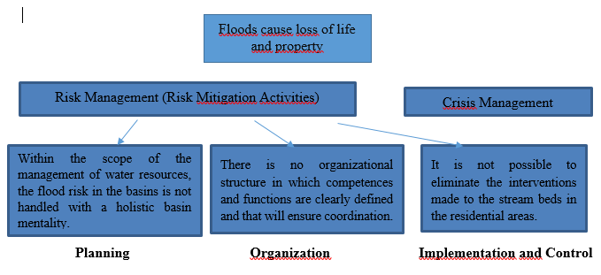
Audıt on Flood Risk Management
PROBLEM ANALYSİS

Slide 5
Audıt on Flood Risk Management
MATERIALITY
FLOODS-LOSSES

Slide 6
Audıt on Flood Risk Management
MATERIALITY
Flood, ranks second among all disasters and first among meteorological disasters in terms of loss of life and property in our country.
Considering the number of occurrences of floods over the years, the recent increase is remarkable. It is possible to see the same increase in the number of people affected by the flood and financial losses.
It is noteworthy that the financial losses in the floods that have occurred in recent years are high.

Slide 7
Audıt on Flood Risk Management
  Audit Questions
Question 1: Is the planning and organizational structure sufficient to reduce the flood risk?
Question 2: Are measures to reduce the risk of flooding implemented?

Slide 8
Audıt on Flood Risk Management
  Audit CRITERIAS
The Floods Directive (Directive 2007/60/EC)
NATIONAL REGULATIONs
Good practıce

Slide 9
Audıt on Flood Risk Management
  Audit Methodology
Interviews
Document review
Practıces of Other country
  Responsıble ınstıtutıons
Ministry of Agriculture and Forestry
General Directorate of State Hydraulic Works
Local governments
General Directorate of Forestry

Slide 10
Audıt on Flood Risk Management
    MAIN FINDINGS
Existing organizational structure and working systematic of flood risks at the basin level is not effective.
The boards and committees formed within the framework of the basin management model do not function effectively.
Flood risk is not taken into account sufficiently in the physical planning of residential areas.
The river beds are covered in a way that increases the risk of flooding.
There are interventions such as illegal structures and excavations that increase the risk of flooding in the stream beds.
Inappropriate bridges and culverts increase the risk of flooding in stream beds.

Slide 11
Audıt on Flood Risk Management
RECOMMENDATIONS
It should be ensured that the boards and committees formed within the framework of the basin management model work more effectively in flood management.
It should be ensured that the flood risk is taken into account in the planning of residential areas.
Any intervention that increases the risk of flooding in stream beds should be prevented.
Bridges and culverts should be constructed in a way that does not increase the risk of flooding.
Risks should be reduced by making improvements for structures at risk of flooding.

Slide 12
Audıt on PLASTIC waste management

Slide 13
Audıt on plastıc waste Management
ObjectIve
The objective of the audit is to evaluate whether the necessary measures have been taken for an effective plastic waste management by the responsible public administrations.
Scope
Legislation regulating waste management and packaging waste management,
The organizational structure consisting of institutions and organizations responsible for waste management,
The targets set by the institutions and organizations on plastic waste and the activities carried out to achieve them,
Data recording systems and monitoring studies were evaluated.
The audit covered the years 2017-2019.

Slide 14
Audıt on plastıc waste Management
MaterIalIty
United Nations Sustainable Development Goals 14-Life Below Water
There is an average of 13,000 pieces of plastic waste per square kilometer of ocean.
Worldwide, one million plastic beverage bottles are purchased every minute, and more than 5 trillion disposable plastic bags are used annually.
According to 2018 Statistics, 4,099,951 tons of plastic packaging were produced in Turkey.

Slide 15
Audıt on plastıc waste Management
AUDIT QUESTIONS
Basic Question: Have the responsible public administrations developed policy (plans and strategies) for plastic waste generation and management and implemented measures to achieve the objectives (adopted in this policy)?
Sub Question 1: Have policies, plans, strategies and legal arrangements been made that are specific to the management of plastic waste or are related to general waste management and include plastic waste as a type?
Sub Question 2: Have any policies (plans, strategies) been implemented by the ministries and municipalities for the proper implementation of plastic waste management and improving the efficiency of the use of existing materials and products (according to circular economy assumptions)?
Sub Question 3: Are the results of the measures implemented regarding plastic waste management monitored?
Sub Question 4: Have the measures taken by the competent authorities regarding plastic waste management been effective?

Slide 16
Audıt on plastıc waste Management
AUDIT CRITERIAS
European Waste Directive 2008/98/EC
Waste hierarchy,
Polluter pays,
Extended producer responsibility (EPR)
Waste separation at source
National Regulations

Slide 17
Audıt on plastıc waste Management
  Audit Methodology
Interviews
Document review
Data analysys
  Responsıble ınstıtutıons
Ministry of envıronment and urbanızatıon
Local governments

Slide 18
Audıt on plastıc waste Management
MAIN FINDINGS
Existing waste management systems could not provide sufficient financial resources for the recycling of packaging waste.
Especially the packaging wastes generated in the residences cannot be collected separately at a sufficient level.
Published statistics are not sufficient to monitor the level of separate collection of packaging waste at its source.
The recovery rate is calculated over the amount of packaging put on the market. Data on the total packaging waste generated in the country do not fully reflect the actual situation.
The targeted recycling rate for municipal waste in the National Waste Management Action Plan has not yet been reached.
According to 2018 data, approximately 20 percent of the waste produced in the country was disposed of in dumpsites. (It is the indicator determined for the target set within the scope of SDG-11)

Slide 19
Audıt on plastıc waste Management
RECOMMENDATIONS
In terms of preventing plastic waste, charging plastic bags is an important step. In addition, the implementation of economic tools and incentives to reduce the production and use of single-use plastic products will be beneficial in terms of reducing plastic waste.
Obligations under “extended producer responsibility” (EPR) should be reorganized to allow for a higher level of financing of recycling.
Municipalities should take the necessary measures to increase the recycling rate of packaging waste and carry out the controls in this regard effectively.
Economic tools such as a deposit system should be used to collect packaging wastes separately at the source.
Indicators that will allow the monitoring of the level of separate collection according to the source of the wastes should be determined and included in the published statistics.
In the published waste statistics, it is necessary to make explanations regarding the total amount of packaging produced.

Slide 20
Thanks for your attention…

