Slide 1
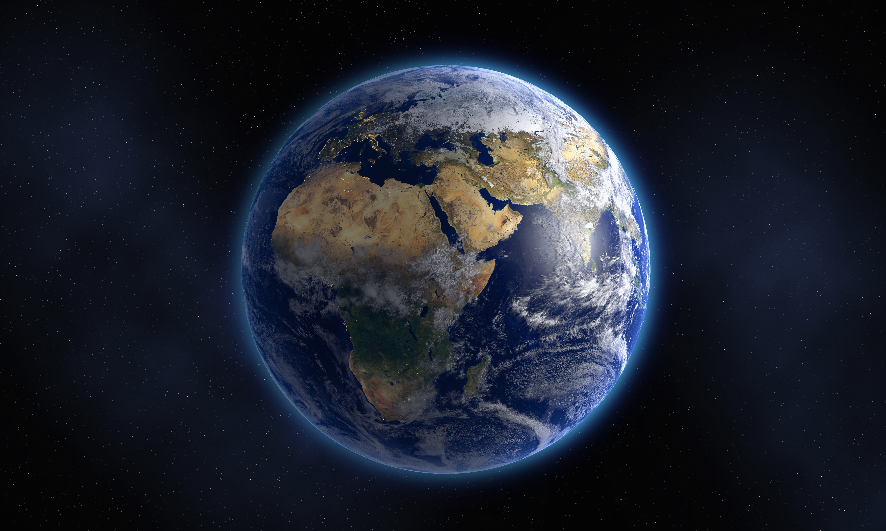
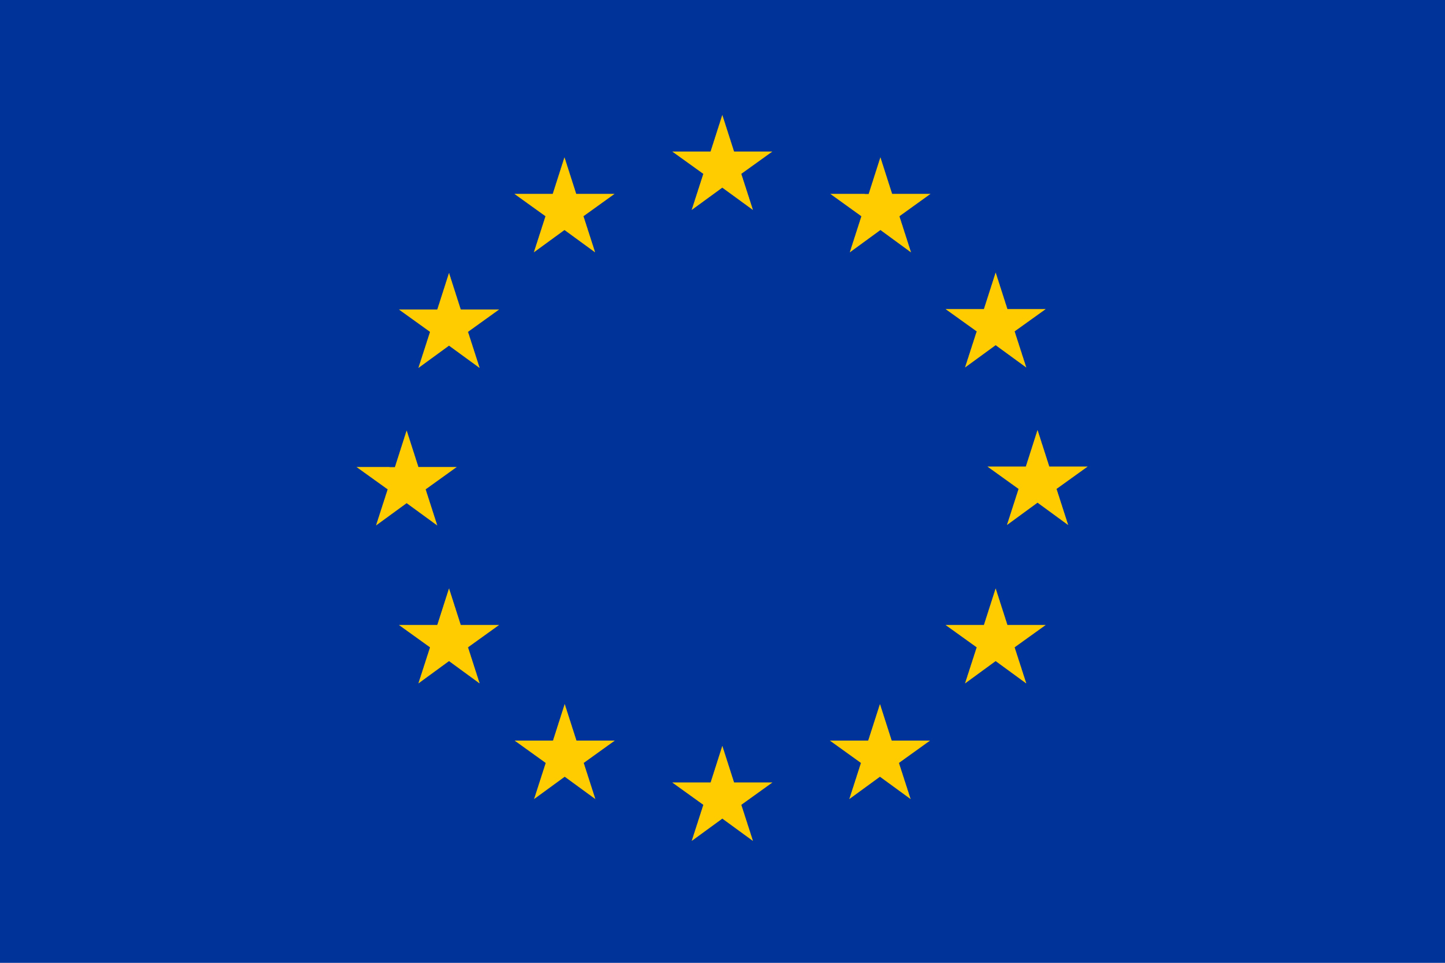

Making Peace with Nature
A scientific blueprint to tackle the climate, biodiversity and pollution emergencies
UNEP’s ‘Synthesis Report’
This project is co-funded by the European Union and the Norwegian Ministry for Climate and Environment
Notes:
It is a synthesis of findings from some 25 major global assessments, including IPCC, IPBES, GEO, GBO and IRP. It does not reassess these assessments – it faithfully represents their carefully crafted findings - but sometimes the synthesis includes additional literature to update or complement the picture.
The synthesis is prepared by more than 50 leading experts from nearly 30 countries familiar with the major assessments. The process has been extremely rapid and taken less than a year. It has not allowed for the involvement of neither Member States not stakeholders, but the synthesis is based on the work of thousands of experts and the many governments involved in the underlying assessments.
The report demonstrates that the messages across assessments are consistent, and that the environmental challenges have grown in number and severity ever since the 1972 Stockholm Conference the Human Environment. The conclusion in the report is that they now combine to an environmental emergency.
The report was launched by UNSG and UNEP ED in Feb 2021, and serves scientific basis for UNEA5 in 2021 and UNEP/Stockholm +50 in 2022.

Slide 2
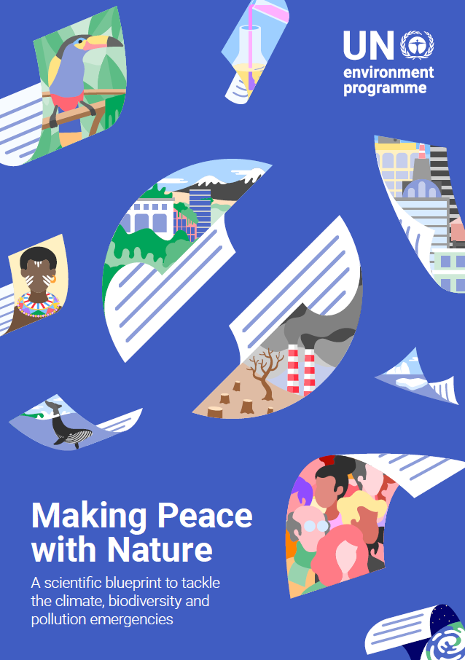
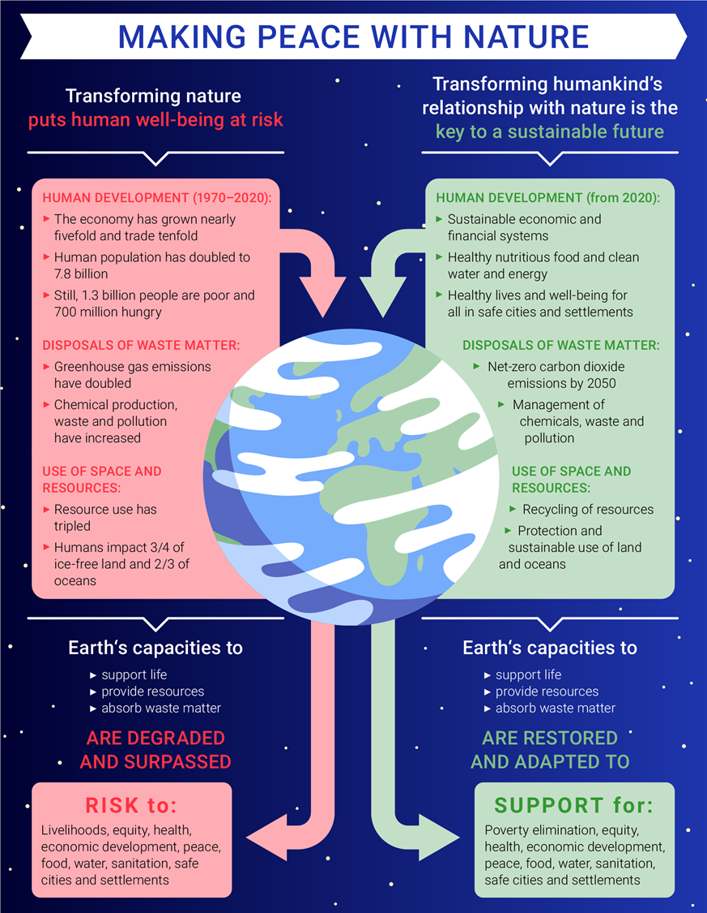
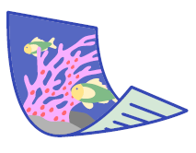



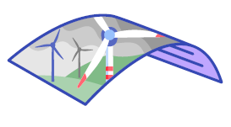
Notes:
On average prosperity has doubled, but about 1.3 billion people remain poor and some 700 million are hungry. These numbers have increased during the pandemic.
SHOW LIDE 2
Let me show you an infographic from the report. If we look at the left hand pink side of the infographic we see that over the last 50 years trade has grown tenfold, the global economy has grown nearly fivefold and the world population has doubled.
Rising Gross Domestic Product (GDP) overstates human progress because it does not account for declines in natural capital. A partial accounting for such capital, mostly natural resources, put the value of natural capital at 20 per cent of planetary wealth.
Inclusive wealth which also accounts for natural, human and social capital is a better measure of sustainable prosperity. Over a period of 25 years (from 1990 to 2014) the growth rate of natural wealth for a large set of countries (135) showed a progress which was nearly half of that of what GDP showed (1.8 per cent versus 3.4 per cent).
Today’s increasingly unequal and resource intensive development model degrades and surpasses Earth’s finite capacity to sustain human well-being.
We must restore this capacity and adapt to it as indicated in this infographic.
This is why the SG rightfully has called on the world to end the senseless and suicidal war and make peace with nature.
It can be done without surrendering hard won development gains while also honoring the rightful aspirations of poorer nations and people to enjoy better living standards.
That means transforming human relation with nature. The challenge is systemic and the coming decade is crucial.

Slide 3
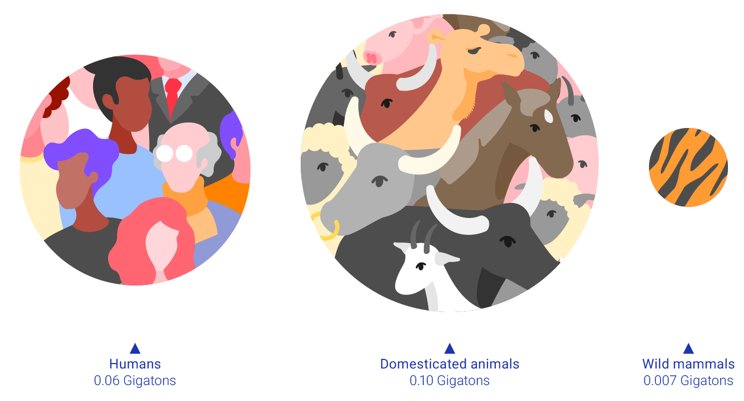
Humans now have a major impact on the Earth
Of the combined biomass of mammals on Earth, human population now constitutes about a third and livestock nearly two thirds, while wild mammals now amount to less than 5 per cent
Notes:
Well let me show you a few slides that illustrate the scale of human impact on the world
first of all the Earth is no longer vast. Humans now dominate the Earth as seen on this slide.
Of the combined biomass of mammals on Earth, human population constitutes about a third and livestock nearly two thirds, while wild mammals from mice to whales amount to less than 5 per cent.

Slide 4
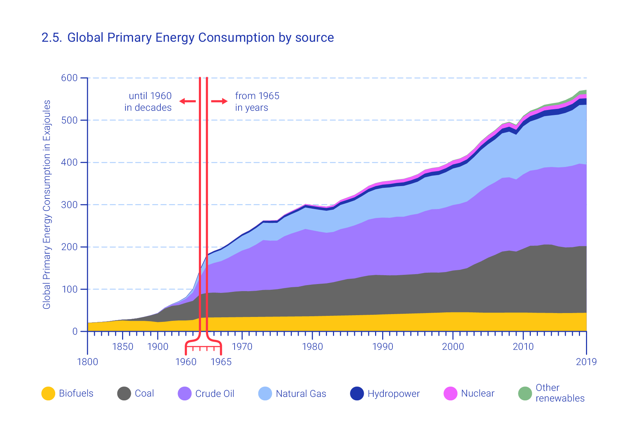
Extraction of natural resources and production of energy has tripled the past 50 years
Notes:
Human development is largely fueled by a tripling in the extraction of natural resources and energy over the past 50 years. The economy has grown more, and some of that is due to increased efficiency., but we are far from a decoupling of the economy from environmental degradation.
This figure shows that growth in global primary energy consumption is largely attributed to the growth in fossil fuels, such as coal in shown in black, oil in purple and gas shown in blue.
About two thirds of the warming caused by greenhouse gases is due to carbon dioxide, mostly originating from the use of fossil fuels. The consumption of bioenergy is at the level of pre-industrial time. Above fossil fuels are hydropower in blue and nuclear power in pink and the thin green line is other renewables.
The figure illustrates the scale of human dependence on fossil fuels, and it serves to illustrate why halting global warming is such a tall order.

Slide 5
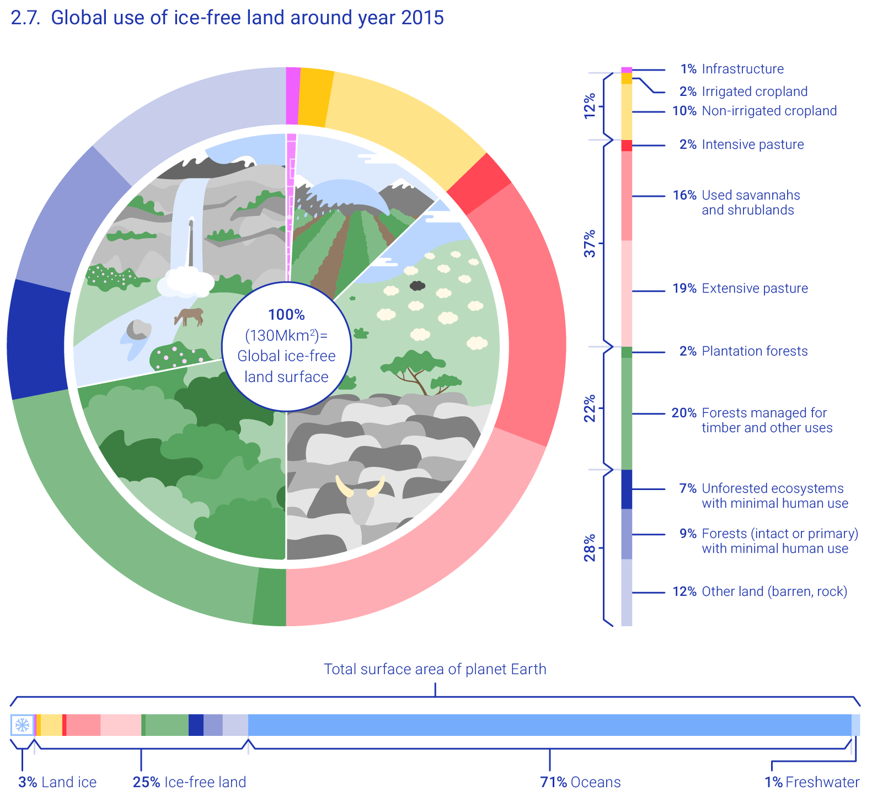
Humanity has a major impact on 3/4 of land and on 2/3 of oceans
1/4 of global warming results from activities related to land-use
1/4 land has been radically transformed
Remaining near-natural land is projected to be only 10 per cent by 2050
Notes:
Three quarters of the land and two thirds of the oceans are now impacted by humans.
1/4 of global warming results from activities related to land-use
This figure shows global use of ice-free land and is adapted from the IPCC.
1/4 land has been radically transformed to cropland, plantations and other human uses.
Remaining near-natural land is projected to be only 10 per cent by 2050.

Slide 6
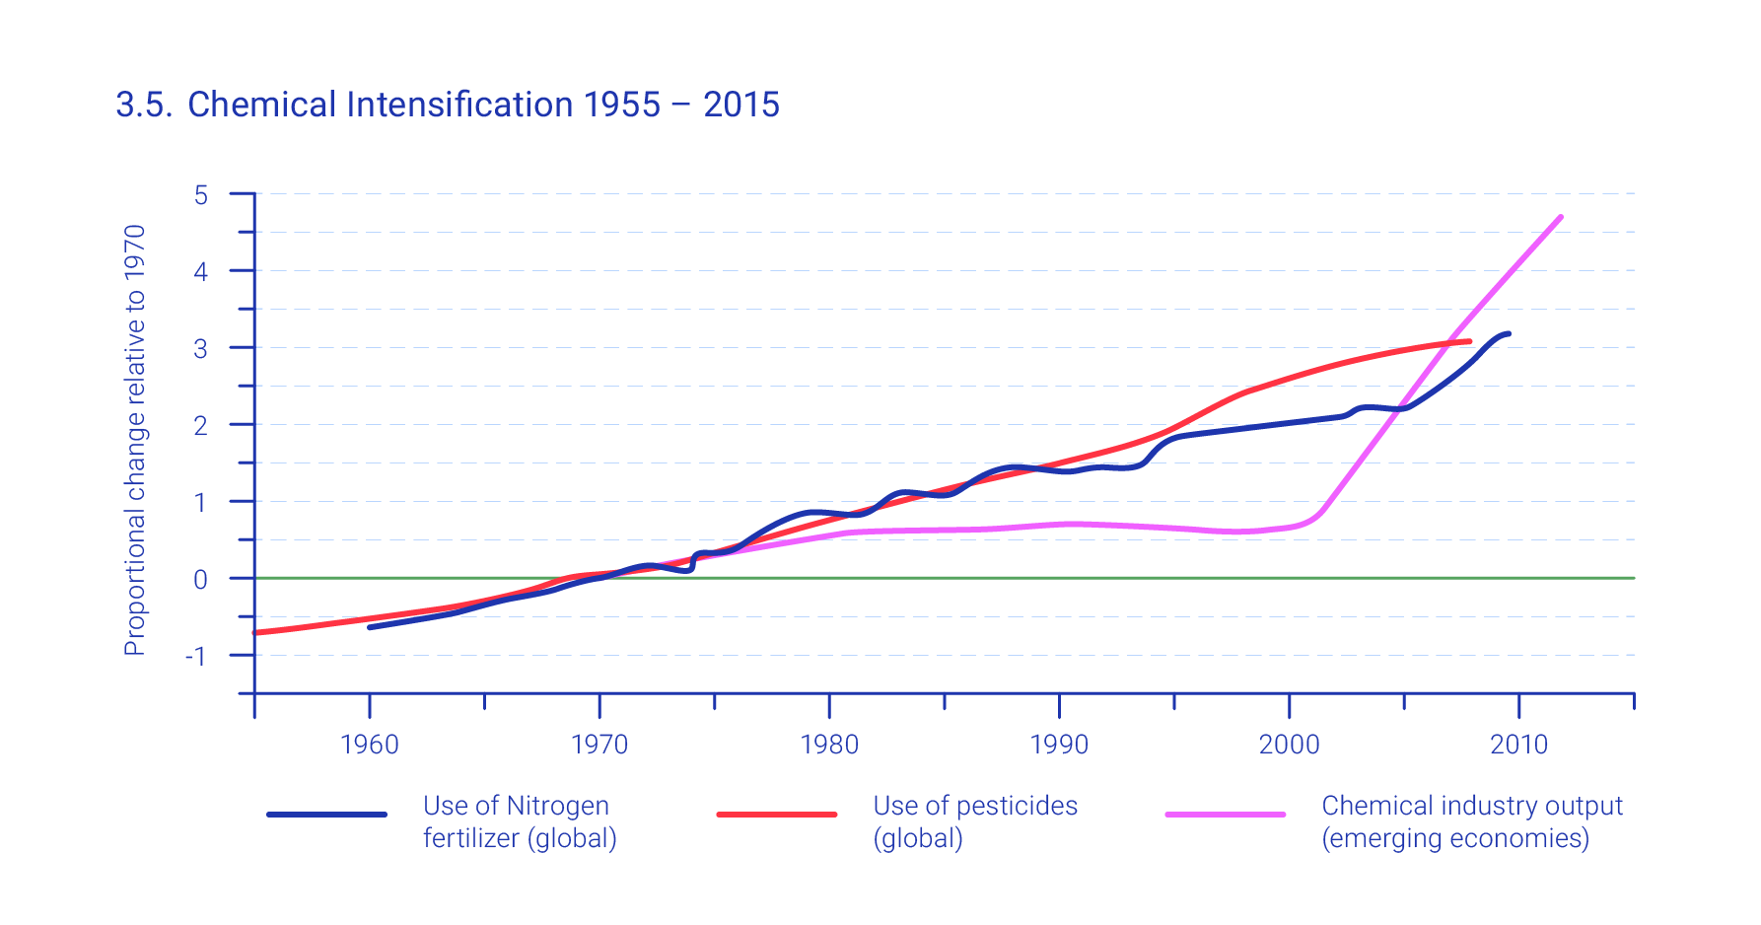
The production and release of chemicals is increasing fast
Some of these chemicals threaten human health and the environment
Notes:
The need to address pollution and waste was a key motivation for the Stockholm conference. It is still with us.
If we look at the production and release of chemicals we see that it is increasing as indicated in this graph adapted from GEO-6.
It shows the use of Nitrogen fertilizer in blue,
Fertilizers entering coastal ecosystems have produced more than 400 “dead zones,” totalling an area greater than that of the United Kingdom or Ecuador.
The graf also shows pesticide use in red and chemical industry output in purple.
Some of these chemicals threaten human health and the environment. Marine plastics pollution has for instance increased tenfold since 1980.

Slide 7
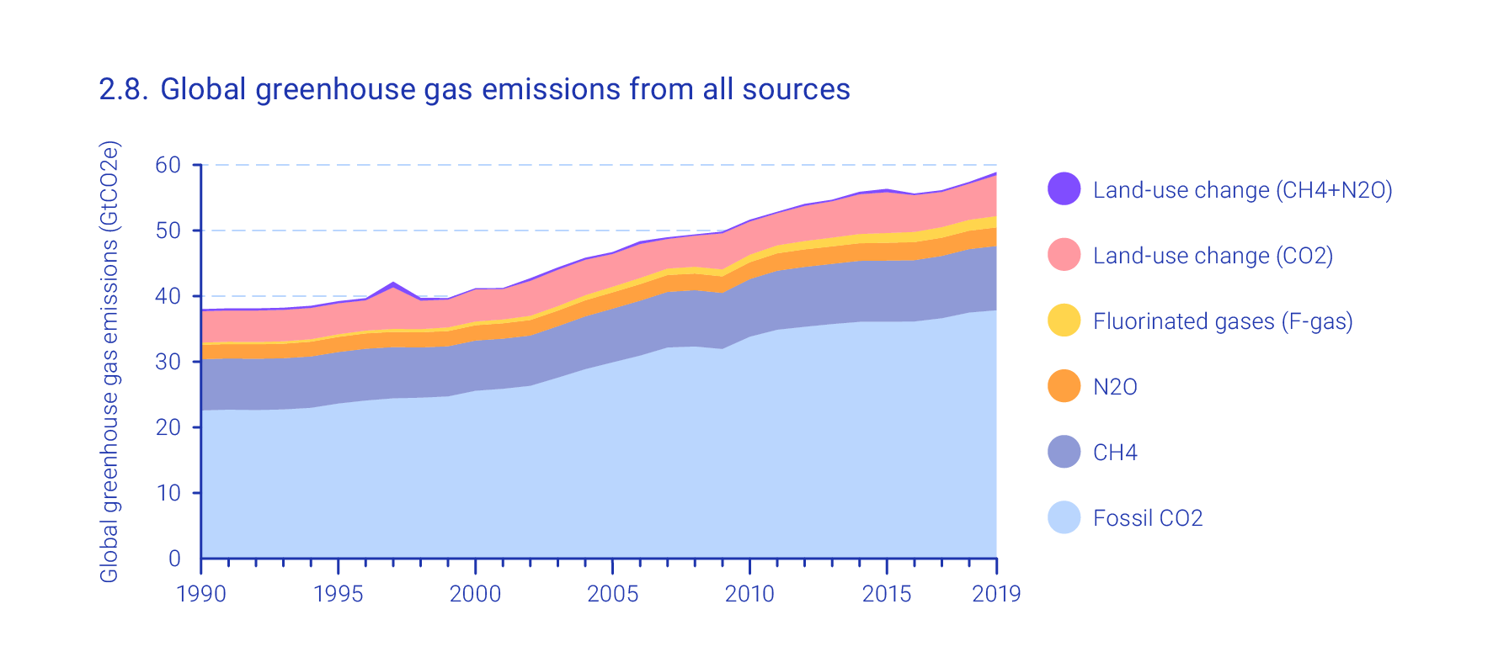
Human Emissions of Greenhouse Gases Continue to Increase
The world is already more than 1ºC warmer than a century ago, accelerating sea level rise, with more frequent and intense extreme events, threatening people and nature
Notes:
The scale of change is now really rapid and in some instances accelerating.
Emissions of greenhouse gases are still increasing as shown in this figure. In fact they have doubled over the last 50 years. Natural sinks today are only able to absorb around half of anthropogenic carbon dioxide emissions, split between terrestrial ecosystems and the ocean. Current atmospheric concentrations are much higher than at any time in the past 800,000 years.
The Earth’s mean near-surface temperature has already risen by more than 1ºC compared to the period from 1850 to 1900.
This warming has already led to shifts in climate zones, changes in precipitation patterns, melting of ice sheets and glaciers, accelerating sea level rise and more frequent and more intense extreme events, threatening people and nature.

Slide 8
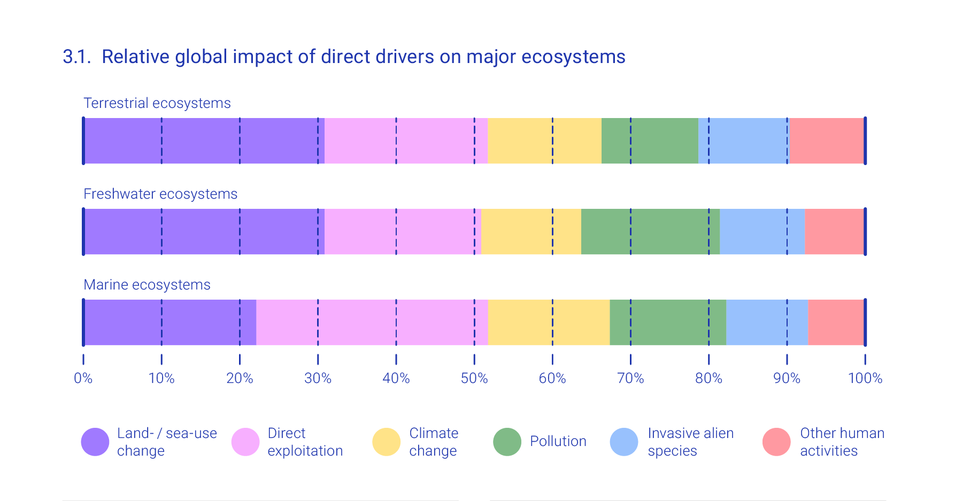
Biodiversity continues to decline at an alarming and accelerating rate
1 million of the world's estimated 8 million plants and animals species are threatened with extinction - population sizes and abundance are dropping - ecosystems are being degraded - ecosystem services are eroding
.
Notes:
We share the Earth with many other forms of life, and we have certainly passed their capacity to sustain our impacts.
Biodiversity continues to decline at an alarming and accelerating rate.
This figure adapted from IPBES looks at the causes of biodiversity loss in terrestrial, freshwater and marine ecosystems.
The most important cause of loss is that we displace other life forms through use of land and seas. If we do not displace them we eat them or exploit them in other ways. That actually constitutes the largest threat in marine ecosystems..
Climate change is the third most important cause, but it is estimated to become even more significant. It is followed by pollution, invasive species and other activities.
One million of the world's estimated 8 million species of plants and animals are threatened with extinction.
The population sizes of wild vertebrates have dropped on average by nearly 70 per cent in the last 50 years, and the abundance of many wild insect species has fallen by more than half.
Ecosystems are being transformed and degraded. Wetlands the most. Only 15 per cent of wetlands remain.
Half of warm water Coral reefs have disappeared, and may be reduced to less than 1 per cent of their former cover at at 2°C of warming.
The number of local varieties of domesticated plants and animal breeds and their wild relatives has been reduced sharply
Many of the ecosystem services essential for human well-being are eroding.
.

Slide 9
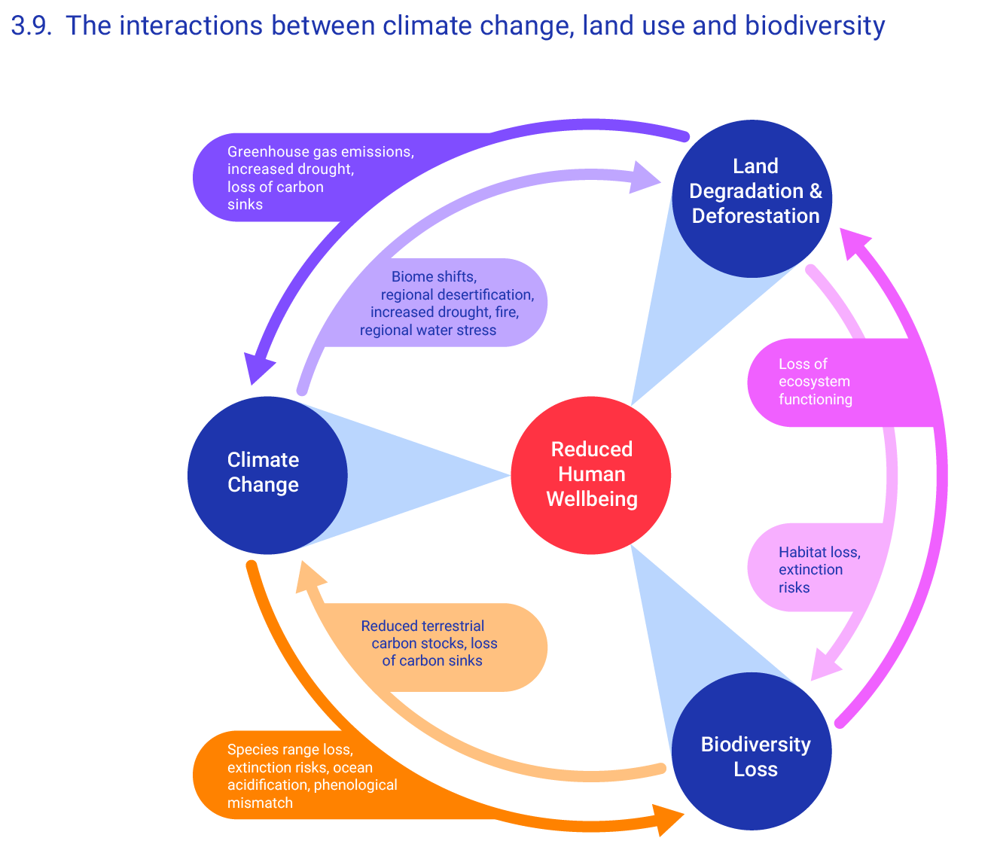
The environmental emergencies are intertwined
Earth’s environmental emergencies and development challenges should be addressed together to achieve sustainability
International environmental agreements need to be aligned and become more mutually supportive
Notes:
Add to that that the environmental emergencies are intertwined as indicated in this figure.
So are the environmental emergencies and development challenges.
They reinforce each other and are caused by the same underlying drivers and should be addressed together to achieve sustainability
International environmental agreements need to be aligned and become more mutually supportive

Slide 10
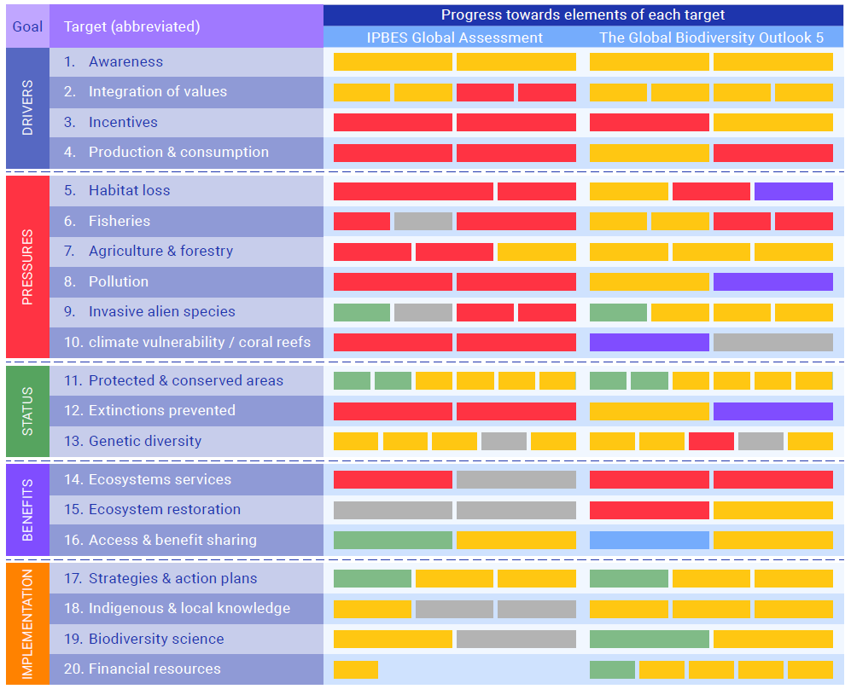
We are going beyond limits agreed in international agreements
Society is not on course to fulfil the Paris Agreement to limit global warming to well below 2°C above pre-industrial levels and to pursue efforts to further limit the temperature increase to 1.5ºC
None of the Aichi Targets have been fully met
Notes:
Well the international community has agreed on these limits by setting environmental targets, informed by science.
Despite some progress, efforts to meet the targets have largely failed.
Society is not on course to fulfil the Paris Agreement to limit global warming to well below 2°C.
At the current rate, warming will reach 1.5°C by around 2040 and possibly earlier. Taken together, current national policies to reduce greenhouse gas emissions put the world on a pathway to warming of at least 3ºC by 2100, but this may change with renewed pledges.
Two independent analyses, the CBD’s (Convention for Biological Diversity) GBO-5 (the Fifth Global Biodiversity Outlook) and IPBES Global Assessment, both show that none of the Aichi Biodiversity Targets have been fully met.
The world have made progress on some elements shown in green and blue, but progress in most elements are insufficient or lacking as shown in yellow and red and in some cases going backwards as shown in purple.
These agreed international goals are regularly updated as they expire as is the case for the Aichi targets. But they also may need to be updated as new knowledge emerge and this why the world in the the Paris agreement to pursue efforts to further limit the temperature increase to 1.5ºC.

Slide 11
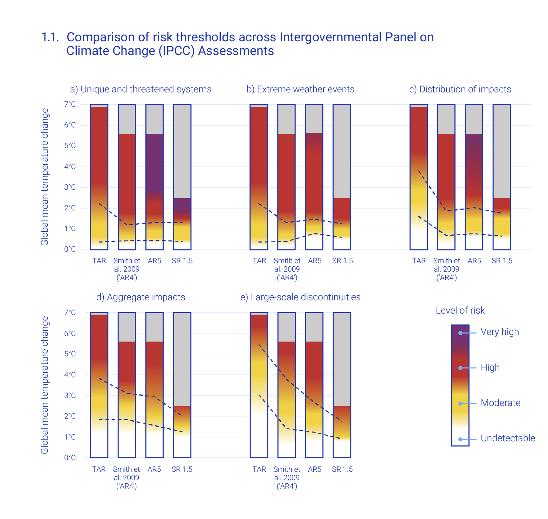
Risks of climate change are more severe than previously thought
And are occurring with smaller changes in temperature
Risks associated with climate change
Notes:
Here is why we should not listen to the people who would like to live in a warmer climate.
This burning embers diagram show assessed risks associated with climate change. Risks increase from yellow via red to purple.
Each of the five panels cover different natural and human systems. A covers unique and threatened natural and human systems – b) extreme weather events – c) vulnerability of developing countries – d) aggregate ecological and economic impacts – e) large scale change such as changes in ocean currents.
The bars in each panel indicates the four latest IPCC reports with the oldest on the left hand side and the most recent to the right.
The dotted lines show how risks of climate change are considered more severe now than previously thought some 20 years ago
Risks are occurring with smaller changes in temperature than previously thought
Climate change together with other factors poses a significant risk to nature and people.

Slide 12
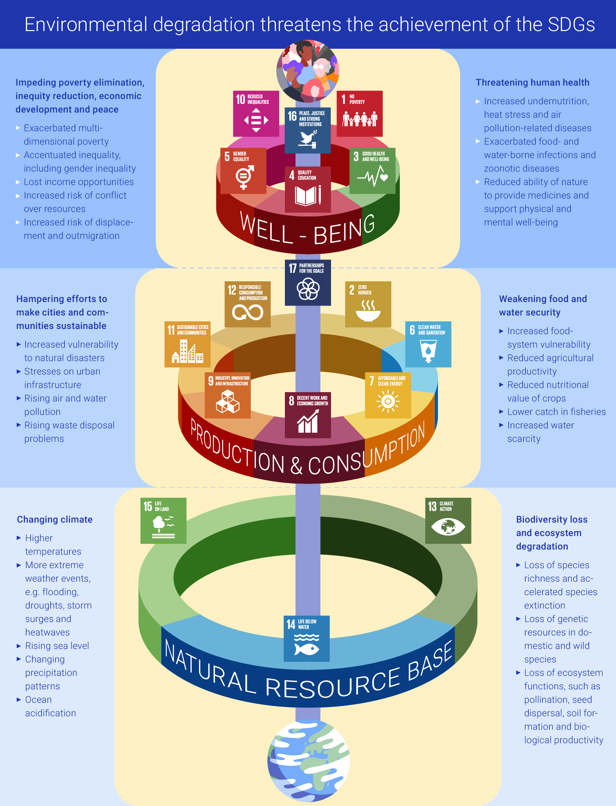
Environmental degradation threatens the achievement of the SDGs
In 2018, damages from climate-related natural disasters cost about $155 billion
Worldwide, 3.2 billion people are adversely affected by land degradation
Pollution causes about 9 million premature deaths annually, primarily from indoor and outdoor air pollution
Notes:
Environmental degradation threatens the achievement of the SDGs. Indeed Human well-being goals in the upper ring rests on production and consumption goals in the middle ring which in turn is based the goals related to nature. This version of the diagram sometimes referred to as the wedding cake is adapted from GEO.
Environmental changes are undermining hard-won development gains by causing economic costs and millions of premature deaths annually. It is impeding progress towards ending poverty and hunger, reducing inequalities and promoting sustainable economic growth, work for all and peaceful and inclusive societies.
In 2018, damages from climate-related natural disasters cost about $155 billion.
An eroding web of life means trouble. Worldwide, 3.2 billion people are adversely affected by land degradation. The loss of animal pollinators, critical to more than 75 per cent of food crops, including many fruit and vegetables and cash crops such as coffee, cocoa and almonds, threatens annual global crop output worth between $235 billion and $577 billion.
Pollution causes about 9 million premature deaths annually, primarily from indoor and outdoor air pollution.
The burden of environmental decline ways heaviest on the poor and vulnerable and looms even larger over today’s young and future generations. The more we delay action the more it will take those coming after us to solve the problem.

Slide 13
Transforming humankind's relation with nature is the key to a sustainable future
Human knowledge, ingenuity, technology and cooperation can transform societies and economies and secure a sustainable future
This transformation will involve a fundamental change in the technological, economic and social organization of society, including world-views, norms, values and governance
Major shifts in investment and regulation are key to just and informed transformations that overcome inertia and opposition from vested interests
Notes:
Environment is about the economy, well-being, health and jobs. It is the foundation as you showed in the wedding cake diagram.
We are struggling to achieve the SDGs because we have failed to address the root causes of the problems. We need to turn our attention to transforming humankind's relation with nature. That is the key to a sustainable future.
Human knowledge, ingenuity, technology and cooperation can transform societies and economies and secure a sustainable future
This transformation will involve a fundamental change in the technological, economic and social organization of society, including world-views, norms, values and governance
Major shifts in investment and regulation are key to just and informed transformations that overcome inertia and opposition from vested interests. The vested interests are often legitimate but there are ways of tackling them through long term objectives, regulations and financial instruments.
We have to start by ensuring that Earth’s environmental emergencies are addressed together to achieve sustainability.

Slide 14
Notes:
We must start by focusing on restoring the Earths capacity to sustain human well being and adapt to it as indicated in the right hand green side of the infographic.
Transformed economic, financial and productive systems can lead and power the shift to sustainability
Society needs to include natural capital in decision-making, eliminate environmentally harmful subsidies and invest in the transition to a sustainable future.
Increasingly, subsidies are calculated by including the environmental costs to society and that also shows why the economic and financial system need to be transformed and how.
Biodiversity, climate and other environmental finance could be ramped up by redirecting some of the values and costs associated with subsidies to fossil fuels, agriculture, fisheries and transport which exceeds $5 trillion per year – [fossil fuels ($4.7 trillion per year) and agriculture ($600 billion per year)].
The food, water and energy systems can and should be transformed to meet growing human needs.
Keeping the planet healthy is key to providing healthy communities and well-being for all.

Slide 15
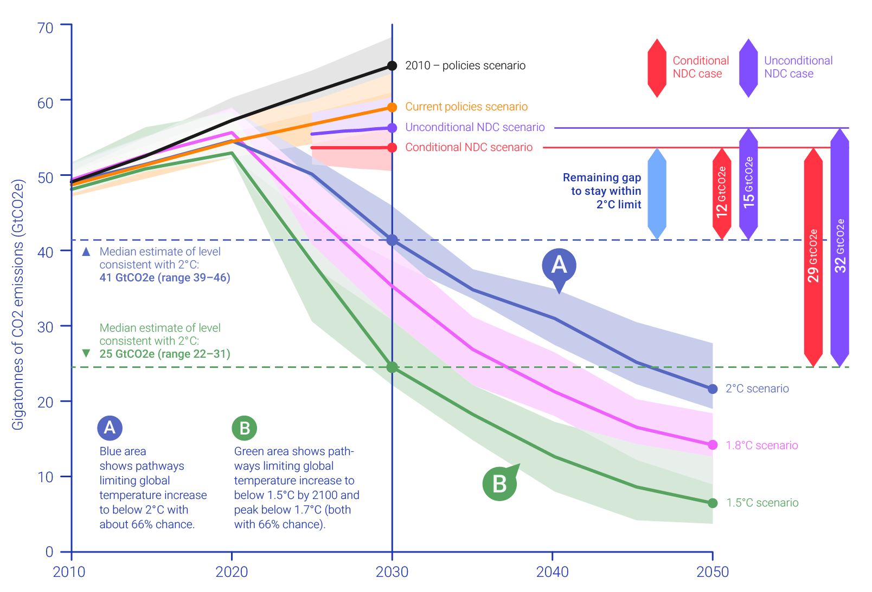
Closing the Greenhouse Gas Emissions Gap
CO₂ emissions need to be:
reduced by 45% by 2030 and
net zero by 2050
to limit global warming to 1.5ºC – and
decline by 25% by 2030 and
reach net zero by around 2070
to limit warming to 2ºC
Notes:
First of all we need to Close the Greenhouse Gas Emissions Gap
To limit global warming to 1.5ºC, with a probability of about 50 per cent, net emissions of carbon dioxide will need to be reduced by 45 per cent by 2030 compared to 2010 levels and reach zero by 2050.
To limit global warming to 2ºC, emissions need to decline by about 25 per cent by 2030 compared to 2010 levels and reach net zero by around 2070. The emissions of other greenhouse gases must also be reduced.
More ambitious reductions would be necessary for higher certainty in limiting dangerous climate change as indicated in the emission gaps presented in this figure adapted from UNEPs Emission gap report., It shows pathways with about 66 per cent chance of limiting global warming to 1.5ºC and 2ºC.

Slide 16
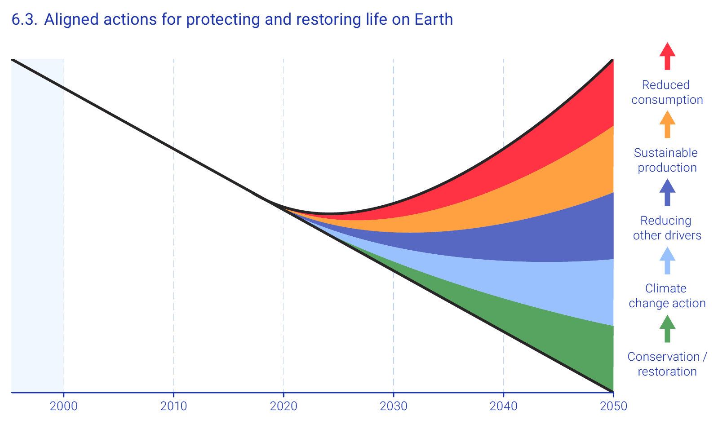
Aligned actions for protecting and restoring life on Earth
The loss of biodiversity can only be halted and reversed by providing space dedicated for nature while also addressing drivers such as:
changing land and sea use,
over-exploitation,
climate change,
pollution and
invasive alien species
Notes:
The loss of biodiversity can only be halted and reversed by providing space dedicated for nature such as through an expanded and better-managed global network of inter-connected protected areas designed to be resilient to climate change.
Protected areas now cover more than 14 per cent of land, and almost 6 per cent of the ocean.
One can only bend the curve by addressing drivers such as climate change, changing land and sea use, over-exploitation, pollution and invasive alien species achieve, sustainable production and reduce consumption as this figure adapted from the global biodiversity outlook shows.
Nature-based solutions, have been estimated to provide between 35 per cent and 40 per cent of the mitigation effort needed until 2030 to limit warming to 2ºC.

Slide 17
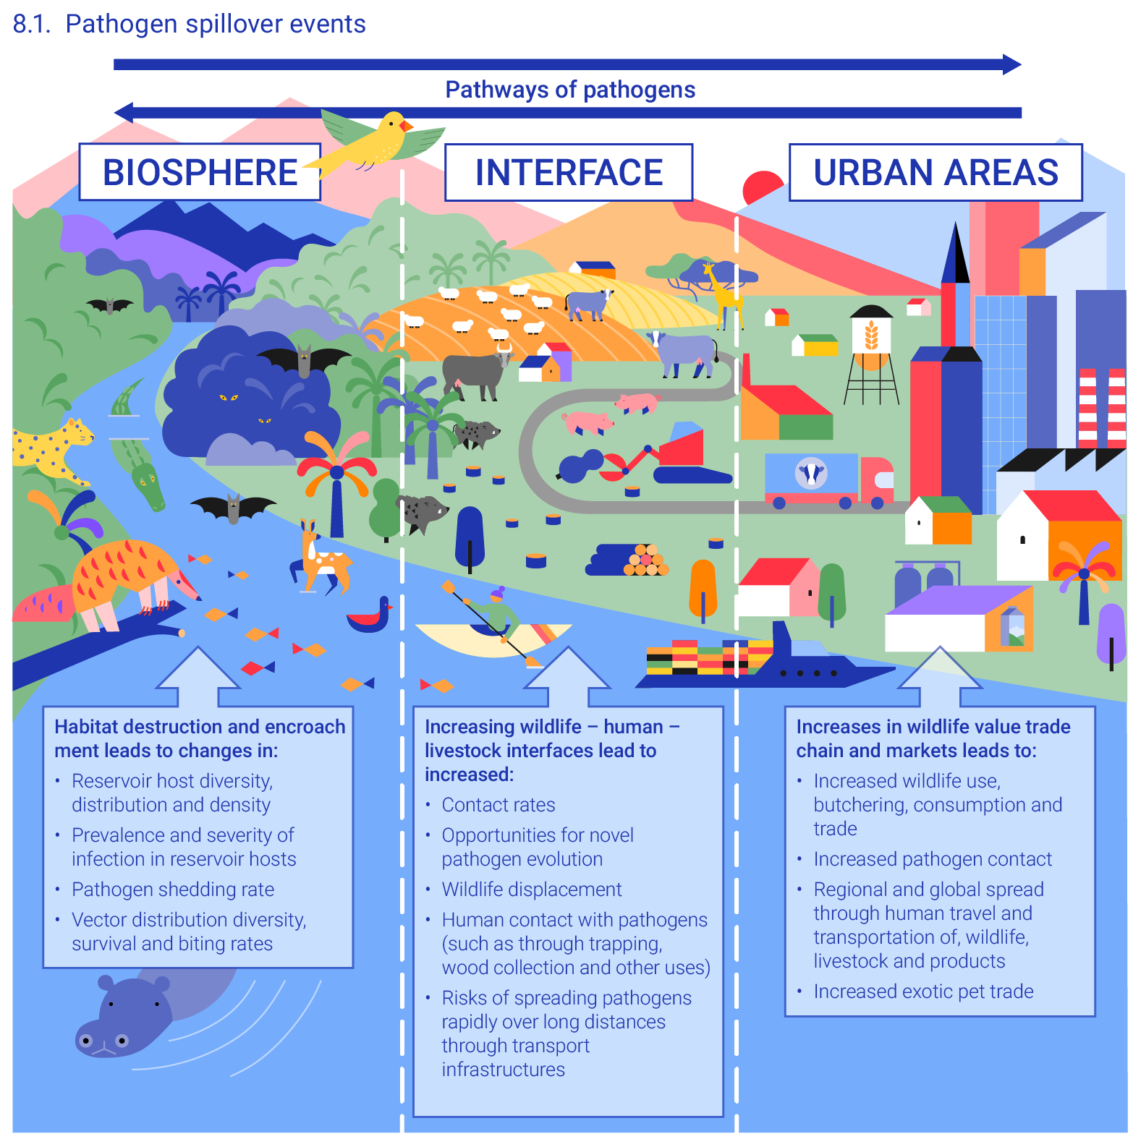
Zoonotic Diseases
About 75% of all new infectious diseases have their origin in animals
700,000 potential viruses in animals and birds could pose a threat to human health
The risks of future zoonotic pandemics could be reduced by managing human activities and applying a holistic one-health approach
Notes:
About 75% of all new infectious diseases have their origin in animals
700,000 potential viruses in animals and birds could pose a threat to human health
The risks of future zoonotic pandemics could be reduced by managing human activities and applying a holistic one-health approach
The COVID-19 crisis provides an impetus to accelerate transformative change.
The pandemic and the ensuing economic upheaval have shown the dangers of ecosystem degradation, as well as the need for international cooperation and greater social and economic resilience.
The crisis has had major economic costs and is triggering significant investments. Ensuring that these investments support transformative change is key to attaining sustainability.

Slide 18







Role of actors
1. Address Earth’s environmental emergencies and human well-being together
2. Transform economic and financial systems so they lead and power the shift toward sustainability
3. Transform food, water and energy systems to meet growing human needs in an equitable, resilient and environmentally friendly manner
B: Intergovernmental Organizations facilitate joint efforts
C: Financial Organizations direct investments
D: Private sector innovates and implements
G: Scientific and Educational Organization develops knowledge and understanding
E: Non-Governmental Organizations (NGOs) conceive ideas and raise awareness
A: Governments at all levels hold a leading role
F: Individuals, households, civil society and youth groups, and indigenous peoples and local communities) put theory into practice
Notes:
That is certainly a key question. First thing is that we need to sign up for common vision and we need to ensure everyone that all actors have a part to play.
The report identifies a number of actions that each actor can take. We do not have time to go into all of that here and now but, in general:
Governments hold a leading role in the economic and regulatory system.
International organizations facilitate joint efforts
Financial organizations direct investments
Private sector innovates and implements
Non-government organizations conceive ideas and raise awareness
Individuals, households, civil society, and indigenous peoples can put theory into practice
Scientific and Educational Organization helps improve our knowledge and understanding – this report is a point in case

Slide 19
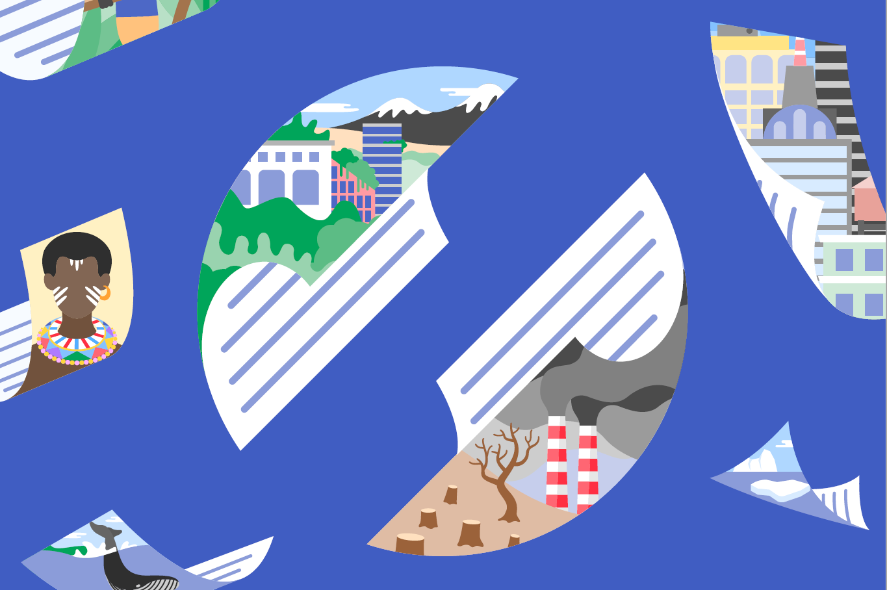
#PeacewithNature
Information, resources and contacts: https://www.unep.org/resources/making-peace-nature
This project is co-funded by the European Union and the Norwegian Ministry for Climate and Environment
Notes:
The report and further resources are available through this web-link.
Thank you!

