Slide 1
Country Paper on Environmental Audit of Depletion of underground Water Resources in Quetta for
The 9th asosai Seminar on Environmental Auditing (August 23-25, 2023)
Kazakhstan by
Muhammad Raza Shah, Director General
Office of the Auditor General of Pakistan

Slide 2
Background
Pakistan has moved from water-stressed to water scarce country in last few years.
The country is facing unprecedented water shortage; owing to climate change and poor water management resulting in exploitation of water at a rate faster than it is replenished.
Balochistan province of Pakistan is the most water scarce province of the country.
Inefficient water use, wastage of surface water and indiscriminate extraction of groundwater resources coupled with water scarcity have aggravated the current situation making management of water resources and drinking water safety a really complex and a difficult task in the province.
The Balochistan Province has 33 districts and the provincial headquarters Quetta is one of them. It is located at an average elevation of l,680 m above sea level and is surrounded by the barren mountain ranges Chiltan, Murdar and Zarghoon.

Slide 3
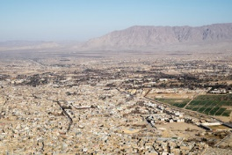
Ariel view of Quetta city

Slide 4
Background
Due to population increase and climatic changes, the scarcity of water in Quetta has grown up as a major issue.
The water supply shortage becomes acute during the period of low rainfall.
The groundwater is the only source to fulfill the requirement for domestic, industrial and agriculture purpose.
The indiscriminate installation of tubewells has been instrumental in extracting a huge quantity of water round the clock.
Due to these tubewells, the rural area of Quetta district is facing a serious problem of water scarcity and drinking water.
Lack of underground water has resulted in the drying up of Hana Lake and appearance of sink holes.

Slide 5
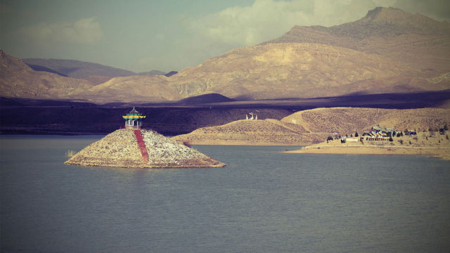
Hana Lake (old view)

Slide 6
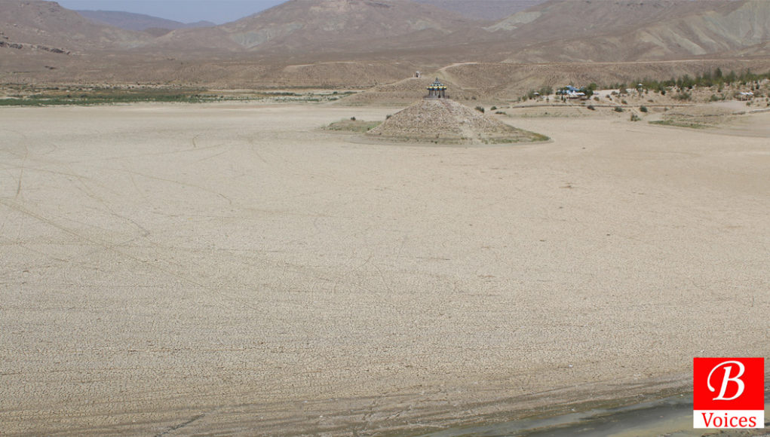
Hana Lake (dried up)

Slide 7
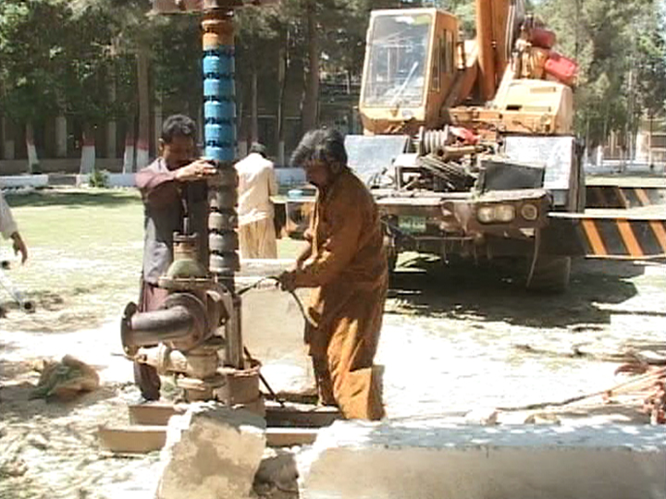
Tube well for ground water extraction

Slide 8
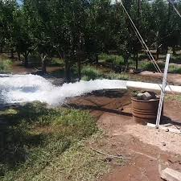
Tube well extracting ground water

Slide 9
Introduction
The Balochistan Ground Water Rights Administration Ordinance 1978 was promulgated by the Governor of Balochistan on 21st March 1978.
The Provincial Water Board was established and Director (Ground Water Development), Irrigation Department was nominated as Secretary to the Board.
A separate Directorate of Water Resources Planning Development & Monitoring was also established under the control of Secretary, Irrigation Department Govt. of Balochistan.
The main responsibility to formulate and implement Act, ordinance, rules & regulations, coordination, monitoring mechanism and policies rests upon:
  Irrigation Department
  Water and Sanitation Authority
  Public Health Engineering Department
  Environment Protection Department

Slide 10
Introduction
It was with this background that the DAGP assessed the auditability of water safety related issues and accordingly selected the topic of depletion of underground water in Quetta
The purpose was to examine the issue from all possible angles and report findings as well as recommendations to the policy makers and stakeholders.

Slide 11
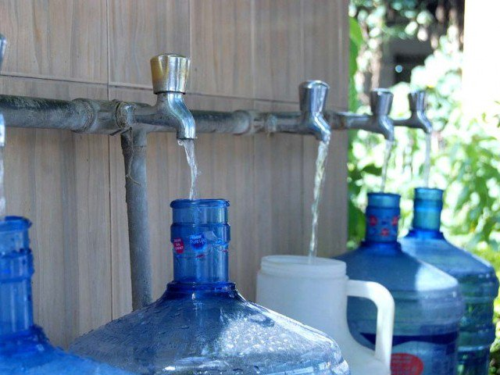
Drinking Water scarcity

Slide 12
Audit Objective
The overall objective of the environment audit was to examine and evaluate the main causes of depletion of underground water resources in Quetta and policy initiatives undertaken to overcome the issue of water availability for drinking and other purposes.
Besides, the aim was also to assess and analyze the implementation status of the applicable rules / regulations and policy interventions meant for water safety in the Quetta region.

Slide 13
Audit Scope And Methodology
The scope of audit extended to examining the activities carried out by a number of relevant departments and agencies of Government of the Balochistan including Provincial Irrigation Department(PID), Provincial Public Health Department (PHED), Quetta Water and Sanitation Authority (QWSA), Forest and Wildlife Department (F&WD), Agriculture Department and Environment Protection Agency (EPA).
The audit was conducted in accordance with guidelines of the International Standards of Supreme Audit Institutions (ISSAIs) adopted by the Auditor General of Pakistan.
The evidence was primarily gathered by applying procedures like inquiries from the management; survey questionnaires, review of documents and reports and interpretation and analysis of primary and secondary data. Data was also collected through observation and structured and unstructured interviews from the relevant officials.

Slide 14
Audit Scope And Methodology
Major documents which were reviewed included Balochistan Ground Water Rights Administration Ordinance, 1978, Quetta Water and Sanitation Authority Act, 2004, Balochistan Ground Water Rights Administration Rules, 2015, Balochistan Rules of Business 2012 (amended 2012 and other SOPs and guidelines issued by the concerned departments.

Slide 15
Audit Results and Key Findings
The key audit findings in the report are summarized as under:
Non-availability of sufficient natural reservoirs and dams for conservation of surface water compromising drinking water as well as overall water safety in the Quetta region.
Non-identification of water rechargeable areas for underground water and non-initiation of schemes for refilling / recharge of aquifer.
Non-determination of safe yield and non-maintenance of water account extracted from ground water.
Non-maintenance of record related to registration and approval of devices used for water extraction by Provincial Water Board and District Water Committees.
Illegal and unchecked operation of tube wells extracting ground water.

Slide 16
Audit Results and Key Findings
Non-up-gradation of monitoring system for effective use of underground water resources.
Non-formulation of policy and lack of campaign to educate general public on depletion of water resources in Quetta and raising awareness on water conservation issues.
Non-conducting study / research on identification and plantation of low water taking crops.
Non-adoption of new / updated methods of irrigation system for economical and efficient use of water resource.
Non-availability of record / data pertaining to deforestation and its impact on water resources.

Slide 17
Audit Results and Key Findings
Non-conducting study / research on the issue of depletion of water resources and its environmental impact.
Non-conducting study / research regarding impact of forestation on global warming and climate change and it impact on water resources.
Lack of effective coordination among the relevant departments dealing with cross cutting issues related to water resources.
Non-conducting of Provincial Water Board Meetings on regular basis resulting in absence of effective oversight by the forum.
Non-development of policy on urbanization in District Quetta.

Slide 18
Recommendations
Recommendations included in the audit report highlighted actions expected to improve the management and overall governance of water safety in Quetta region.
Based on findings contained in the audit report, the following major recommendations were placed before the management of the audited entities and policy makers:
  Rechargeable areas / points should be identified on scientific basis and innovative methods of underground water recharge should be employed.
  PSDP and ADP projects should be formulated for refilling / recharge of aquifer and a proper mechanism be developed to monitor the ground and surface water.
  On the basis of scientific studies and best international practices a comprehensive system should be devised to monitor the ground water resources on Quetta sub-basin.

Slide 19
Recommendations
Proper policy and mechanism should be developed for waste water treatment system and segregation of waste water to be recycled for further utilization.
A comprehensive Policy should be prepared at Provincial / District level and awareness campaigns should be instituted to educate general public about depletion of water resources and methods through which consumption of water could be controlled / minimized.
Mechanism should be devised for proper coordination among the concerned departments keeping in view the cross cutting nature of the issue of water resources.
There is a need to formulate a procedure to maintain water account of ground, surface and waste water.

Slide 20
Recommendations
Dams should be constructed on the basis of comprehensive plan to store surface water that can be utilized for drinking, recharge and irrigation purposes.
Provincial Water Board should take necessary actions to convene regular meetings, besides follow up of actions / decisions taken in the previous meetings.
Steps should be taken for determination of safe yield in respect of each basin beyond which the District Water Committee will not be authorized to issue further permits. Besides, taking appropriate steps to identify water rechargeable areas for each basin. Further, mechanism should be devised to monitor the underground level of water and same should be communicated to the relevant authorities for remedial measures.

Slide 21
Recommendations
Mechanism should be devised regarding installation of water meters at each device extracting ground / surface / waste water, besides installation of water meter at end point to stop the pilferage of water through any illegal means.
There should be digital database available at PWB and DWC containing information regarding registered and unregistered devices used for extraction of underground water.
Urbanization policy should be formulated in consultation with experts keeping in view the scarcity of water resources.
A comprehensive innovative method of irrigation system should be adopted and crops taking low water should be introduced to save water without affecting economic activities based on agrarian economy.

Slide 22
Way Forward
Keeping in view the sensitivity of the issue, it is important that the policy makers and implementation agencies may take concrete steps in a timely manner to resolve the issue of depletion of water resources and scarcity of drinking water through effective implementation of policies, monitoring of ground water and building reservoirs, otherwise the issues will be further complicated leading to non-availability of water for drinking and other purpose in the region.

Slide 23
Challenges Encountered in Conducting Audit
The issue of water depletion / safety was cross cutting involving nine different departments of Balochistan government which were responsible for management of water related affairs in accordance with their designated roles. Proper coordination with all these departments was a challenge for the audit team.
Obtaining the relevant documents in a timely manner and cross linking them was also a challenge.
Constitution of an audit team with expert knowledge of water management related audit was a challenge. Likewise, the logistics of planning, coordinating and developing findings and conclusions from nine departments also proved to be challenging.

Slide 24
Challenges Encountered in Conducting Audit
Audit assignment was a time bound exercise and reviewing relevant documents i.e. policies, rules and regulations and other documents was a time consuming exercise. Hence, completion of audit assignment within timelines was also a challenge.
The audit team experienced difficulty in obtaining responses to the questionnaires.
The site visits of the schemes / project was delayed due to non-availability of the concerned project officials.
There was some delay in holding entry and exit meetings with the management due to lack of proper coordination among the various departments / wings.

Slide 25
Experiences / Lessons Learnt
For cross cutting issues there is a need that the human resource of different Field Audit Offices (FAOs) are pooled up so as to get a mix of expertise for facilitating the assignment.
Proper desk audit is required to be conducted before proceeding for the field work. This will reduce the work load in the field and facilitate smooth execution of audit.
The audit team should consult subject matter experts for complex audits so as to gain a better understanding of the potential issues and risk areas.

Slide 26
THANK YOU

