Slide 1
Country Paper
The 9th Working Meeting of ASOSAI WGEA
and the 9th Seminar on Environmental Auditing
Government Auditing Ensures
Drinking Water Safety in China
Department of Natural Resources, Ecology and Enviroment Audit
China National Office of Audit
Astana, August 2023
Drinking Water

Slide 2
In 2022, 2.2 billion people still lacked safely managed drinking water, including 703 million without a basic water service.
UN World Water Development Report
Our world is facing a serious “water crisis” today and in the future.

Slide 3
01
Background
02
CNAO’s Audits of Drinking water Safety
Contents
Contents
03
Result and Impact
04
Drinking Water
Drinking Water
Difficulties and Challenges

Slide 4
01
Background

Slide 5
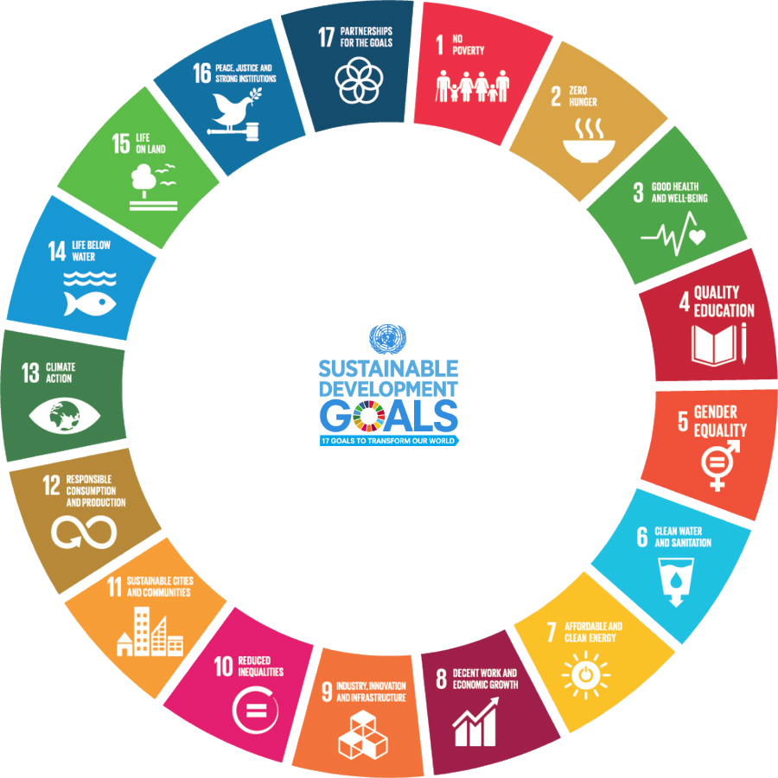
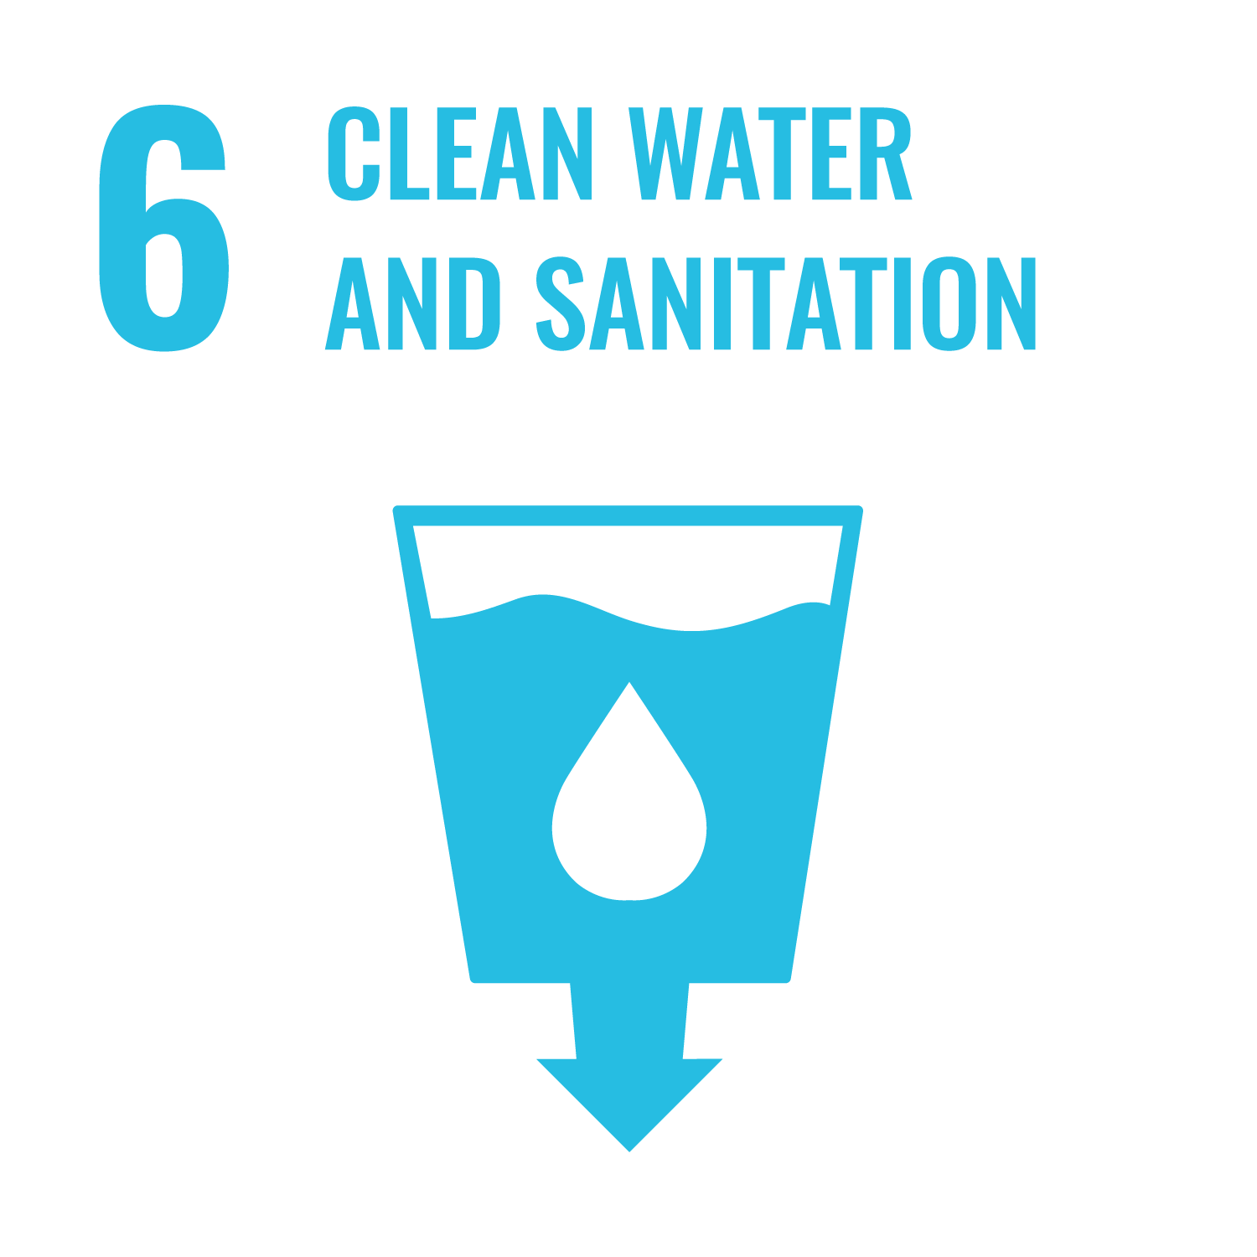
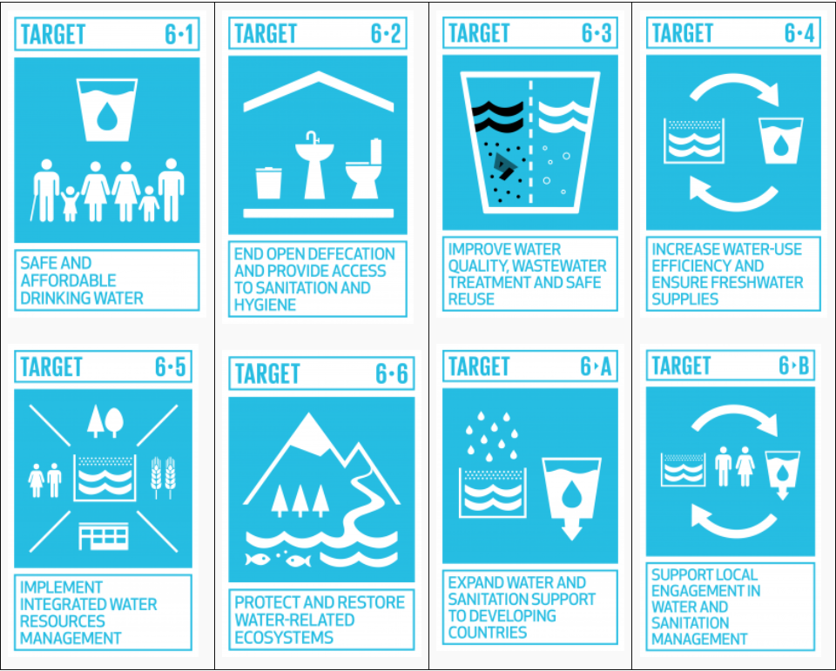
Ensure availability and sustainable management of water and sanitation for all.
Target
6.1
By 2030, to achieve universal and equitable access to safe and affordable drinking water for all.

Slide 6
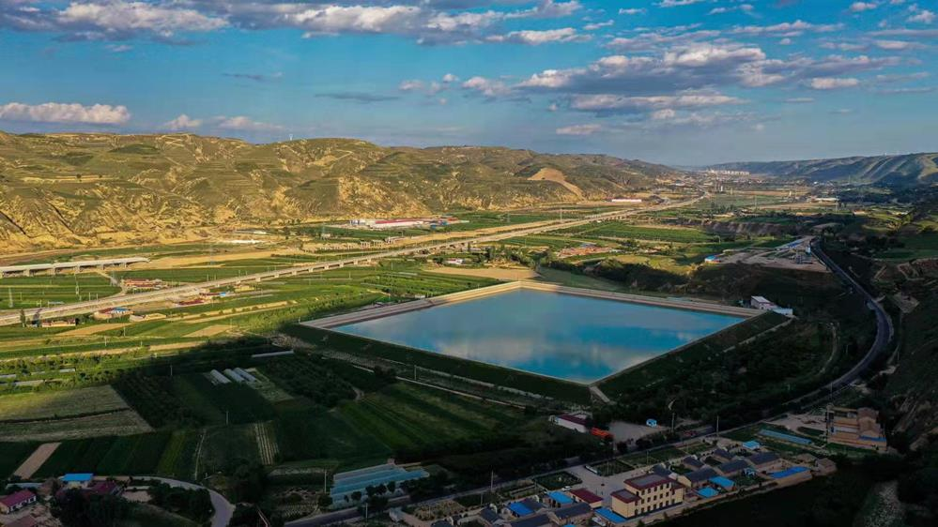
penetration rate
of rural tap water reaching
water supply
capacity of water conservancy projects
guarantees water supply for
20%
87%
890 billion M³
of world population

Slide 7
I. The basic rights to access to drinking water safety should be guaranteed for all, and governments, social organizations and international community should provide supports and assistance for equal access to such rights.
II. We should recognize the limited and irreplaceable nature of fresh water resources, and facilitate the efficiency on water conservation in agriculture, emission reduction on water conservation in industry, and loss reduction on water conservation in urban areas, thus enhancing the capacity of efficient and intensive utilization of water resources.
III. We should respect the basic rights of natural rivers to survive, regarding rivers as organic lives, constructing river ethics, and safeguarding the healthy lives of rivers to realize the harmony between humanity and rivers.
IV. Facing the challenges posed by global climate change and the intensification of its impacts, the role of UN should be given full play to bring together the wisdom and strength to address problems on water disasters, water resources, water environment and water ecology.

Slide 8
02
CNAO’s Audits of
Drinking Water Safety

Slide 9
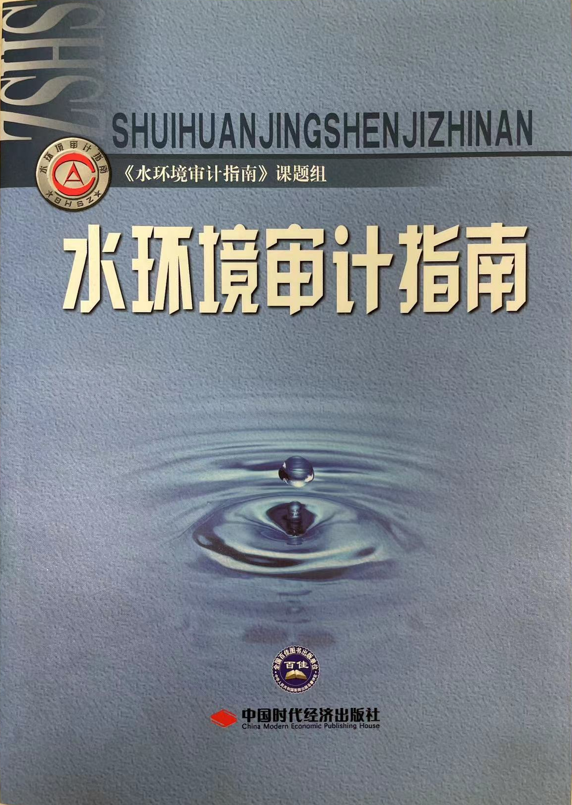
In 2004, the INTOSAI WGEA issued the Water Auditing: Guidance for Supreme Audit Institutions
In 2011, SAI China released the Guideline for Water Environment Auditing

Slide 10
Audit Objective
Reinforce the protection of drinking water sources, guarantee the safe quality of drinking water, and advance the consolidation and upgrading of drinking water safety programs, enabling the people to drink clean and safe water, and safeguarding their health.

Slide 11
Supply
Project
Focus on the Supply of Drinking Water
Focus on the Supply of Drinking Water
Audit Content
Safety
Fund
Focus on Drinking Water Safety
Focus on the Management and Use o Funds

Slide 12
Audit Content
Focus on the Supply of Drinking Water
Supply & Demand for Residents
Whether the demand for drinking water is guaranteed;
Whether the structure of water sources is reasonable, such as a single source of water supply only, or a high ratio of groundwater supply, or insufficient water supply;
Whether the local economic layout, industrial structure and development scale affect the drinking water supply to residents.
Supply
Surface water
Groundwater
Supply Proportion
Demand

Slide 13
Audit Content
Focus on Drinking Water Safety
Source safety
Management:
Whether the goal of protecting drinking water sources has been achieved;
Whether the drinking water source protection zones have been defined and constructed in accordance with the law;
Whether the quality of drinking water sources is in compliance with the standards;
Whether the responsibility for water source management and protection is clarified;
Whether water quality monitoring is conducted regularly;
Whether emergency scheduling plans for sudden water contamination have been prepared
Safety
Emphasis on drinking water safety in rural areas.

Slide 14
Audit Content
Focus on the management and use of funds for drinking water safety and special funds in upgrading of drinking water safety projects.
Whether the relevant funds are allocated in a standardized and reasonable way
Fund
Whether there is inadequate investment of funds related to drinking water safety;
Whether the funds are used in accordance with relevant regulations and whether the funds are withheld or misappropriated.

Slide 15
Audit Content
Focus on the construction and operation of drinking water safety projects
Plan
Construction
Performance
Whether the project construction procedures are standardized;
Whether there are any unapproved changes;
Project
Whether the project decision-making is proper；
Whether there is insufficient discussion resulting in loss;
Whether the environmental and social benefits have met established targets;
Whether the completed projects are unable to operate normally, or the facilities are damaged or even cause environmental pollution, etc.
Whether the progress are as scheduled;
Notes:
whether the project decision-making is proper and whether there is insufficient discussion resulting in loss;
whether the project construction procedures are standardized; whether there are any unapproved changes in the project construction content; whether the progress are as scheduled;
whether the environmental and social benefits of the completed project have met established targets; whether there are any projects unable to operate normally, overloaded or under inefficient operation for a long period after completion, or the facilities are seriously damaged or even cause environmental pollution, etc.

Slide 16
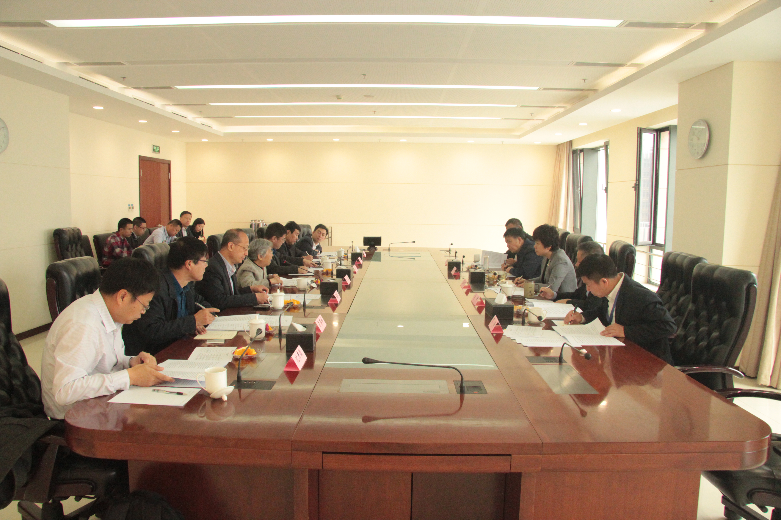
Audit Methodology
Full collaboration with external experts, from the competent authorities, research institutions or third-party agencies.
This is principally due to the complexity and expertise of environmental issues.
Drinking Water
Drinking Water

Slide 17
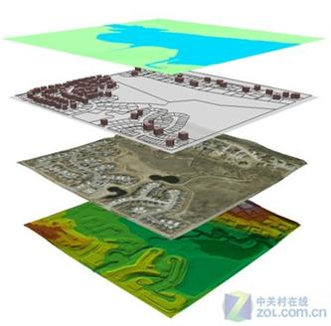
Audit Methodology
Conduct big data audits using departmental data and geographic information technology.
Examine the relevant departments’ business data, law enforcement records etc. effectively, and analyze continuous changes in satellite images of specific areas to identify potential issues in drinking water sources.
Drinking Water
Drinking Water

Slide 18
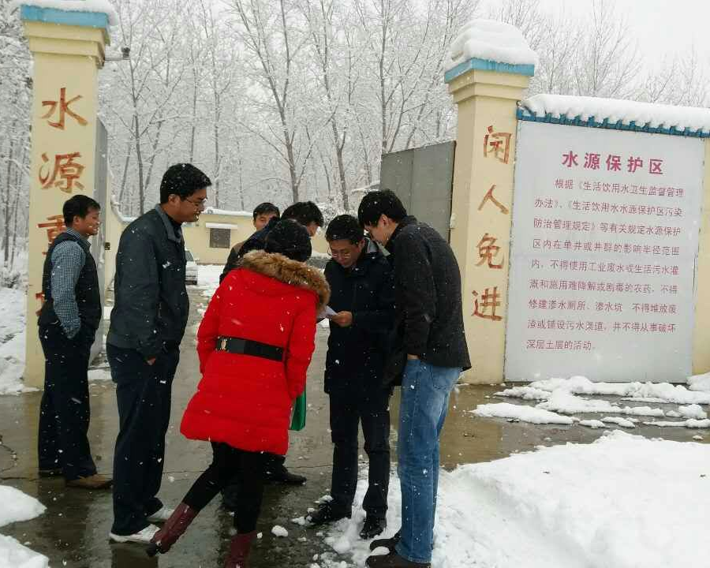
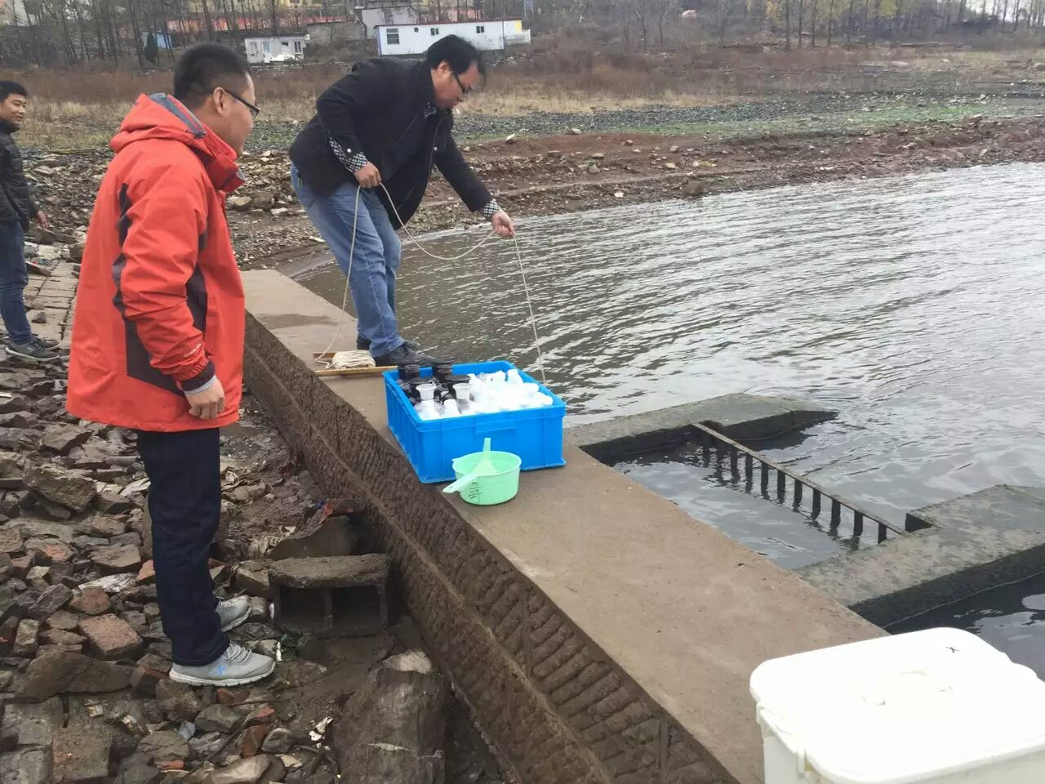
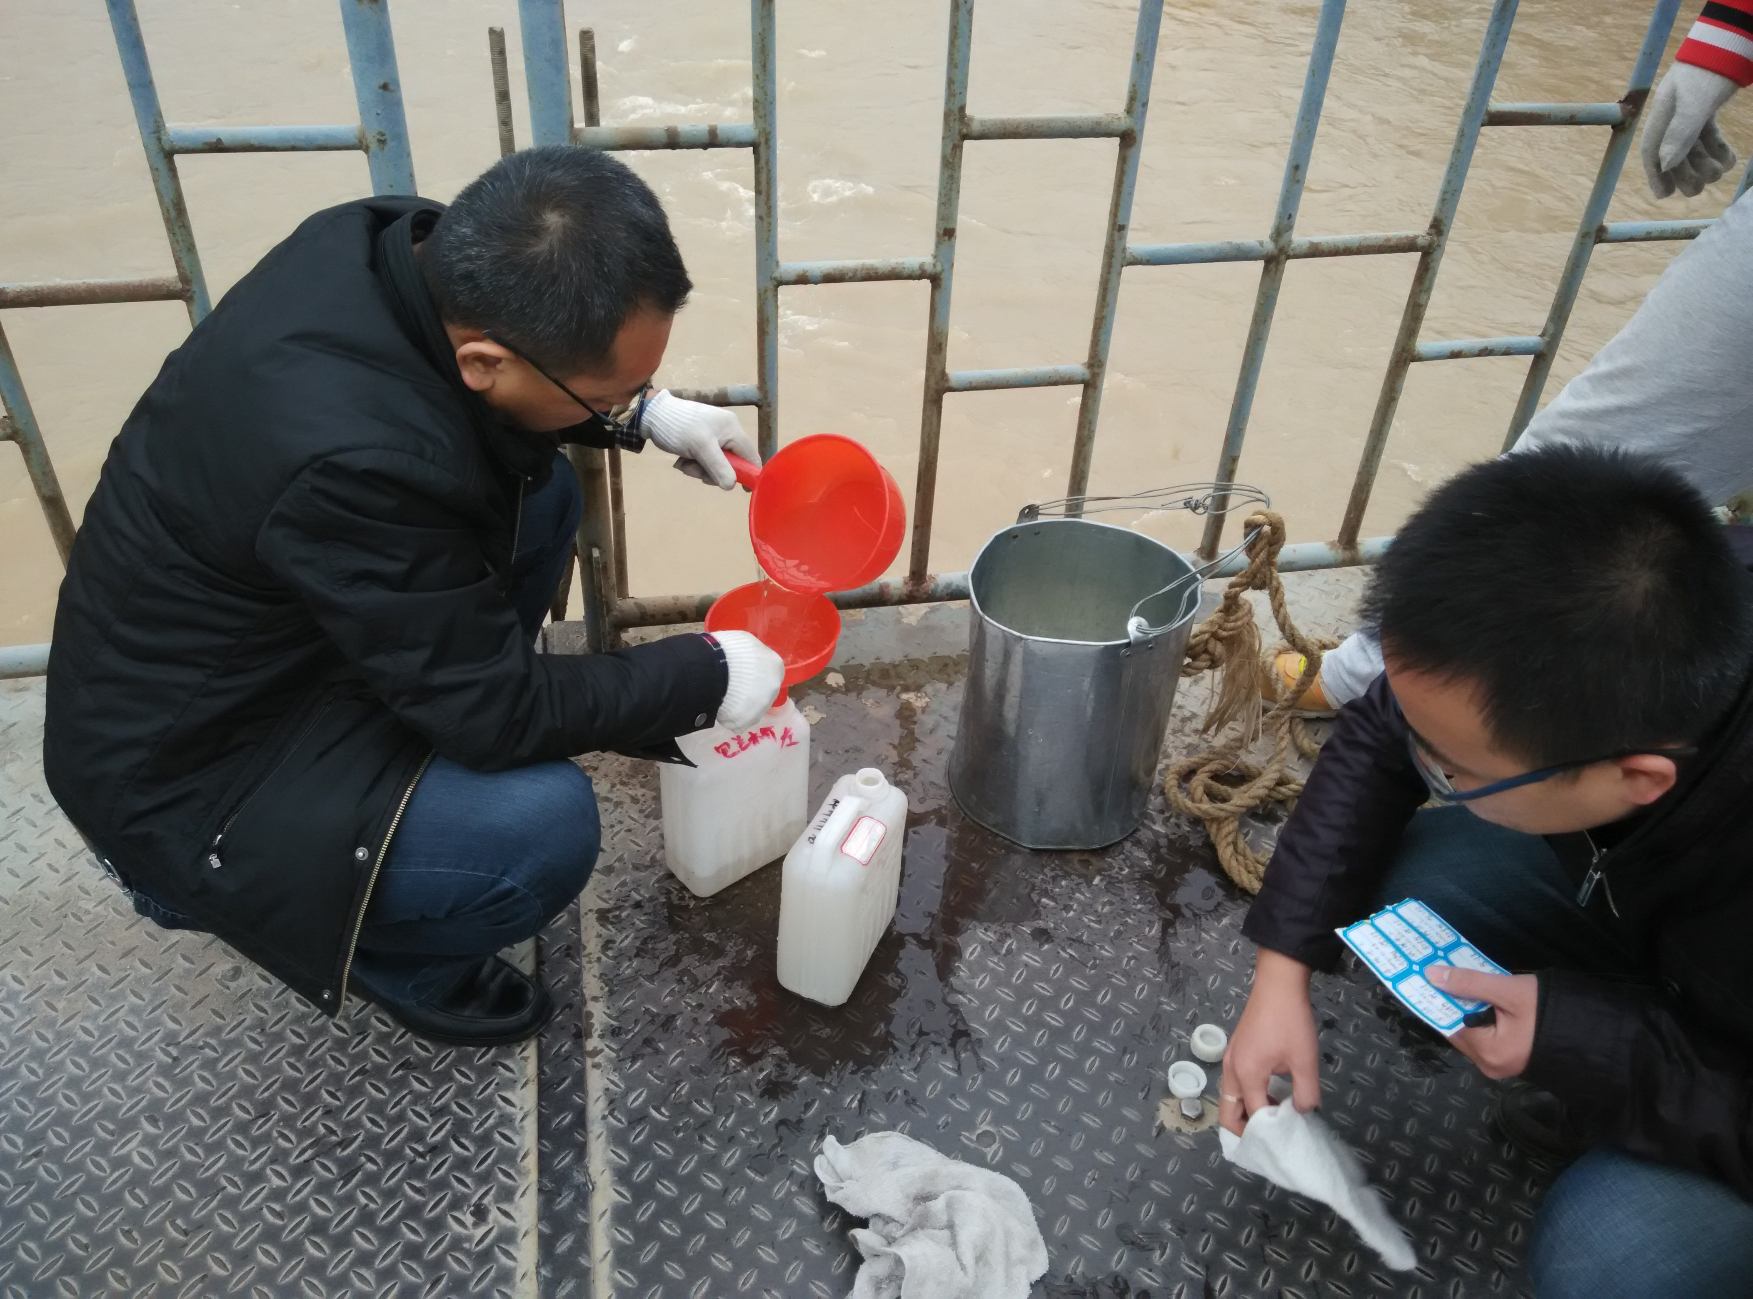
Audit Methodology
On-site sample verification. After analyzing with information technology, key issues and areas are extracted for on-site verification to obtain first-hand audit evidence, identify suspected cases and verify audit conclusions.
Drinking Water
Drinking Water

Slide 19
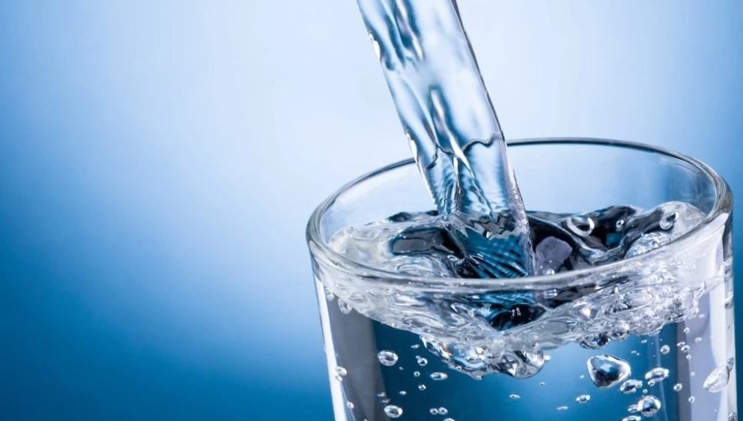
Audit Findings
Audit Findings
a. Insufficient integration of drinking water resources.
Some places did not fully utilize the water resources outside the region in spite of the limited local water resources.
The problems such as unapproved water extraction or over-extraction still exist, increasing drinking water supply pressure.
There are also places where groundwater was over-extracted for drinking water, resulting in groundwater levels declining and ground subsidence.
Management:

Slide 20
Audit Findings
Audit Findings
b. Improper industrial layout nearby water sources.
Some water bodies were improper for drinking water sources. For example, in the protected area of a drinking water source nearby urban area, there were industrial and living activities affecting water quality.
In some of the protected areas of alternative water sources, the water supply systems were not well connected to enable water complement in case of environmental emergencies
The capacity of the alternative water sources was insufficient to ensure emergency water supply.
Management:

Slide 21
Audit Findings
Audit Findings
c. Imperfect risk prevention and control mechanisms.
Some localities failed to identify safety hazards in the surrounding environment of some drinking water sources, not carrying out environmental risk assessments.
In some cases, there were no standardized emergency response plans, and water was supplied only through a single source.
Management:

Slide 22
Audit Findings
Audit Findings
d. Weakness in the fund management.
In some places, the funds were used for non-sewage treatment-related projects, such as road hardening, landscape cobblestones, network pipeline embedment and highway barriers, in the construction of drinking water source and peripheral sewage treatment projects.
In other places, performance evaluation was not conducted in a standardized manner after completion and acceptance of the project and the expenditure of required funds.
Management:

Slide 23
Audit Findings
Audit Findings
e. Irregularities in project construction management.
Some project construction progressed slowly, not completing the tasks on time, and some new water plants and water supply pipeline networks were not put into operation after the completion of many years.
Some construction projects cut corners, leaving potential hazards in drinking water safety.
Some projects were not properly managed during operation and maintenance stage, with facilities so damaged that they were unable to function.
Management:

Slide 24
03
Result and Impact

Slide 25
Supply
c
c
c
c
Enhancing the implementation of national policies and measures on water resource protection and drinking water safety, facilitating the collaborative governance of the various functional sectors of drinking water supply and water source protection, as well as coordinated treatment of major issues such as spatial control, water pollution control, and water ecology protection on a basin-wide basis

Slide 26
Safety
c
c
c
c
Strengthening the protection of drinking water sources, striving to solve historical problems, and improving publicity, supervision, inspection and rectification;

Slide 27
Fund
c
c
c
c
Promoting fund performance management, setting performance objectives that meet standards, conducting project performance evaluation, and improving the effectiveness of fund use

Slide 28
Project
c
c
c
c
Strengthening the construction and management of government investment projects, strict with requirements such as investment estimates, research and design, construction standards and period, and implementing according to the contracts, to ensure the projects to be completed on schedule and the investment benefits to be achieved in a timely manner.

Slide 29
04
Difficulties
and Challenges

Slide 30
How to balance moderation and advancement in the development of water-related projects.
How to tackle the limited evidence collection in the audit.
How to enhance the audit capacity of auditors.

Slide 31
Thank You for Your Attention
Department of Natural Resources, Ecology and Enviroment Audit
China National Office of Audit
Astana, August 2023
Drinking Water

