Slide 1
23-25 Aug 2023
STATE AUDIT OFFICE OF THE KINGDOM OF THAILAND
Post-Pandemic Environmental Auditing: Exploring Four Foresight Scenarios and Their Implications for Sustainability
9th ASOSAI Seminar on Environmental Auditing in Kazakhstan
By Dr. Sutthi Suntharanurak Nunnapat Rueangsri
Chomprang Wongrussameeduen

Slide 2
BACKGROUND
The COVID-19 pandemic has resulted in significant social, economic, and environmental disruptions worldwide. As the world gradually moves into the post- pandemic era, there is an urgent need to address
pressing environmental challenges and sustainable practices. Supreme Audit
promote Institutions
(SAIs), which are responsible for auditing government activities, play a critical role in ensuring governments uphold their environmental commitments and prioritize sustainability.

Slide 3
RESEARCH QUESTION
How can Supreme Audit Institutions use the foresight approach to promote sustainability in a post-pandemic world?

Slide 4
RESEARCH OBJECTIVES
To explore the foresight approach in environmental auditing
To identify potential challenges and opportunities for SAIs in the post- pandemic era
To develop policy recommendations for SAIs to better address environmental challenges and promote sustainability

Slide 5
CONTRIBUTIONS OF STUDY
The body of knowledge on the role of SAIs in promoting sustainability through a foresight approach
Insights for policymakers and other stakeholders on the potential implications of different environmental auditing scenarios
Offers practical recommendations for enhancing the effectiveness of SAIs in addressing environmental challenges and promoting sustainability in a post- pandemic world

Slide 6
RESEARCH METHOD: FORESIGHT
The foresight method involves a systematic, participatory process for envisioning multiple plausible futures and understanding the implications of different scenarios.
It allows for the identification of trends, opportunities, and challenges in a given context.
This research will employ the foresight method to develop four distinct scenarios representing different possible trajectories for environmental auditing in a post-pandemic world.

Slide 7
EXPECTED RESULTS
The results will present four distinct foresight scenarios, each outlining a possible future for environmental auditing in a post- pandemic context.
These scenarios will be analyzed for their implications on sustainability, focusing on the challenges and opportunities faced by SAIs in each scenario.
The findings will provide valuable insights into the potential trajectories of environmental auditing and the role of SAIs in promoting sustainability.

Slide 8
HOW TO BUILD 4 SCENARIOS FOR POST-PANDEMIC EA...
IDENTIFY TWO KEY UNCERTAINTIES
Level of government commitment to environmental sustainability
Technological advancements in environmental auditing
Back to Agenda

Slide 9
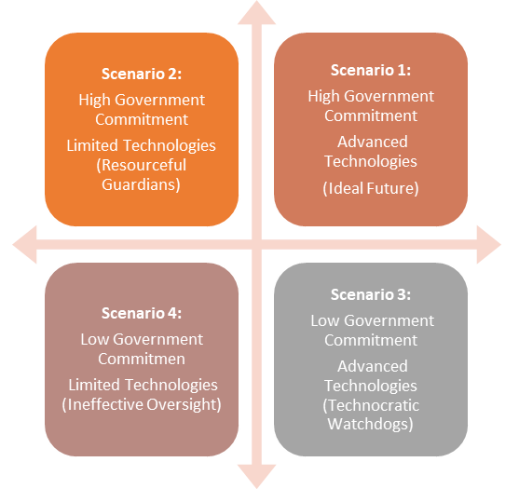
Government Commitment
FOUR SCENARIOS
Technological advancement

Slide 10
FOUR SCENARIOS
 | Scenario 2 (Resourceful Guardians) |  | Scenario 3 (Technocratic Watchdogs) |  | Scenario 4 (Ineffective Oversight)
Scenario 1 (Ideal Future)
Environmental sustainability is prioritized
SAIs play a proactive role in driving positive change.
Governments are highly committed to environmental sustainability Technological advancements are limited.
SAIs leverage their limited resources to ensure governments fulfill their sustainability commitments
Governments show a low commitment to environmental sustainability.
Have access to advanced technologies SAIs use technology to hold governments accountable and push for stronger environmental policies.
Governments are lowly committed to sustainability. Technological advancements are limited. SAIs struggle to effectively monitor and audit government actions- Ineffective oversight system
Back to Agenda

Slide 11
POLICY RECOMMENDATIONS AND CALL FOR ACTION
These recommendations will focus on enhancing the effectiveness of SAIs in environmental auditing and encouraging collaboration between SAIs, governments, and other stakeholders.
The call for action will highlight the urgent need for SAIs to adopt the foresight approach in their operations and emphasize the importance of proactive measures to address environmental challenges and promote sustainability in a post-pandemic world.

Slide 12
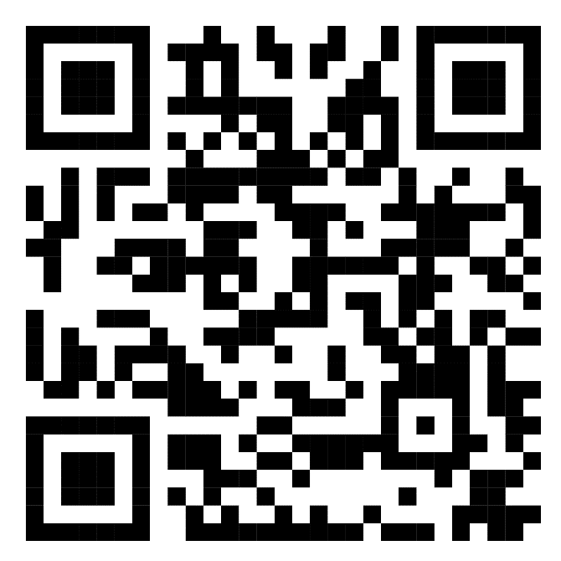
STATE AUDIT OFFICE OF THE KINGDOM OF THAILAND
THANK YOU FOR YOUR ATTENTION
Link to full paper

