Slide 1
SAI Philippines: Performance Audit of the Solid Waste Management Program (SWMP)
9th Seminar on Environmental Auditing and
9th Working Meeting of ASOSAI WGEA
August 23 – 25, 2023
Astana, Kazakhstan

Slide 2
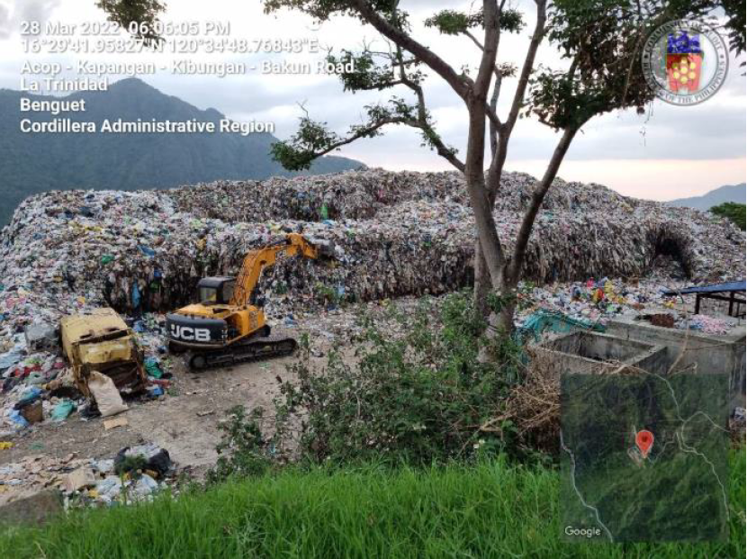
Audit Topic/Subject Matter
One of the priority programs of the government
Performance Audit of the Solid Waste Management Program
Significant impact to the Filipino people and environment
Sustainable Development Goal 12.5
At least Php 47.997 Billion for CYs 2002 - 2021

Slide 3
Audit Objective
To assess the extent to which the goals and objectives of the Program were achieved
To identify opportunities for improvement
To recommend appropriate measures for the economical, efficient, and effective implementation of the Program

Slide 4
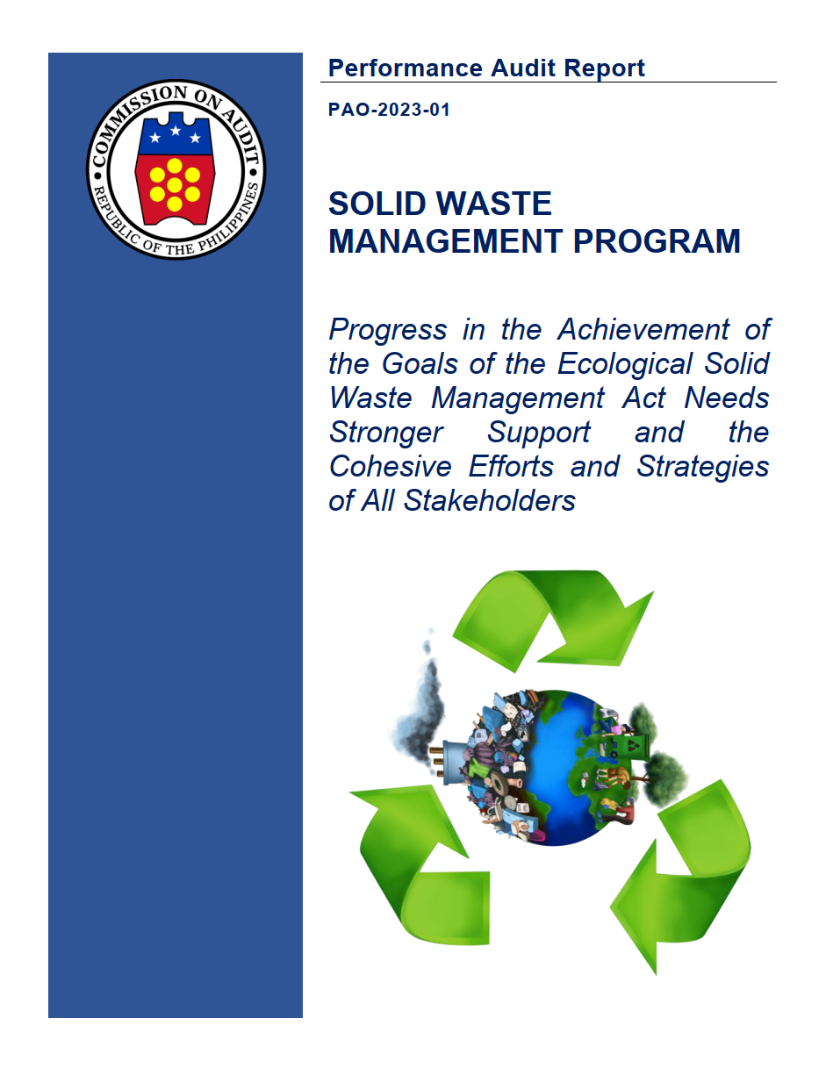
AUDIT FINDINGS
Solid waste management has continued to be an issue of concern, more than 20 years after the passage of the ESWM Act. While the respective national agencies and local government units have partnered to achieve its intended goals and objectives, the results from our performance audit show that progress needs stronger support and the cohesive efforts and strategies of all stakeholders.

Slide 5
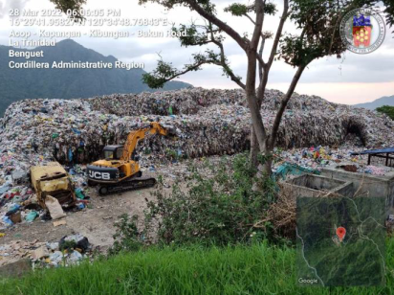
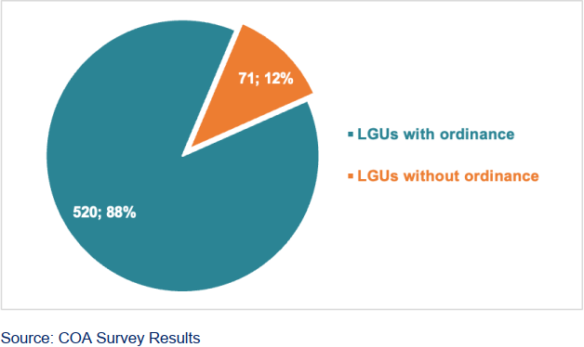
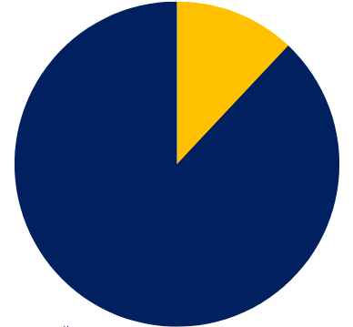
Key Findings
Inconsistent implementation of waste segregation and waste diversion, wherein significant presence of mixed wastes were found in landfills
71 (12%)
520 (88%)

Slide 6
Key Findings
Insufficient waste facilities and landfills to service the LGUs and barangays nationwide
2017
2018
2019
2020
2021
2017
2018
2019
2020
2021

Slide 7
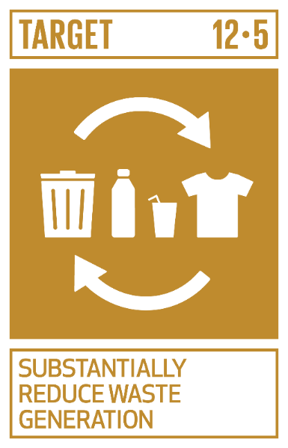
Key Findings
Progress in the attainment of Sustainable Development Goal (SDG) 12.5 has not yet been monitored and tracked by the government
No. of Barangays Nationwide | 42,046
Agency-funded MRFs | 1,840
Operational MRFs | 63.64%
Operational MRFs with Complete Data | 40.76%

Slide 8
Key Findings
The Solid Waste Management Fund, which is a special account in the National Treasury intended to fund the approved the SWM plans of LGUs was not established.
Likewise, the non-establishment of the National Ecology Center for 20 years formed a vast gap in the effective and efficient administration of the Program.

Slide 9
Key Findings
Fragmentations in the program implementation causing non-delivery of proper operationalization
Horizontal integration (overlap in beneficiaries receiving SWM equipment due to lack of coordination among implementing agencies)
Vertical integration (unutilized equipment downloaded to local government units due to absence of electricity lines or incompatible power connection)

Slide 10
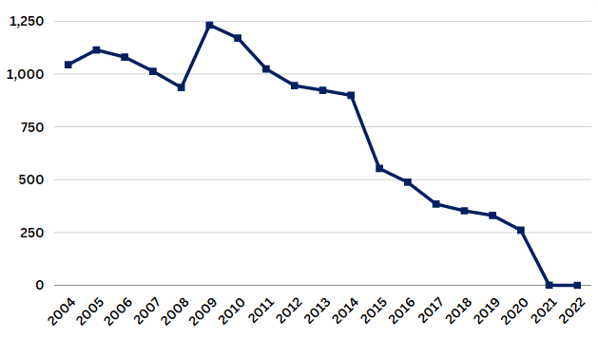
Key Findings
Successful decrease of illegal dumpsites in CY 2021

Slide 11
AUDIT EXPERIENCES
Through our experience in conducting performance audits, we have gained new insights and approaches to conducting environmental audits. Our experiences were overall significant and while there were challenges, we were able to mitigate them during the course of the audit.

Slide 12
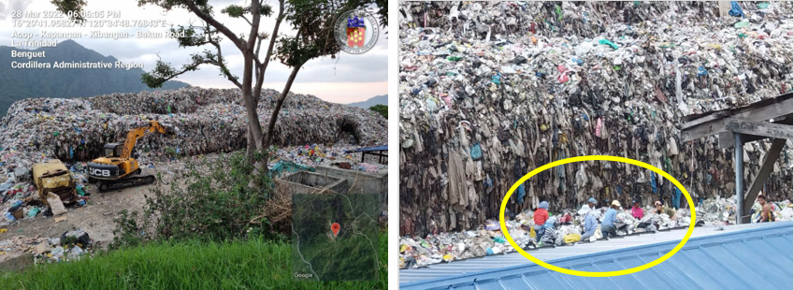
Immersion on the Ground
Mixed wastes present in landfill | Workers sorting wastes

Slide 13
Audit During COVID-19 Pandemic
Changes in audit procedures due to travel restrictions and alternative work arrangements
Use of online platforms for meetings
Uploading of data on online repositories such as Google Drive
Conduct of fieldwork validation and inspection when travel restrictions eased up in mid-2022

Slide 14
Exploring Data Sources
Agency regional offices
Local government units
SAI Philippines regional auditors

Slide 15
Gathering Environmental Data Through Geotagging
Geotagging – attaching geospatial metadata real-time to images
1. Date and Time
2. Geographic
Coordinates
3. Location (LGU,
Province, Region)
4. Google Map terrain

Slide 16
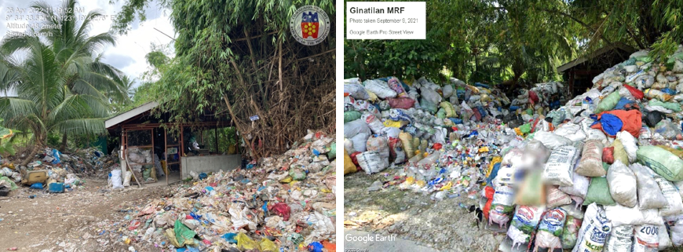
Gathering Environmental Data Through Geotagging
SAI Philippines Validation April 2022 | Google Earth image September 2021

Slide 17
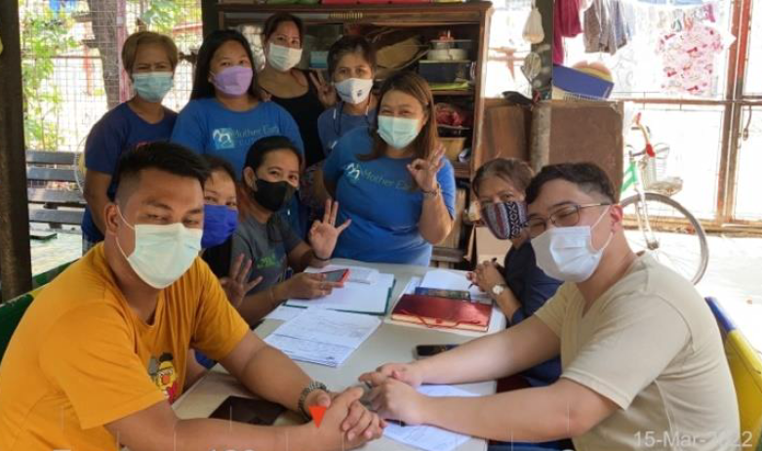
Working with Multi-Stakeholders
Whole-of-government approach
External to SAI
National government
Local government
Civil society organizations
Public citizens
Internal to SAI
SAI Philippines regional auditors
Citizen Partner

Slide 18
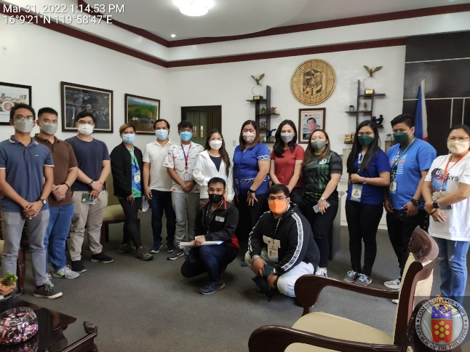
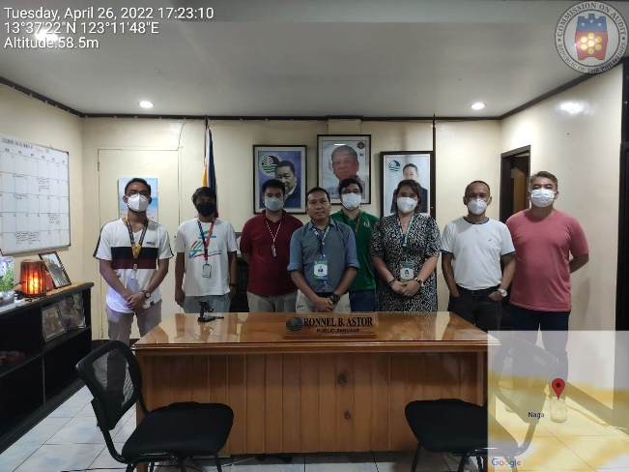
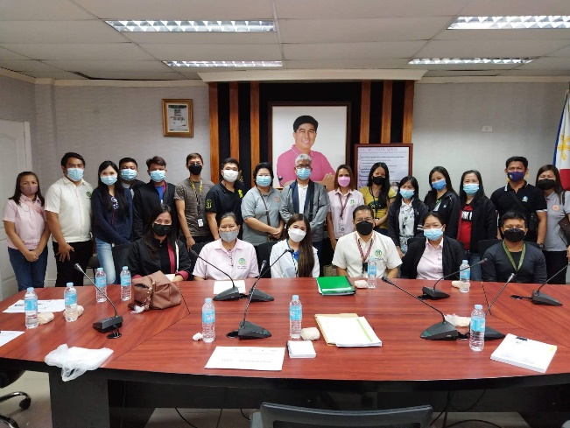
Working with Multi-Stakeholders – LGU officials

Slide 19
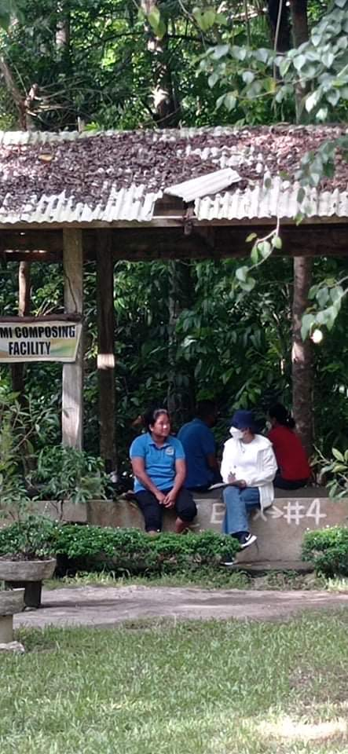
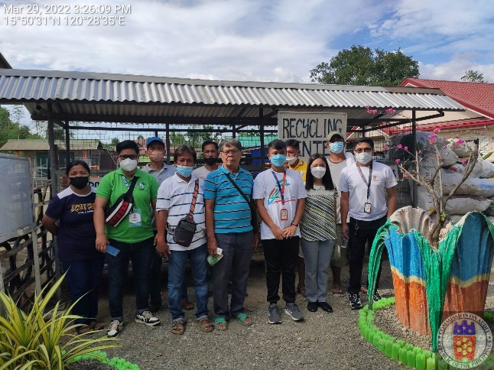
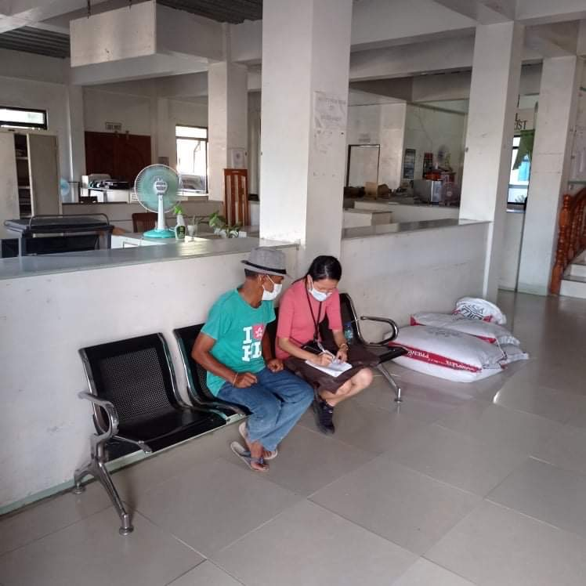
Working with Multi-Stakeholders – Waste Facility Workers

Slide 20
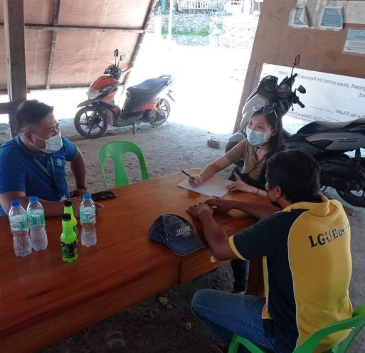
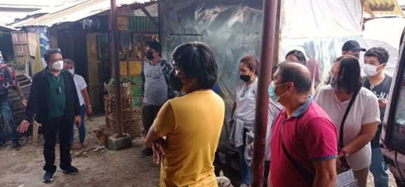
Working with Multi-Stakeholders – Survey Respondents

Slide 21
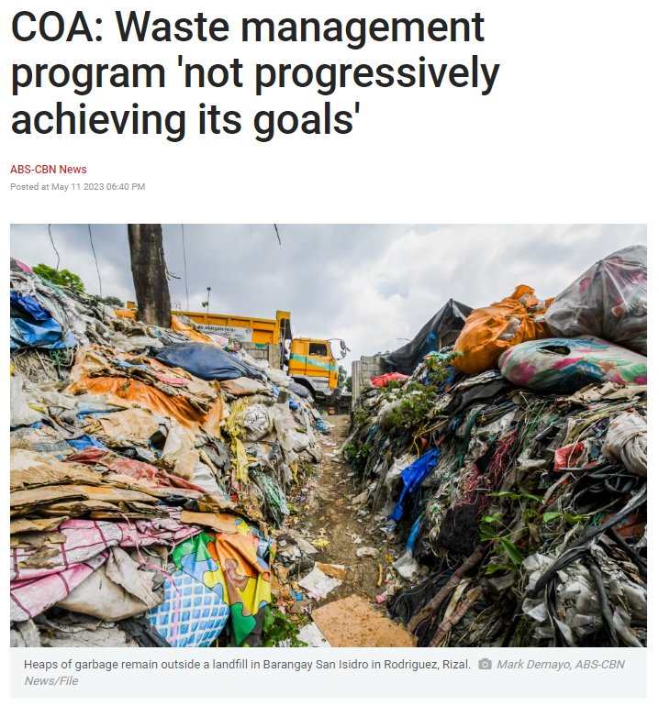
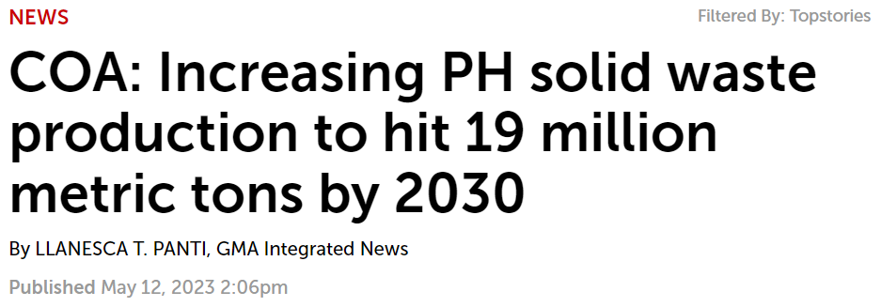
Media Coverage of the Results of Performance Audit of SWMP

Slide 22
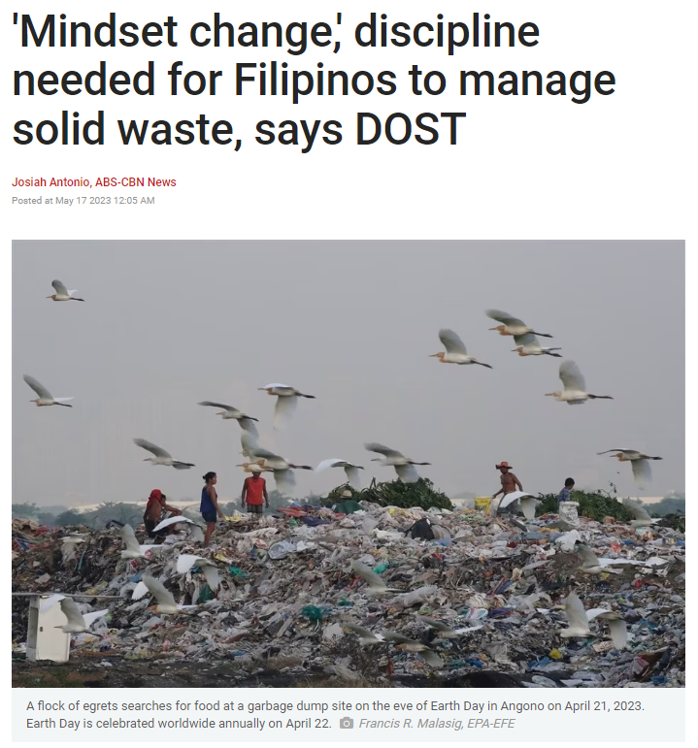
Media Coverage of the Results of Performance Audit of SWMP

Slide 23
FINAL THOUGHTS
"Environmental auditing shines a light on the true cost of our actions, revealing the hidden impacts we leave behind. It empowers us to make informed decisions and holds us accountable for the environmental debts we incur.“
- Dr. James K. Boyce, environmental economist and professor

Slide 24
Thank you!

