Slide 1
9th Seminar on Environmental Auditing And 9th Meeting on ASOSAI WEGA
Office of the Auditor General
Kathmandu Nepal
2059 AD
August, 2023

Slide 2
Audit Objectives Scope and Method
Constitutional and Legal Provision
Constitution of Nepal
Audit Act, 2019
Objectives
Financial Audit
Compliance Audit
Performance Audit
Special Audit
Scope
3 tire of Government
State owned Enterprise
Entities as per legal provision
Methods
Risk Based, High Low
NAMS

Slide 3
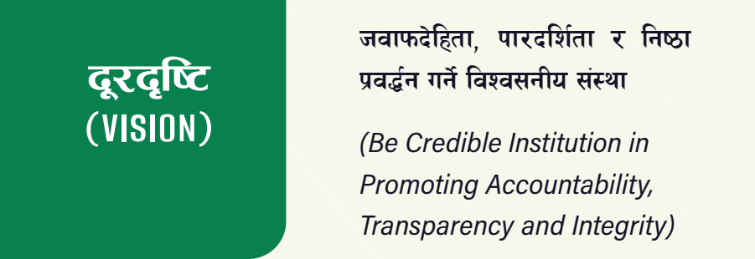
Vision Mission and Core Values
Regularity
Economy
Efficiency
Effectiveness
Propriety

Slide 4
Organizational Structure
AG-1
DAG - 4
AAG -18
Director -110
Auditor officer-255
Audit Superintendent -110
Auditor Inspector – 25
Other Staff
Total 643

Slide 5
Annual Audit
Financial Audit – more than 6000 entities
Federal Level Government Org
Provincial Level Government Org
Local Level Government Org
Performance Audit about 10 topic each year
ICT Audit -2 organization
Environment Audit- 1 or 2 Topic each year
SDG Audit
Other Audit as per the Commitment of SAI Nepal in INTOSAI and ASOSAI working committee

Slide 6
Why Environmental Audit in Nepal
The Asian Organization of Supreme Audit Institutions (ASOSAI) defines environment as: a ‘complex of physical, chemical and biotic factors that act upon an organism or an ecological community and ultimately determines its form and survival’.
Nepal is
4th most vulnerable country from climate change,
11th most vulnerable country from earthquakes,
30th most vulnerable from floods and landslides,
Maximum average temperature every year is increasing by 0.056 degree Celsius,
Nepal; only contributes 0.027% to the greenhouse gas emission
Based on facts above, environmental audit in Nepal is of quite importance.

Slide 7
SAI Nepal Focus on Environmental Auditing
2016
Extraction of Natural Resources, Based 4 districts (Lalitpur, Dhading, Chitwan and Makawanpur)
2017
Air Pollution of Kathmandu Valley
2018
Scientific Forest Management
2019
Assessment of Environmental Conditions of Kathmandu Valley,
Bagmati river cleaning and beautification
2020
National Park Management
2021
Climate Change
2022
Implementation of multilateral environmental agreements
2023
Implementation of Sendai Framework in Disaster Management
Medical Waste Management in selected Hospital

Slide 8
Climate Change Audit
We conducted climate change audit in 2021
Major highlight of this Audit
About Topic, Audit objectives, Scope, Methodology, Major Findings, Recommendation and Corrective Action

Slide 9
Climate Change Audit
Nepal has been commitment on International convention of Climate Change since 1992.
UN Conference on Environment and Development in Rio de Janeiro, Brazil in June 1992. Nepal signed this Convention on 12 June 1992 and became Party to it in 1994, Nepal enacted Climate change policy 2011 and amened in 2019 as National Climate change policy.
Policy developed implementation framework of National Adaption Plan for Action(NAPA), Local Adaption Plan for Action(LAPA).
Budget Coding (Climate Change Budgeting)

Slide 10
Topic Selection
It is Global issues,
Nepal is 4th ranking in most vulnerable country from the Climate change.
Nepal has investing in climate change adaption program since 2010,
Budget coding is also implemented,
(Climate resilient society, effective use of climate finance, Awareness program, Institutional capacity building, common voice raise in international communities from impacted vulnerable countries are some challenges )

Slide 11
Audit Objectives
To review the compliance and progress of the international commitments made by Nepal,
To take stock of the laws and policies related to climate change.
The message of the principle and importance of adaptation to climate change should be conveyed to the risk settlements and community level, and accordingly, through the local government, there should be a climate change adaptation program in the communities.
To assess whether effective coordination has been established between the federal, provincial and local governments and inter-agency to design and implement plans and programs related to climate change.

Slide 12
Scope
To evaluate and analyze the interrelationship of the National Adaptation Program (NAPA), Local Adaptation Action Plan (LAPA) prepared under this Ministry and Community-level Adaptation Plan (CAPA) to deal with the effects and impacts of climate change.
Evaluating the international commitments made by Nepal, accounting and evaluating the goals and practices to increase the number of electric vehicles taken by Nepal.
To take account of the challenges and coordination of the environment policy brought by the Ministry of Forestry and Environment.

Slide 13
Audit Methods
Random Sampling methods for Local and Community Level Selection.
Chhayanathrara- Mugu, Naraharinath- Katikot, Mohanyal- Kailali, Bhimeshwor- Dolakha, Namobuddha- Kavre
Interview with farmer, teacher, local level government staff and concern stakeholder are contributor of that report.
Document Review (Policy and legal documents, Program documents, Budget)
To analysis gap, we use INTOSAI ISSAI 3000, Performance Audit Guideline of OAG

Slide 14
Policy Recommendation
Policy and legal provision, Environment protection act:- Local level can formulate and implement adaption plan.
Environment Protection Regulation:- 3 tire government can implement adaption plan (NAPA, PAPA, LAPA, CAPA)
15th period plan:- Adaption can be done using proper coordination with Public, Private, Non-Governmental intuition.
In 12 Years- only 242 local level has prepared Community Level Adaption plan of Action (Only)

Slide 15
Recommendation
Mainstreaming of targeted people
collaborative Monitoring of the vulnerable zone
Awareness Building and Capacity Development
3 tire government, NGO, Academic Intuition, Community level, Club
Climate Finance Management
At least 80% international finance utilize in targeted community level by using climate coding budge.
Electric Vehicle
To meet 2050 zero green house gases on transportation sector, need to set goal of reduction of gases in annual plan.

Slide 16
Recommendation
Documents and Reports:-
Develop an Integrated Management Information System to record all the documents, data, information related to Climate change from 3 tire government and even individual level.
Monitoring and Evaluation
Provide training and awareness program to Provincial and local level political and administrative personnel to closely monitoring of venerable area

Slide 17
Working with ASOSAI WEGA
WEGA Member, Since from established
Participated in different initiatives conducted by ASOSAI, WEGA
Geographically suitable place for environmental audit
Strong commitment but need to support Financial and capacity building program.

Slide 18
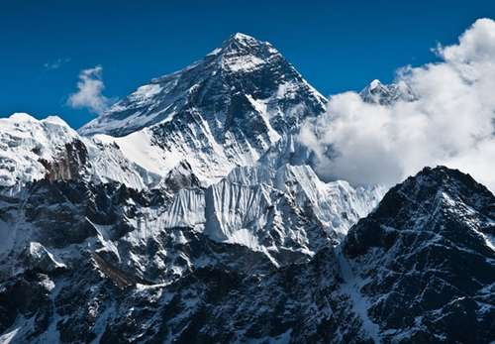
Mt. Everest

Slide 19
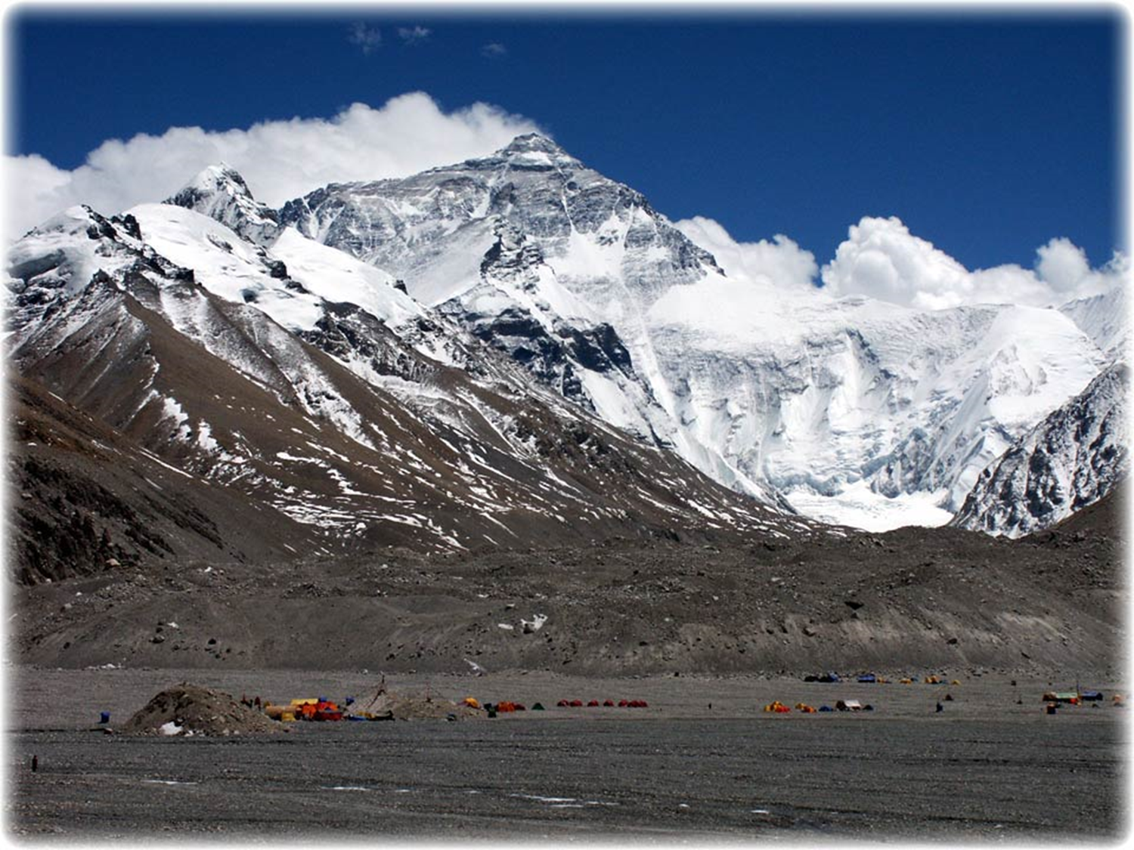

Slide 20
Everest hosts Nepal cabinet meeting (December 4, 2009)
"Save the Himalayas.“ Meeting was held before United Nations climate summit in Copenhagen,

Slide 21
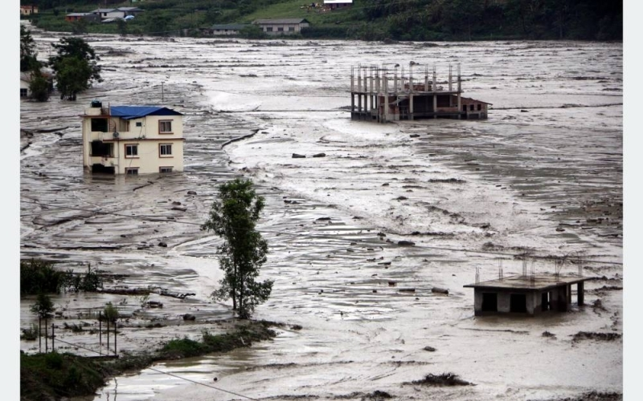
Melamchi Flood Disaster in Nepal 2021 June
Nepal, with 80 per cent of its area comprising fragile Himalayan mountains, has been facing a number of disasters of late.

Slide 22
Condition of Himalayas, Inconvenient Truth, 2006 Al gore

Slide 23
Condition of Himalayas, Inconvenient Truth, 2006 Al gore

Slide 24
For a common sustainable future
Innovative environmental auditing

