Slide 1
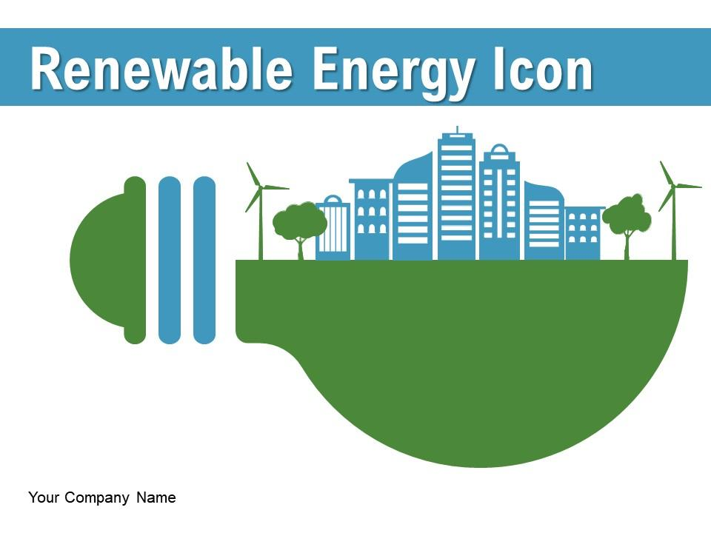
PERFORMANCE AUDIT ON MANAGEMENT OF RENEWABLE ENERGY
DEVELOPMENT PROGRAMME
by National Audit Department of Malaysia

Slide 2
CONTENTS
Background of Renewable Energy in Malaysia
Challenges in Conducting The Audit
Audit Findings
How to Address The Challenges
Lesson Learnt

Slide 3
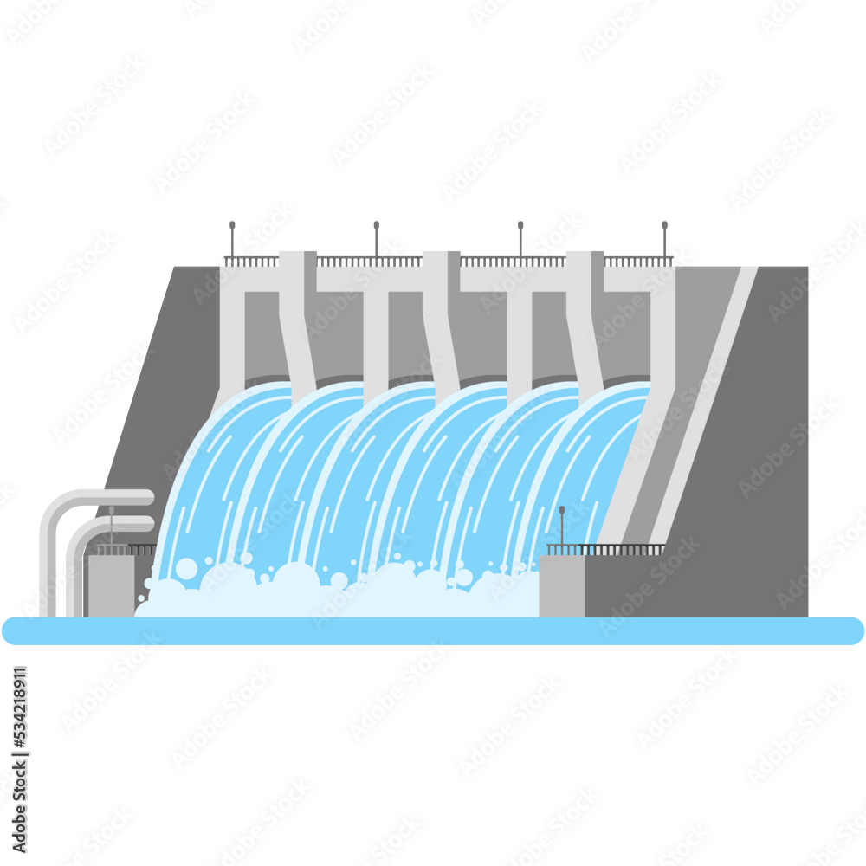
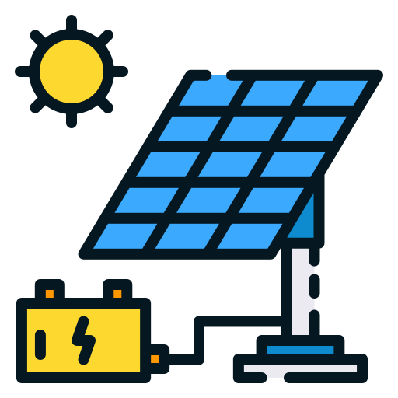
Background of Renewable Energy in Malaysia
National Renewable Energy Policy and Action Plan (NREPAP) (2010)
Renewable Energy Act (Act 725) (2011)
a mechanism to make Malaysia a leader in renewable energy & green technology
aims to streamline the legal framework and governance of the renewable energy sector in Malaysia - implement a special tariff mechanism
Renewable Energy (RE) Electricity generated or produced from renewable sources
Small
Hydropower
Solar
Photovoltaic
Biogas
Biomass
Geothermal

Slide 4
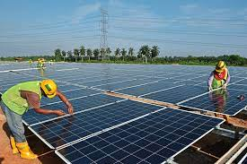
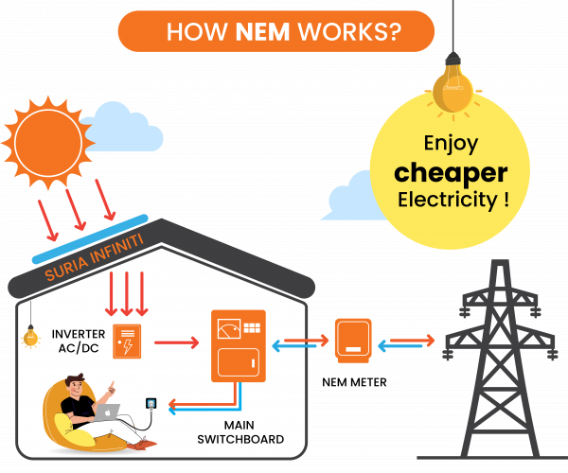
Background of Renewable Energy in Malaysia
Ministry of Natural Resources, Environment and Climate Change (NRECC)]
Programmes
Feed in Tariff Programme (FiT)
Net Energy Metering (NeM)
Large Scale Solar (LSS)
Self Consumption
(SELCO)
Large Hydropower
SEDA Malaysia
Energy Consumption (ST)
ST & Ministry

Slide 5
Why this topic is important to audit?
The energy sector is the largest contributor to greenhouse gas (GHG) emissions
Implementing the RE strategy in an integrated and planned manner can reduce the release of GHG into the atmosphere because electricity generation using RE is zero emission.
National Goal
National Grid
Financial RE Fund
The goal of the national renewable energy policy through the National Renewable Energy Plan and Policy (NREPAP) may not be achieved
May affect the ability of RE production that are supposed to be distributed to the national grid
May affect the planning and financial position of the Renewable Energy Fund (REF) collected from the electricity consumers

Slide 6
Audit Objective?
The audit was carried out to assess whether the RE development programme have been managed economically, efficiently, and effectively in line with the objectives of NREPAP set as follows:
03
02
01
Awareness
Future Generation
Raise awareness of the role and importance of RE
RE’s Contribution
Preserve the environment for future generations
Increasing RE’s contribution to the diversification of national power generation

Slide 7
1
Reviewing
Files, record, documents
5
2
Discussion & Interview
officers involved
Further clarification
Site Visit
observe the performance of program participants
study the problem occurred on the site
Walkthrough
eFiT system
3
Analysis System Data
6
4
Questionnaire
eFiT and eNeM system
National Energy Balance Report (2010 – 2018)
Data submitted by Energy Commission (2019 - Sept. 2021)
online questionnaire was distributed to RE programme participants
to obtain views & feedback
awareness of the RE programme

Slide 8
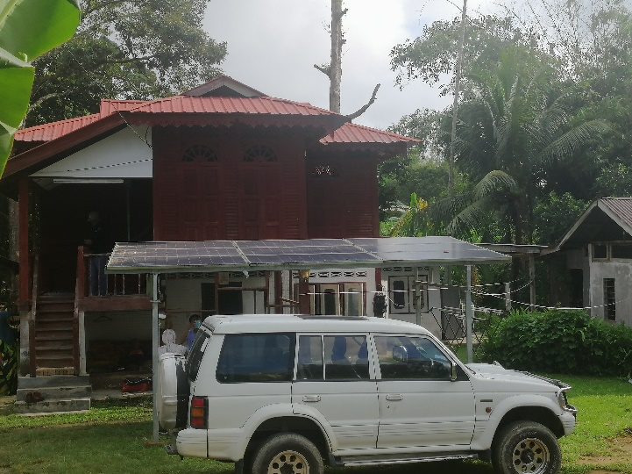
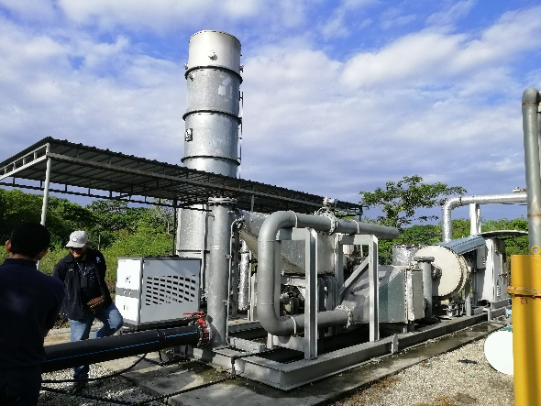
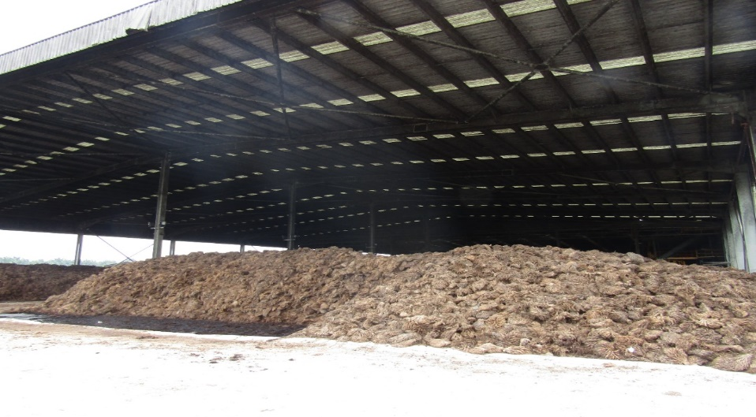
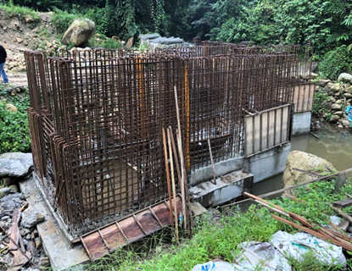
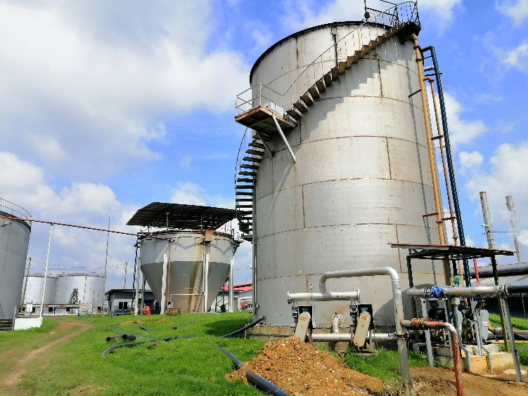
Site Visit
FEED IN TARIF (FIT) PROGRAMMED
Biomass Raw Material – Empty Fruit Bunches Palm
PV Solar at Resident House
Biogas Plant
Hidro Mini
Biogas Plant
Biomass raw material – Wood Chip

Slide 9
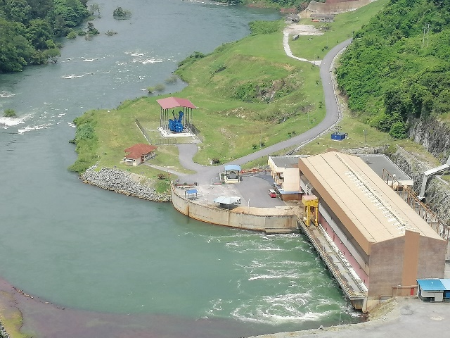
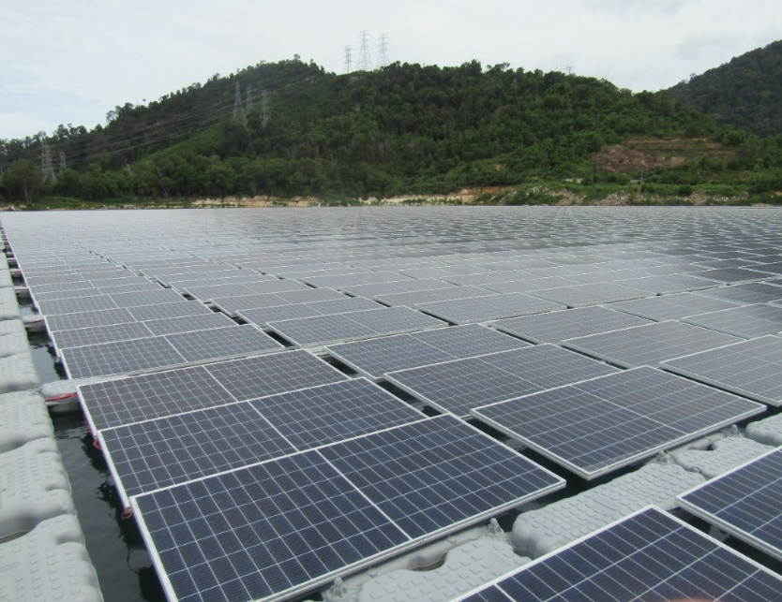
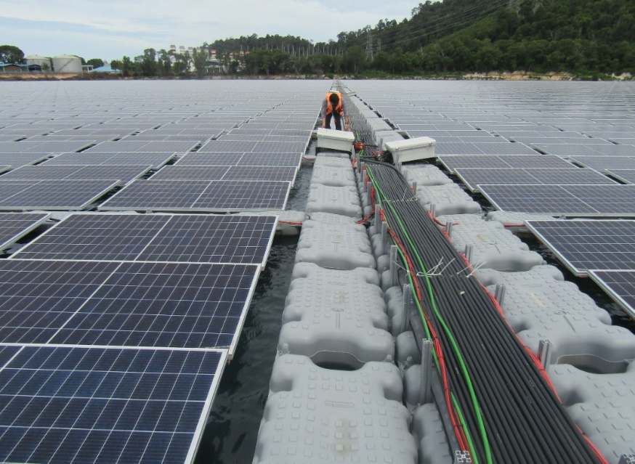
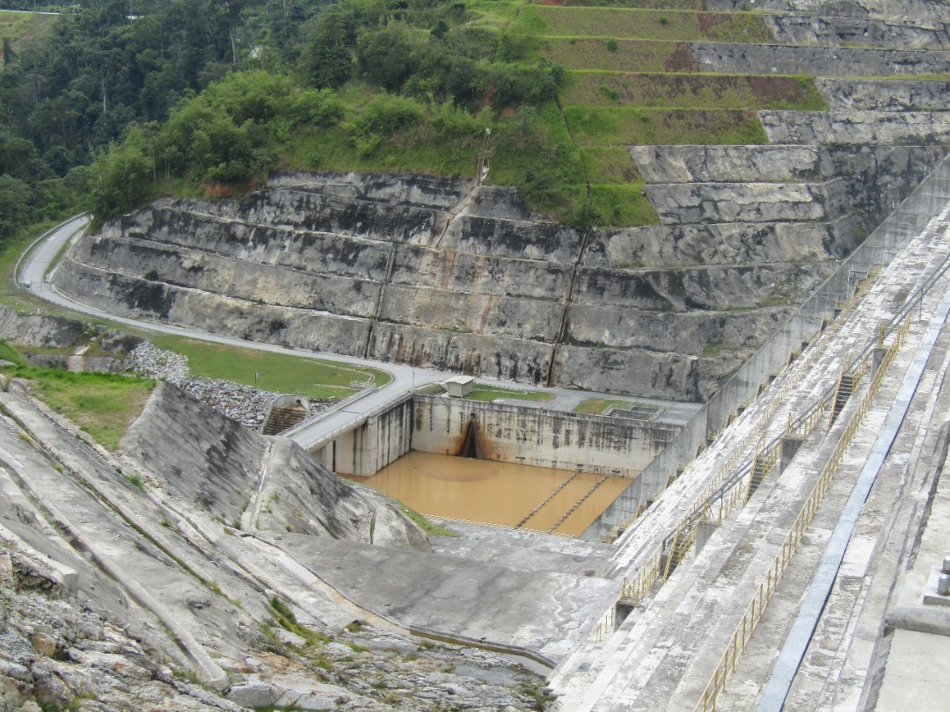
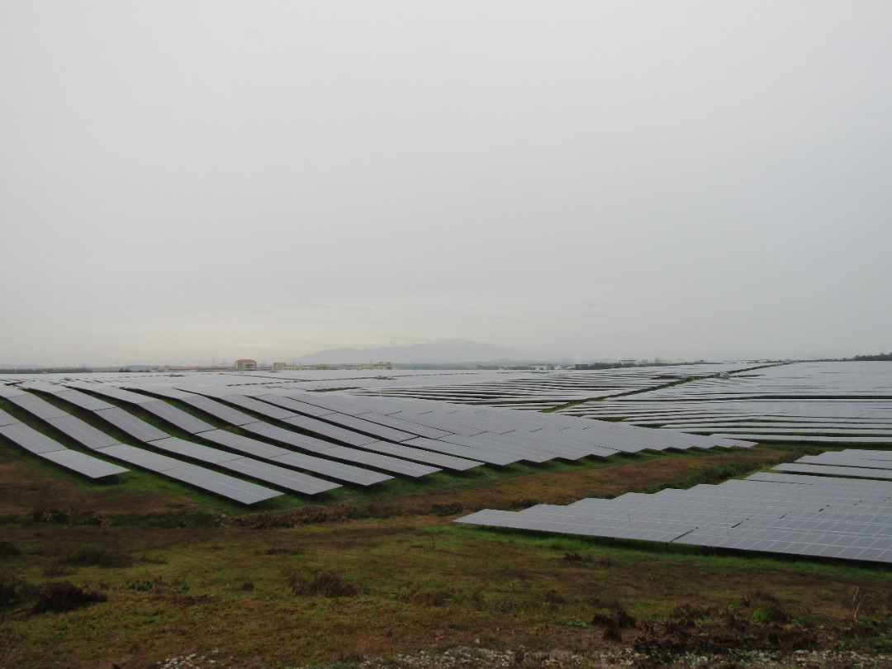
Site Visit
LARGE HIDRO
LARGE SCALE SOLAR (LSS)
TEMENGGOR PERAK DAM
ULU JELAI, C. HIGHLANDS DAM

Slide 10
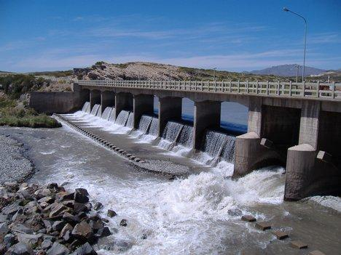
Output Achievement
Renewable Energy Achievement
23.6%
RE Installed Capacity
Through the Green Technology Master Plan (GTMP), the Government has targeted the achievement of installed capacity RE in the energy sector by 20% in 2020. This plan stipulates a gradual increase in the percentage of RE in the energy mix through the implementation of FiT, LSS, NEM, SELCO, and large hydropower programmes
Target Achieved

Slide 11
Outcome Achievement
Target
Actual
2015
5%
15%
Energy Generation Mix
2020
9%
19%
RE’s Contribution to the National Energy Generation Mix
total energy generation mix increased annually from 2017 before decreasing in 2020 from 175,501.99 Gigawatt hours (GWh) to 165,550.66 GWh.
decreased generation mix - decrease in the non-RE capacity entry on the electricity supply system, where electricity demand was reduced during the Movement Control Order (MCO) period.
demand for Malaysian electricity decreased by 5% in 2020 compared to 2019 due to the effects of the Covid-19 pandemic.
RE generation shows an increasing trend and is more consistent than the energy mix.
This amount shows an increase from 27,943.20 GWh (17.4%) in 2017 to 30,749.72 GWh (18.6%) in 2020

Slide 12
Outcome Achievement
Contribution of the Renewable Energy Programme to the Avoidance of Carbon Dioxide (CO₂) Gas
7.07 million tons by 2020
Targeted
Malaysia, through the Paris Climate Agreement (2016), has expressed a commitment to reduce the intensity of greenhouse gas emissions up to 45% by 2030. NREPAP 2011 to 2020 has given targets for a period of 10 years for CO₂ reduction. The CO₂ reduction target set until 2020 is 7.07 million tons.
10.99 millions ton
Achievement
45% GHG emission reduce by 2030
The generation of RE succeeded in producing CO₂ avoidance as stipulated in the NREPAP.
The achievement in 2020 amounted to 10.99 million tons (155%), compared to the 7.07 million tons set.

Slide 13
Lesson Learnt in Auditing
Tax Incentives for RE Producers
Government approved - investment worth RM996 million
to increase the percentage of renewable energy in the energy mix for electricity generation
RE Contribution (installed capacity)
2020 & 2021 – most contributed by the large hydropower programme
followed by the Large Scale Solar (LSS) programme & Feed in Tariff Programme (FiT)
Promotion
SEDA Malaysia held the promotion
However - more focused on certain groups & coverage is less comprehensive
National Power Generation Mix
Generation mix for 2015 and 2020 has reached the target set
Installed capacity - term used in the energy sector that refers to the maximum ability to produce electricity (name plate rating) by an electrical power plant

Slide 14
Challenges in Conducting the Audit
Data & information do not match the audit period
The governance of RE implementation in Malaysia involves two responsible parties based on their respective state/territorial jurisdiction
The official data report issued by the responsible party for the use of electricity from renewable energy and the avoidance of carbon dioxide (CO2) is from 2016 to 2018
However - audit period is until 2021.
Target data for 2015 and 2020 were released in 2010
The auditing of RE management is a new audit carried out by the National Audit Department and has never been carried out previously
This target information is not updated until the audit date in 2021.
Therefore, the target analysis compared to the actual achievement still uses past information.

Slide 15
How to Address the Challenges
Engaged with Technical Person
Obtain internal advisory services from officer with an electrical background
Engaged With Other RE Stakeholders
That involved in producing electricity from RE sources to obtain the latest data and information
Monitoring
Ministries and regulatory agencies should enhance the monitoring of the generation performance of all RE programmes
Cooperation
Between ministries/departments at the federal, state, and local government levels

Slide 16
Thank You
National Audit Department of Malaysia

