Slide 1
SAI Kuwait’s Country Paper on the Topic:
"Responding to Climate Change and Environmental Protection Audit”
ASOSAI WGEA 9th Seminar and Meeting
Kazakhstan, 23 – 25 August 2023
Presented by:
Mr. Sultan Al-Otaibi – Controller of Performance Audit Department
Mr. Talal Al-Wuhaib – Lead Auditor

Slide 2
The Audit Methodology
Planning Phase
(Climate Change Pre-Study)
Reporting Phase
(Results & Recommendations)
Examination Phase
(Collecting and Analyzing Climate Change Related Data)

Slide 3
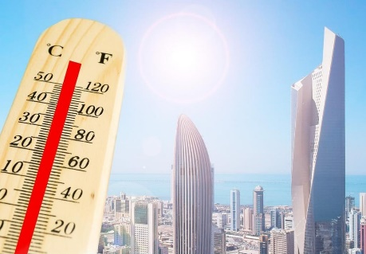
Pre-Study: Kuwait’s Climate
Recent irregular rainfalls leading to floods
(Whole rain season amount in 1 day)
Scarce freshwater resources
(Seawater Distillation Plants)
High Temperatures in Summer
(over 50 C°)
Dust and Sand Storms
Drought and Desertification

Slide 4
Main Auditees
Ministry of Public Works
Ministry of Health
Ministry of Electricity & Water
Environment Public Authority
Kuwait Meteorological Department

Slide 5
Meteorological Department Role in Identifying Climate Change Risks
Our Recommendation:
Meteorological Department should improve its systems and human resource capacity to closely monitor climate changes and coordinate with relevant authorities to take preventive measures to deal with current and future climate change risks.
Infrastructure of the oil sector was affected operationally and economically by dust and sand storms

Slide 6
Climate Change Effects on the Public Health Sector
Our Recommendation:
Prepare an emergency healthcare plan related to climate impacts to safeguard the health and wellbeing of the community
Absence of a healthcare emergency plan to deal with patients during unstable weather conditions.

Slide 7
Climate Change Effects on the Infrastructure Sector
Our Recommendation:
Government entities should improve the rainwater drain system in order to adapt to climate change effects and prevent future floods and damages to the infrastructure that greatly costs public and private funds.
Irregular rainfall led to floods notably in 2017 and 2018.

Slide 8
Climate Change Effects on the Energy & Water Sector
Highest in Kuwait’s History
Our Recommendation:
Ministry of Electricity and Water to pace its development projects for power and water distillation plants by using the best environmental approaches to operate them including renewable/clean energy in order to mitigate climate change risks to the sector.
Summer heat escalating the electrical load
annually due to high consumption.

Slide 9
Environment Public Authority Role in Addressing Climate Change Risks
Our Recommendations:
-Expanding the vegetation cover in coordination with the relevant authorities through afforestation projects and the establishment of a green belt around residential cities, vital facilities, and highways.
-Implementing effective methods to follow-up GHG emissions reduction projects based on SDG 13 requirements within a specific timeframe.
Efforts to implement the National Adaptation Plan 2030 and SDG 13 to mitigate climate change risks were not sufficient.

Slide 10
Audit Conclusion
Power outage
Most of Kuwait GHG emissions comes from the energy sector at 96% of its total GHG emissions in 2016. However, Kuwait is affected by climate change risks rather than contribute to it. In 2018, Kuwait’s GHG emissions represent approximately 0.246% of the world’s GHG emissions. Current resilience and adaptation actions are insufficient.
Floods
Respiratory Diseases
Financial Losses
Drought

Slide 11
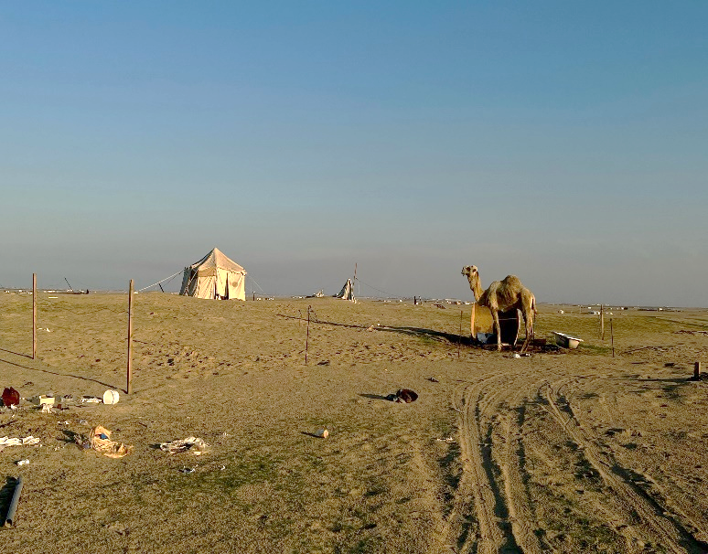
What’s new for 2023?
Audit Follow-up on Combating Desertification
Our Conclusion:
There’s minimal progress towards achieving SDG 15 targets due to insufficient government action in rehabilitation of the wild environment, high-pressure on soil due to negative human practices (camping, overgrazing) and lack of afforestation projects.
Camping and random grazing negative impact on
the environment’s green cover

Slide 12
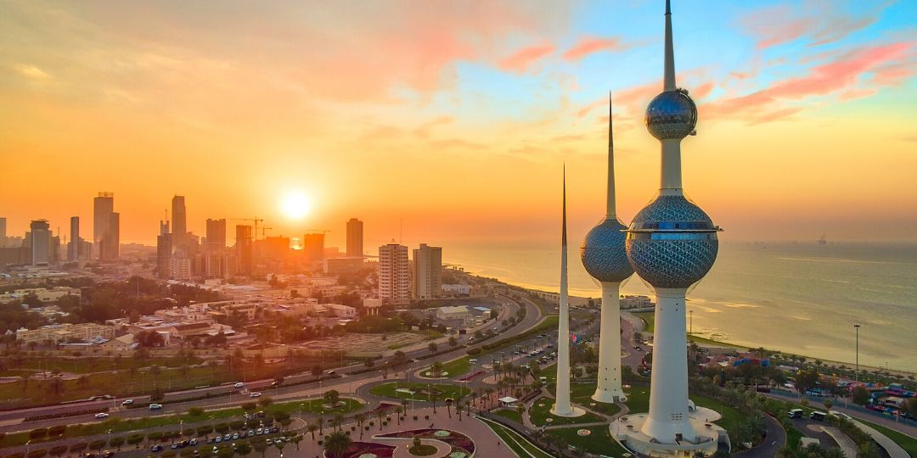
Thank you

