Slide 1



Climate Change and Environmental Protection Audit

Slide 2
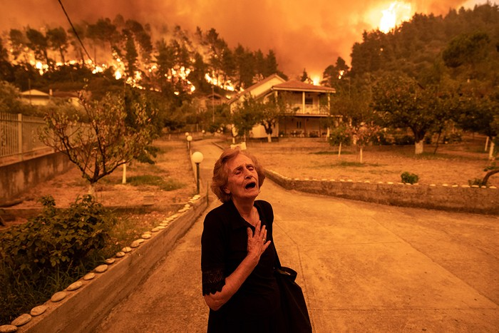
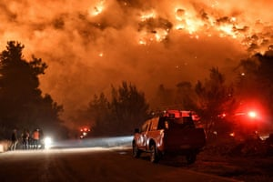
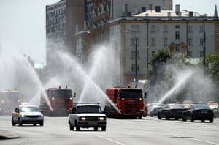
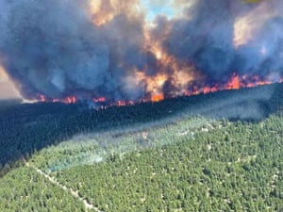

Slide 3
Introduction
In light of the increasing global awareness of the importance of environmental problems as a result of the challenges of economic and social development, attention to the environmental performance of economic5 units has increased and the need for information has emerged that gives a complete picture of the extent to which these units fulfill their responsibilities towards the environment and the need to disclose this, so that, the supreme audit institutions are required to expand the types of audit they implement to include environmental audit, as it is one of the main pillars in the audit process.
In order to achieve the SAI's strategic vision of sustainable professional audit excellence to enhance public accountability, consolidate the concepts of disclosure and transparency, and help the public sector to work efficiently and effectively, and to achieve its mission of contributing to improving the use and management of the state's public resources to achieve sustainable development of society through comprehensive independent audit over the public sector To achieve all this, the State Audit Institution develops and improves the quality of audit methods and outputs, applies quality assurance mechanisms in the audit work, and adopts new audit methods. So that the concern of environmental audit increased.

Slide 4
The task of auditing environmental legislation is considered one of the tasks of the Audit Bureau under the law amending the Audit Bureau Law No. (3) of 2002 and in implementation of the vision of His Majesty King Abdullah II and in view of the increasing interest in environmental issues and the increasing pressure on its elements, he has instructed the formation of a special ministry for the environment in 2003 as a competent authority for environmental protection at the level of the Kingdom and a competent reference in the event of any cases or violations related to the environment.
The ministers’ council approved the National Climate Change Policy for the years 2022-2050, which was prepared by the National Committee in line with international trends to reach neutral emissions by 2050, by raising the ceiling of the percentage of targeted renewable energy sources in the energy mix used in Jordan to 20% in 2025.
The Ministry of Environment coordinates national actions aimed at predicting the climate change process, and accounting for greenhouse gas emissions and mitigation, which under the Environmental Protection Law No. 6 of 2017 is responsible for following up the implementation of the provisions of any agreement related to the environment to which the Kingdom is a party, including the United Nations Framework Convention on Climate Change and the Paris Agreement.

Slide 5
Jordan doubled its target to reduce greenhouse gas emissions to 31 percent by 2030 by increasing projects in renewable energy and energy efficiency, moving to electric and public transport, increasing efforts to establish an integrated waste management system, and approving Jordan's national action plans for green growth for the six main sectors: water, transport, energy, agriculture, tourism, and waste.
the projects that are planned to be implemented until 2024 are characterized by being climate-responsive, and within the performance indicators of the program implemented by the government to promote the green economic recovery in Jordan, in addition to other indicators achieved in 2021, such as the issuance of instructions for "climate-responsive government and private capital expenditure and financing for the year 2022", green bond guidelines, and training government agencies on the use of the monitoring, reporting and verification system for greenhouse gas emissions.
The legislative system for environmental protection in Jordan has developed over the past decades, and this system was characterized by the ratification of 15 international agreements and protocols that entered into force with the aim of protecting the environment, pointing out that the Jordanian governments have ratified during the past three decades about 20 supporting laws and 40 regulations and instructions directly and indirectly related to the protection of the environment and climate change which multiply the role of the audit bureau in the environmental audit .

Slide 6
Government measures to address climate change:.
Climate change system: The Ministry of Environment is making efforts to develop and implement commitments towards addressing climate change and its effects. A special regulation on climate change was issued, Law No. (79) of 2019, and Jordan worked on developing the first national plan for adaptation to climate change, and a national climate change policy was also made.

Slide 7
Green Economy: The Ministry of Environment launched the concept of green economy, which is concerned with sustainable economic growth in light of preserving the environment and its elements, and the focus is on the social dimension, which includes social justice and reducing poverty and unemployment. Efforts are focused on six sectors: energy, water, waste, agriculture, tourism, and transport. In cooperation and coordination with partners in the public and private sectors and civil society institutions, which aim through the green economy model to contribute to facing challenges at the national economic, environmental or social levels, As well as contributing to responding to international requirements, especially related to sustainable development goals and climate change, the Ministry of Environment has developed the National Executive Plan for Green Growth, which provides the environment, its applications and management with limitless opportunities for green growth. The sectors identified – energy, water, waste, tourism, agriculture and transport – are opportunities for green investment, job creation, encouraging green entrepreneurship, as well as transformation through innovation, technology and efficient management towards a sustainable and competitive economy and a better quality of life.
The national strategy for green growth contains a number of opportunities that must be followed up on their implementation through the Ministry of Environment in coordination with all ministries according to the specific roles and with the participation of the private sector and civil society institutions of all kinds in the design, implementation and financing of projects. A partnership council with the private sector has also been formed at the Ministry of Environment to provide advice and advice on environmental problems, and propose the necessary solutions to them, which contribute to achieving sustainable development in Jordan.

Slide 8
Strategy of the Ministry of Environment: The strategy document is one of the most important tools that provide a roadmap for decision-makers related to the state of the environment in Jordan, and contribute significantly to proper planning with the aim of setting priorities in exploiting the available capabilities and resources, to obtain the desired objectives of the strategy, which includes a set of strategic objectives that include a set of executive programs for each of the six goals. The table below shows the extent of achievement:

Slide 9
Strategic Objective No. (1) | programs | Expected impact | The actually achieved
 |  |  | -Continue to follow up on emissions from the chimneys of major companies through the program of direct electronic connection to their chimneys with the Ministry of Environment -Contribute to the sustainability of the work of the national project for remote water quality monitoring consisting of thirteen monitoring stations. -progress of projects to expand the national network for monitoring ambient air quality
3. Confronting the effects of climate change | 1. Climate Change Mitigation and Adaptation Program 2. Ozone Layer Protection Program | -The existence of a national team capable of negotiating project financing from the Green Climate Fund | -Completion of EU-funded solar pump projects -Implementation of the National Afforestation Project
4. Shift towards a green economy | 1. Green Economy Transformation Program | -Gradual shift towards green growth and promotion of sustainable consumption and production patterns | - Launch of the Executive Plan for Green Growth 2021-2025. -The development of a project included in the executive plan for green growth is being followed up.

Slide 10
National Climate Change Policy: The National Climate Change Policy was issued in 11/2022 with the aim of reaching a society more resilient to climate change and contributing to the international effort for carbon neutrality and the implementation of the frameworks of the United Nations Framework Convention on Climate Change

Slide 11
Sustainable Development Goals (SDGs)
The Sustainable Development Goals (SDGs), formally known as Transforming Our World (2030 Agenda for Sustainable Development) are a set of 17 goals set by the United Nations, which were mentioned in the United Nations General Assembly resolution on 25 September 2015 and on 1 January 2016, the 17 Sustainable Development Goals were included in the 2030 Agenda for Sustainable Development. Among these goals is climate change.
Goal 13 – Climate Action
It includes a set of sub-objectives:

Slide 12
Enhance flexibility and resilience to climate-related hazards and natural disasters in all countries, and enhance resilience to those hazards.
Integrate climate change measures into national policies, strategies and planning.
Improve education and raise awareness and human and institutional capacities to mitigate, adapt, reduce its impact and early warning climate change.
Implement the commitment made by developed country Parties to the United Nations Framework Convention on Climate Change (UNFCCC) to jointly mobilize $100 billion annually by 2020 from all sources to meet the needs of developing countries, in the context of meaningful mitigation actions and transparency of implementation, and bring the GCF fully operational by providing it with capital as soon as possible.
Strengthen mechanisms to improve the capacity of effective climate change planning and management in least developed countries and small island developing States, including focusing on women, youth and local and marginalized communities.

Slide 13
Climate Change in Jordan:
Jordan has increasingly faced the effects of climate change on its society and economy, and severe water scarcity exacerbated by climate change impacts has led to increased heat waves, rainfall variability, extreme weather events and land desertification, which is also affected by increasing urbanization.
The effects of climate change are evident in urban and rural areas, affecting food security, energy security and various sectors of the economy.
It is worth noting that the report of the results of the Global Environmental Performance Index for 2020 issued by the universities of Peel and Columbia, which assesses the achievements of countries in terms of the environmental sector, including the vitality of ecosystems, which include: biodiversity, forests, forests, marine fish farms, climate and energy, and agriculture. Jordan showed progress of 2.11% in the areas of air pollution, environmental sanitation, and climate change, as Jordan ranked 48th in the global ranking and third in the Arab countries this year. Jordan also made progress in the Global Environmental Performance Index 2020, achieving 62nd globally and 5th in the Arab world on the 2018 Environmental Performance Index, advancing 14 places.

Slide 14
The State Audit Institution and its role in the subject of climate change:
- The State Audit Institution participates with the Sustainable Development Goals Committee of the Arab Organization of Supreme Audit Institutions (ARABOSAI) and the Environmental Control Committee of INTOSAI, attending their periodic meetings and proposing projects related to the implementation of oversight tasks on sustainable development goals, including those related to climate change.
- Participation in scientific roundabouts and meetings to gain experiences and exchange knowledge with Arab and international regulatory bodies, and publish the results of these participations on the SDG platform on the website of the State Audit Institution to spread awareness and knowledge of colleagues about the sustainable development goals.
- Inclusion of sustainable development goals in the strategic plan of the State Audit Institution and assigning the Directorate of Performance audit and Environmental audit to implement performance audit and environmental audit tasks related to the sustainable development goals, including goal No. (13) of the sustainable development goals related to climate change.

Slide 15
Performance assessment Methodology
The NAO carried out a set of performance and environmental audit tasks related to climate change, for example, in 2022, three tasks related to Goal No. (13) were implemented, as follows:
Review and evaluate the measures taken to reduce the negative effects of climate change on the agricultural sector.
Assessment of wildlife protection performance (forest and rangeland).

Slide 16
First Topic: Review and evaluate the measures taken to reduce the negative effects of climate change on the agricultural sector.
The efficiency and effectiveness of the Ministry of Agriculture's procedures in facing the negative effects of climate change on the agriculture sector for the period (2019-2021) related to Goal (13) of the Sustainable Development Goals (enhancing resilience and resilience in the face of climate-related risks and natural disasters in all countries and enhancing the ability to adapt to those risks) were reviewed in accordance with the audit methodology approved by the NAO for environmental audit and analysis of environmental data and approved based on international performance auditing standards........ The main conclusions are as follows:
No local national indicators have been found to measure the performance of government agencies in charge of implementing climate change programs.
The multiplicity of government agencies that organize plans and policies related to climate that may result in overlap or duplication in achieving the goals (attached is a list of plans, agreements and entities that implemented them).
The multiplicity of external agreements and international protocols related to climate without projects to implement all these agreements.

Slide 17
The Green Economy Unit in the Ministry of Agriculture has not been strengthened with a legal framework as instructions that regulate the work of the unit and allow it to follow up and supervise the implementation of projects contained in the operational plans of the government sectors and to ensure the achievement of the objectives of the Green Economy Program.
The Ministry of Agriculture did not include the climate change target as a main strategic objective as it did not include its strategic plan.
The absence of a national climate finance plan specifying the type of financing, projects, programs and priority plans.
The Ministry of Agriculture does not implement the operational plan of the green economy program directed to it by the Ministry of Environment, as the plan requires the implementation of (8) climate change projects.
Failure to develop performance indicators at the level of agricultural projects that contribute to facing the effects of climate change in the Ministry of Agriculture.
Failure to update the GHG emission inventory report.

Slide 18
Recommendations:
Study the possibility of including and integrating environmental objectives in national policies and plans with multilateral international agreements and with the strategic plans of the Ministry of Agriculture and the Ministry of Environment.
Work on finding approved national performance indicators to confront climate change linked to the national policy and the contributions document.
Unify the climate plans and policies of the concerned authorities to implement the procedures and priorities related to confronting the effects of climate change to avoid overlap and duplication in achieving the goals.
Statement of results and outputs resulting from the implementation of external agreements and protocols related to climate, including implemented projects, and their impact on the ground.
Finding instructions or regulations organising the work of the Green Economy Unit that allow it to follow up and supervise the implementation of projects contained in the operational plans of the government sectors in order to ensure the achievement of the objectives of the program.

Slide 19
Include the strategic objective related to confronting climate change within the strategic plan of the Ministry of Agriculture, including identifying priorities, programs, projects and performance indicators for these projects.
Adopting a database in the Ministry of Agriculture that provides information related to the implemented and stalled agricultural projects of previous years, especially projects related to climate change.
Updating the annual reports submitted by the Ministry of Environment on reporting preliminary data related to greenhouse gases and related performance indicators.
Take the necessary measures and intensify efforts towards providing the necessary funding from external parties to implement the planned climate change projects by developing a climate finance plan.

Slide 20
Topic Two: Wildlife Protection (2018-2021)
It is also linked to Goal (15) of the Sustainable Development Goals (SDGs) / Wildlife - Combating Desertification and Restoring Lands Affected by Desertification) and is also linked to Goal (13) of the Sustainable Development Goals (Enhancing flexibility and resilience to climate-related hazards and natural disasters in all countries and enhancing resilience to those hazards) and the following are the main conclusions:
The Ministry's Directorate of Rangelands and Badia Development did not set grazing periods in the existing grazing lands under a spring and autumn grazing program.
The Directorate of Pastures and Badia Development in the Ministry did not adopt the models of the spring and autumn grazing periods, the number of sheep allowed to enter, and the vegetation cover assessment forms in the pastoral reserve before and after grazing.
The Directorate in the Ministry does not register the types of plants growing in pastoral reserves (pastoral load).

Slide 21
The Ministry's failure to develop pastoral nurseries through the preparation of studies and research for new types of pastoral plants suitable for inclusion in the cultivation of pastoral lands, despite the inclusion of the performance indicator of increasing agricultural research for the sustainability of forestry and rangelands by (40%) in the National Strategic Plan for Agricultural Development.
Not to choose any sites for the purpose of rehabilitating degraded pasture lands within the environmental compensation program.

Slide 22
Recommendations:
Include in the National Strategy for Agricultural Development and the Executive Plan the programs and projects necessary to implement the strategic objective related to the development of forestry and rangelands.
Work to include in the National Plan for Sustainable Agriculture a strategy to finance projects related to forestry and pastures and according to the priority of implementation in the National Strategy for Agricultural Development.
Work on the development of annual plans required to protect and develop pasture lands and include in the plans for the development of the selected pastoral sites the technical procedures that will be followed to develop the productivity of the pastoral site and determine the fodder productivity of all pasture lands.

Slide 23
Adopting national criteria for the selection of pastoral sites in the network of pastoral reserves, and approved procedures for the purposes of declaring, establishing and managing pastoral reserves and developing technical procedures to link the pasture system to the sustainable development goals.
Work to include pastoral development areas and other selected pastoral areas within the network of pastoral reserves and choose the necessary pastoral sites in the forestry and pasture program.

Slide 24
Prepared by
Auditor: Rana Atallh Al-Hanaqtah& Suzan Ftaimat
Audit Bureau of Jordan 2023

